Slide 1
Geography at Internet Scale
11.03.16

Slide 2

80 billion transactions
200 milliseconds
15 terabytes
20 petabytes
2500 servers

Slide 3

0. Spatial is a special class of data

Slide 4
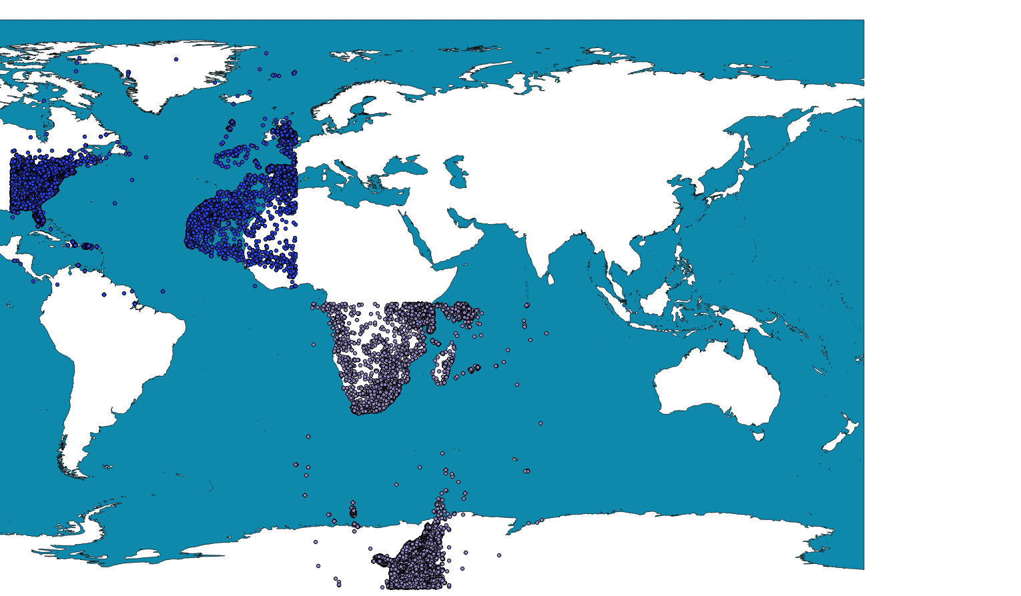
Notes:
This is the Earth. It’s roundish.

Slide 5
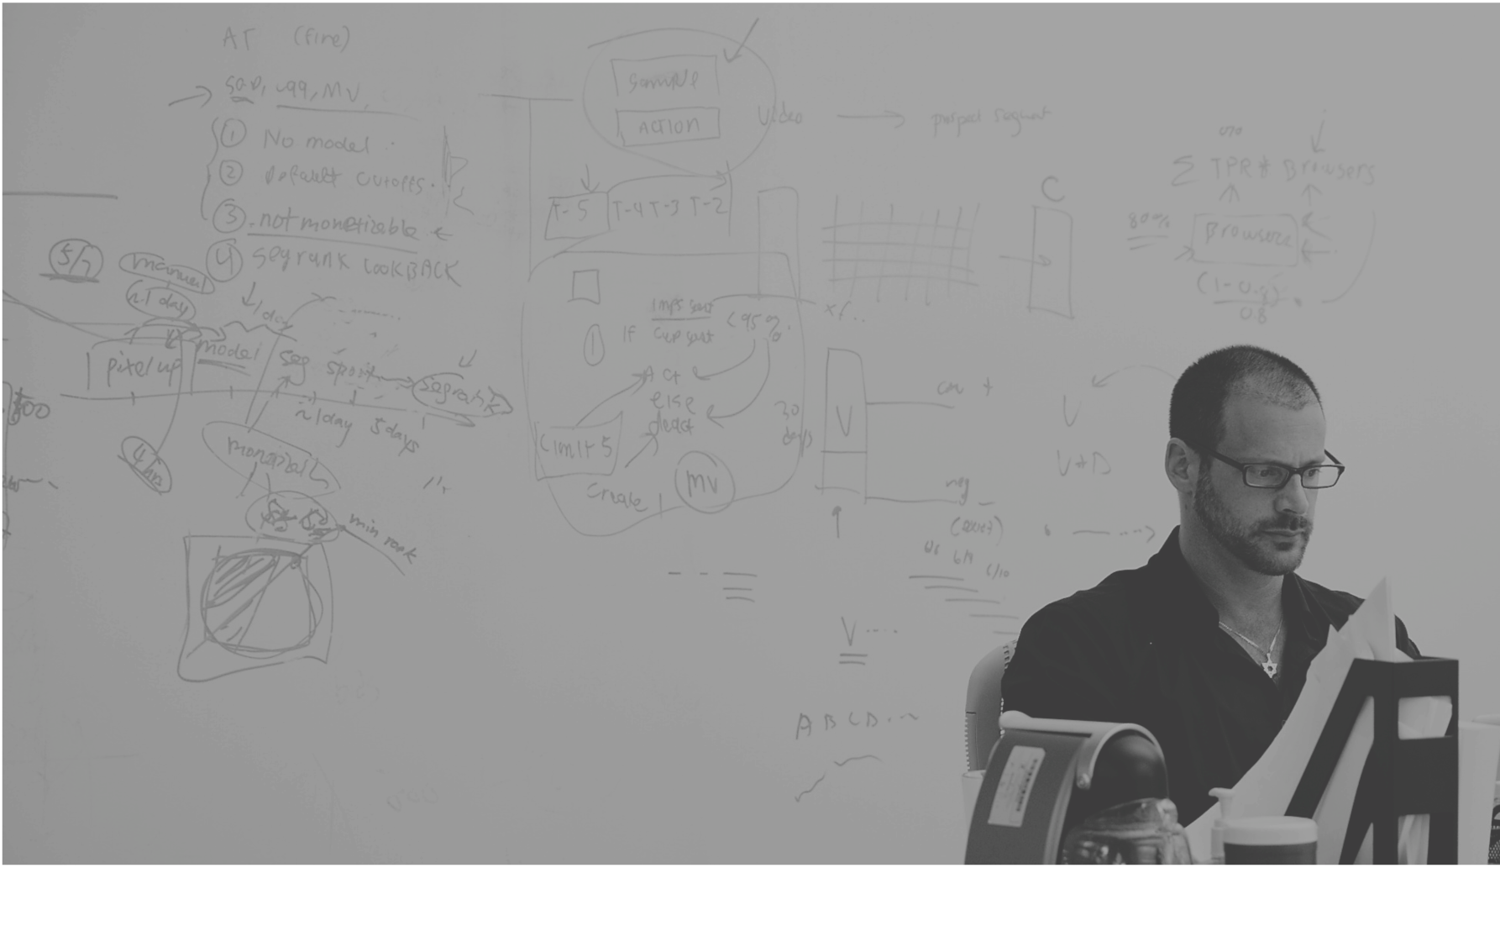
Dstillery Audiences
1. Ask how it was collected
Notes:
replace this with the red one that Shane has

Slide 6
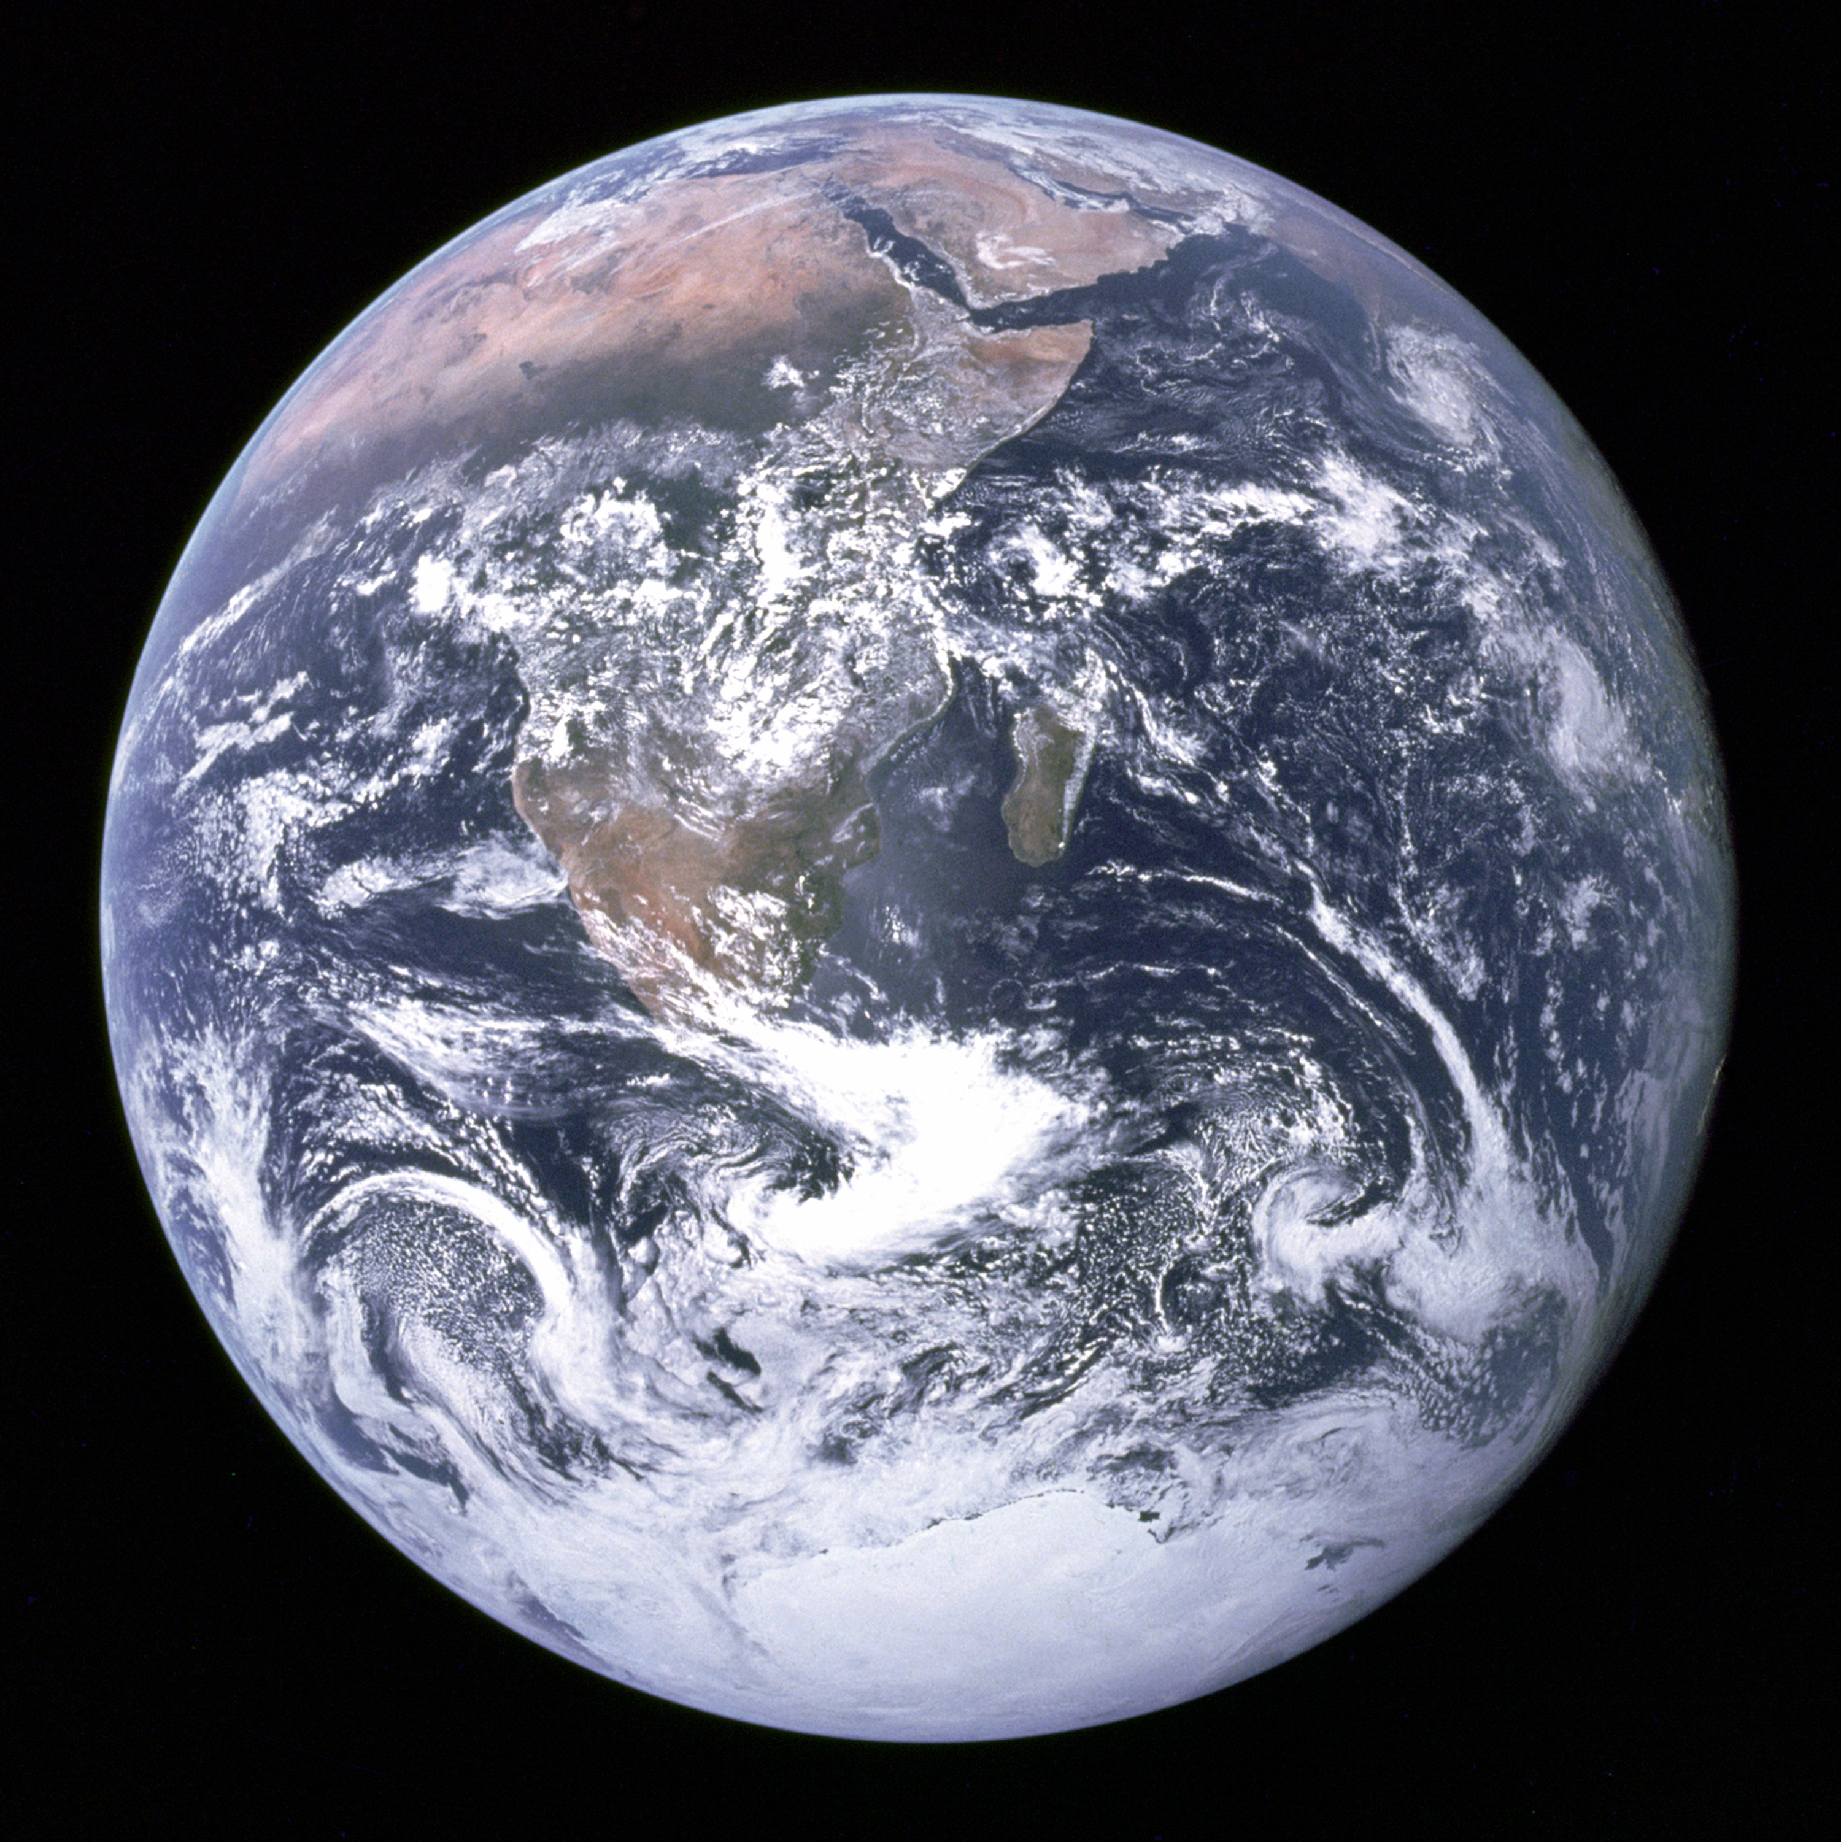
Notes:
This is the Earth. It’s roundish.

Slide 7

Notes:
And this is why it’s only roundish.

Slide 8
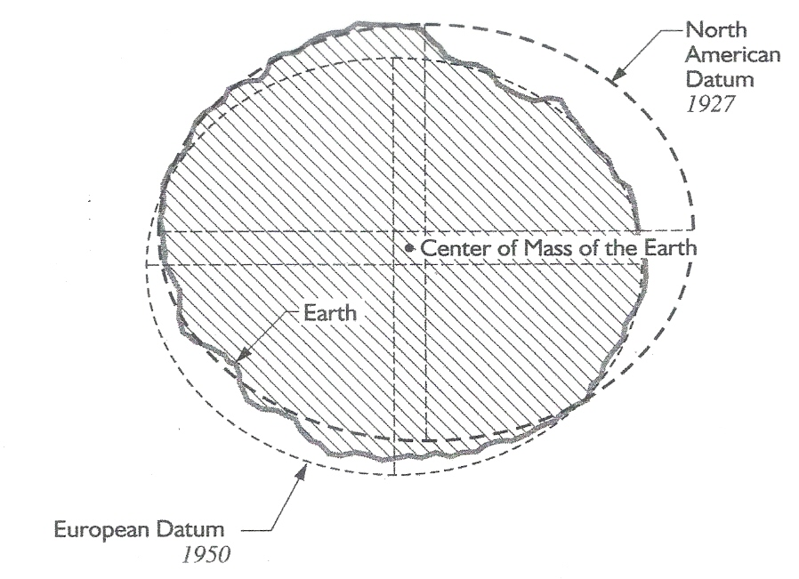
Datums
North America
Europe
Notes:
Cartoon of two datums demonstrating how geographers deal with the non-uniform roundness of the Earth

Slide 9
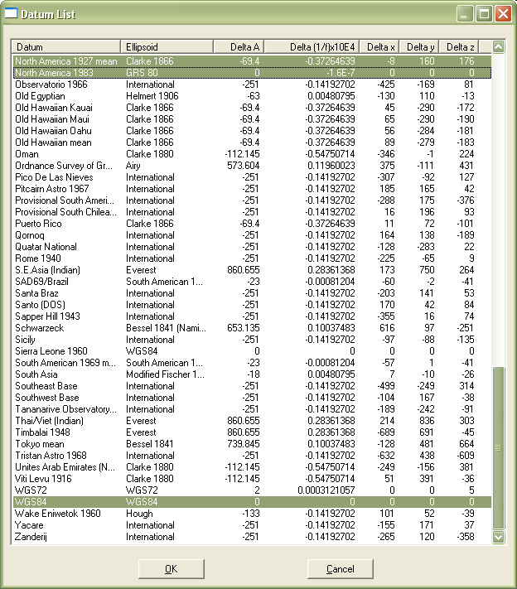
Datums
Notes:
Datums screenshot

Slide 10
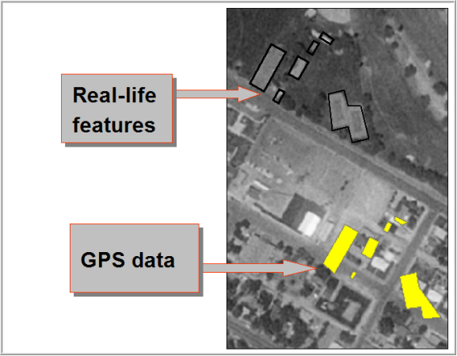
Datums
Notes:
ArcMap screenshot

Slide 11
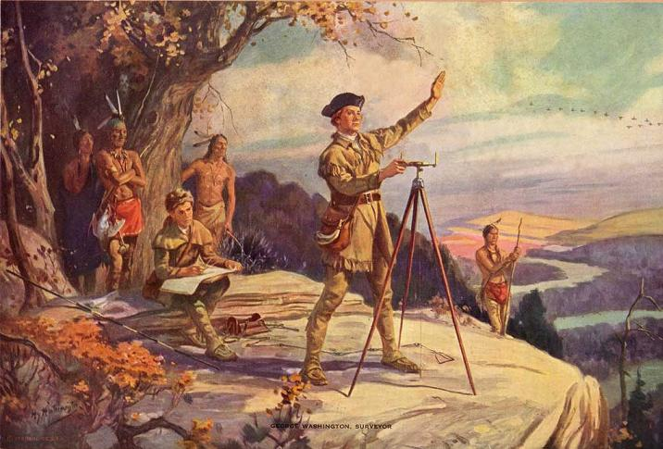
Notes:
George Washington as a surveyor in a really culturally insensitive painting

Slide 12
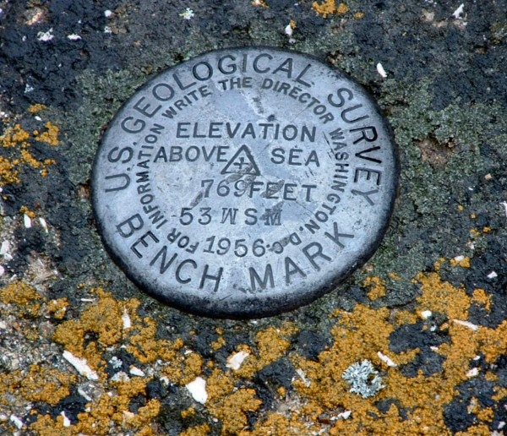

Slide 13
Notes:
George Washington as a surveyor in a really culturally insensitive painting

Slide 14
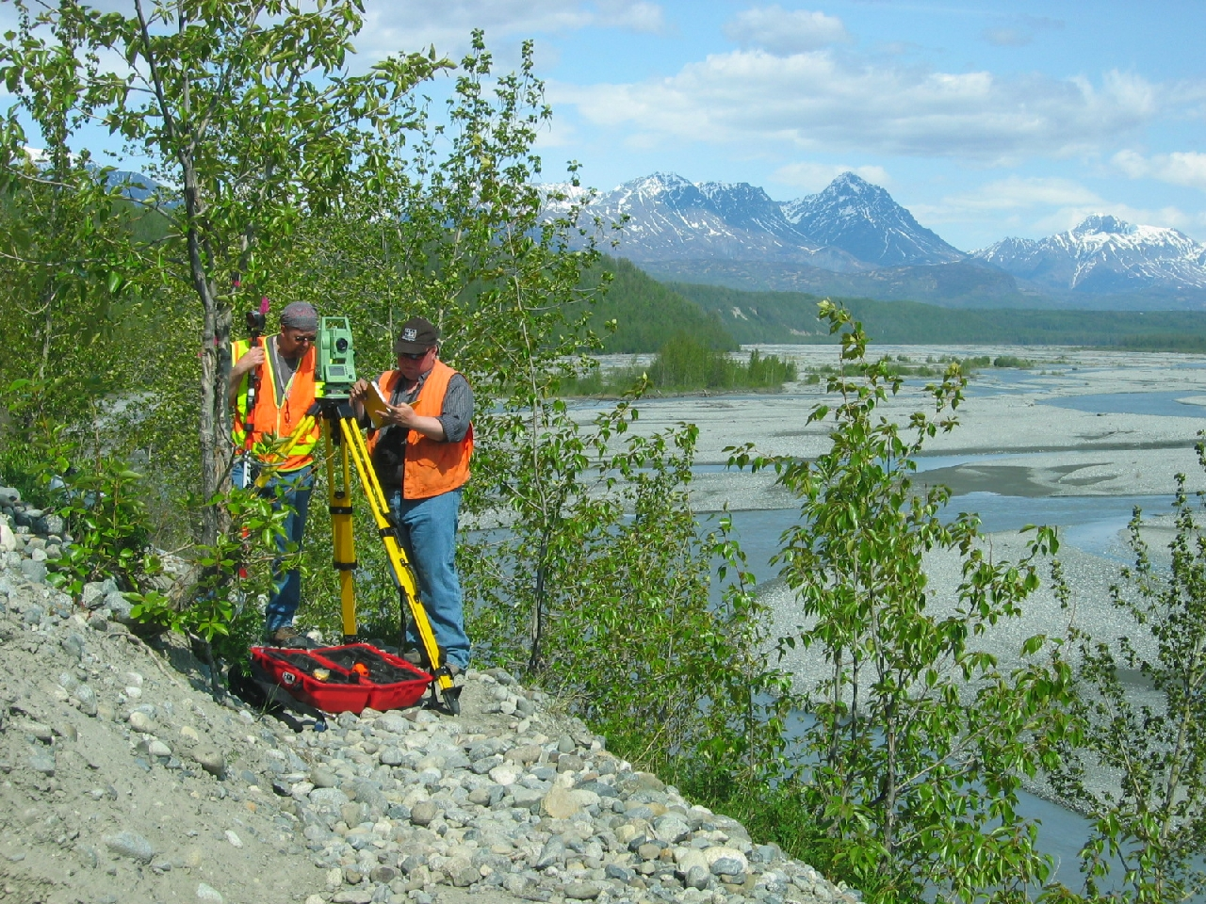

Slide 15

2. Think about how you visualize

Slide 16
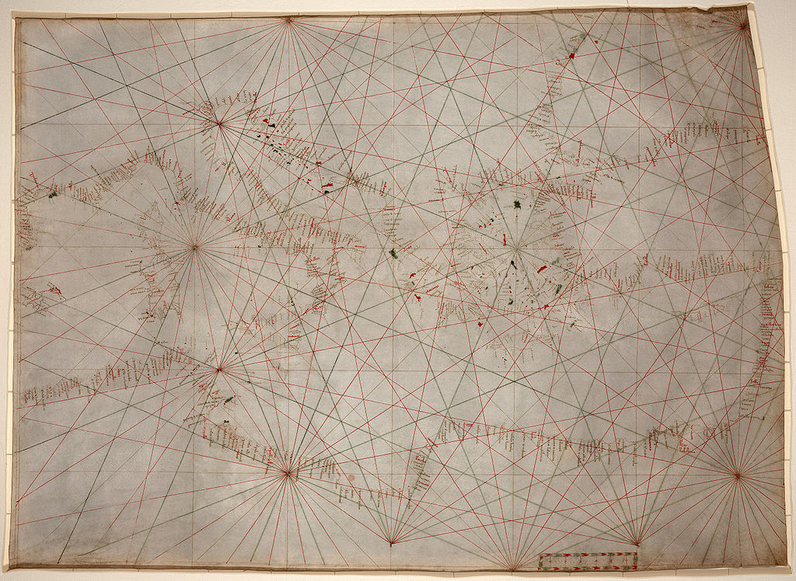
Projections into slide here

Slide 17
Projections into slide here

Slide 18
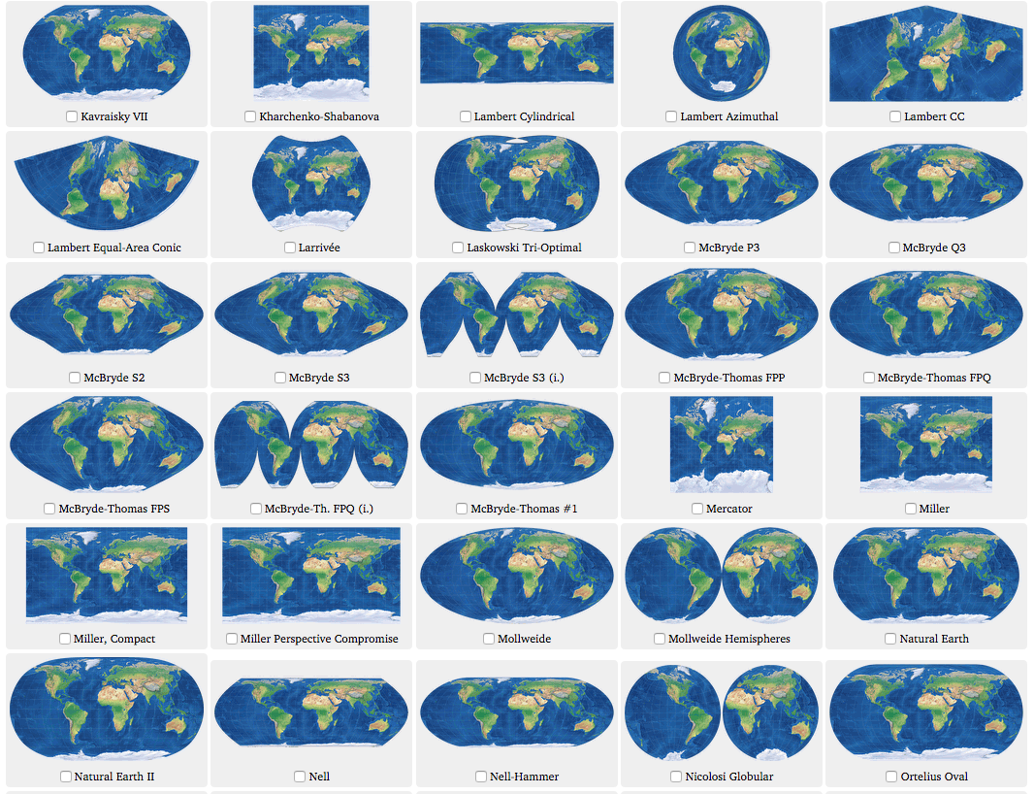
Projections

Slide 19
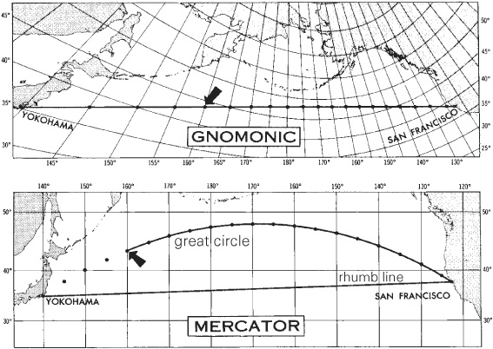

Slide 20
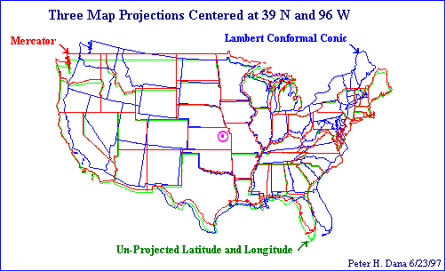

Slide 21
3. Be skeptical about locations

Slide 23
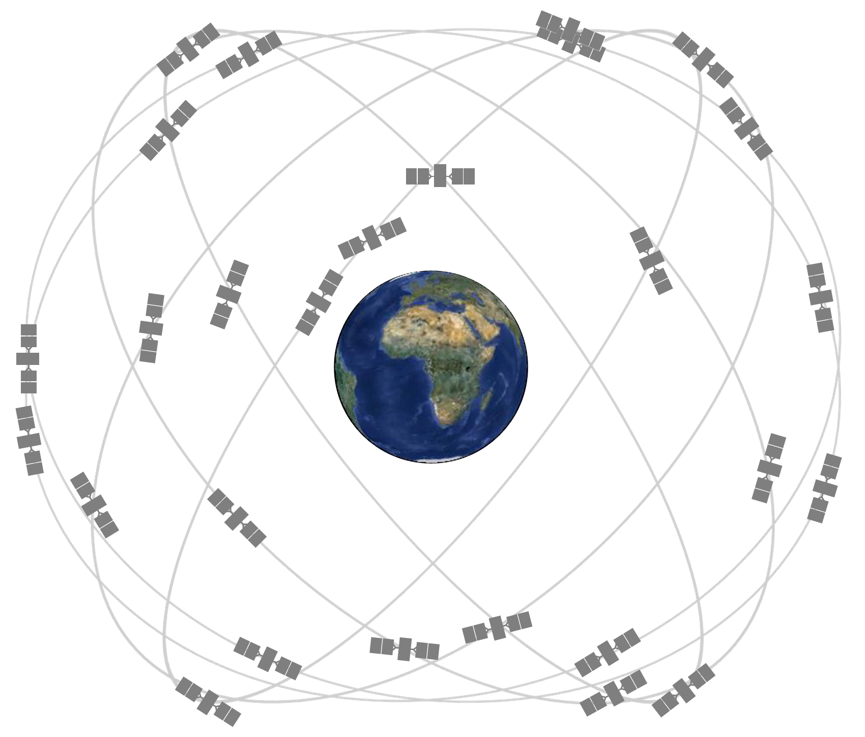
GPS
Notes:
GPS Constellation

Slide 24

You are here!
Notes:
GPS block III

Slide 25
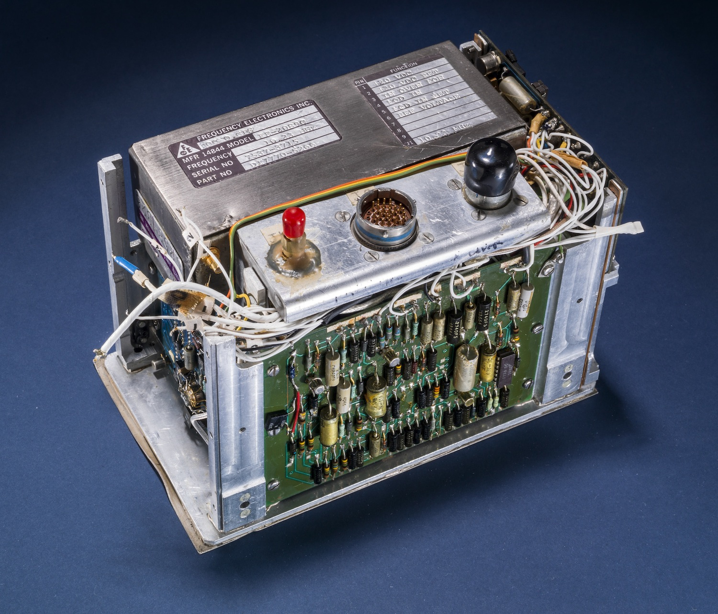
You are here!
Notes:
GPS Block 1 Cesium Clock

Slide 26

You are here!
Notes:
Atlas V GPS launch from Vandy

Slide 27

GPS
Notes:
Trilateration not triangulation

Slide 28
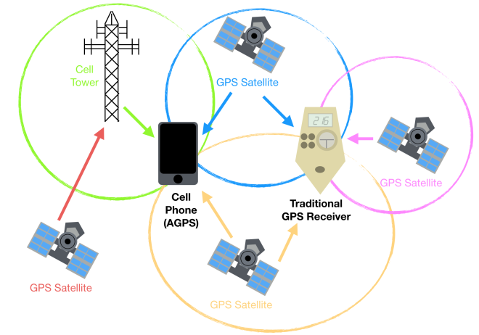
AGPS
Notes:
Assisted GPS
Towers record data from GPS network (esp. Almanac)
If the tower is broken or you are connected to a far off tower (which happens way more often then you think) you can end up with inaccurate data.

Slide 29
Not all geodata is created equal
Wrong
Broad
Mesolocal
Hyperlocal
Notes:
Placeholder Slide

Slide 30
Dstillery Audiences
4. You can be picky
Notes:
replace this with the red one that Shane has

Slide 31
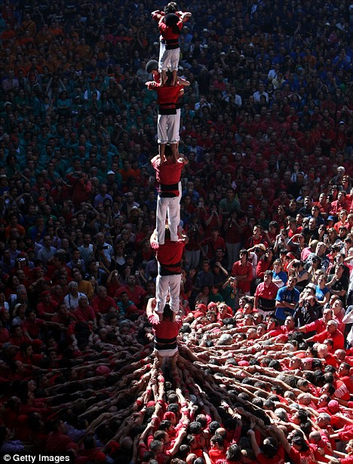
Manhole Cover
Notes:
Manhole cover filter illustrated Catalonian tradition

Slide 32
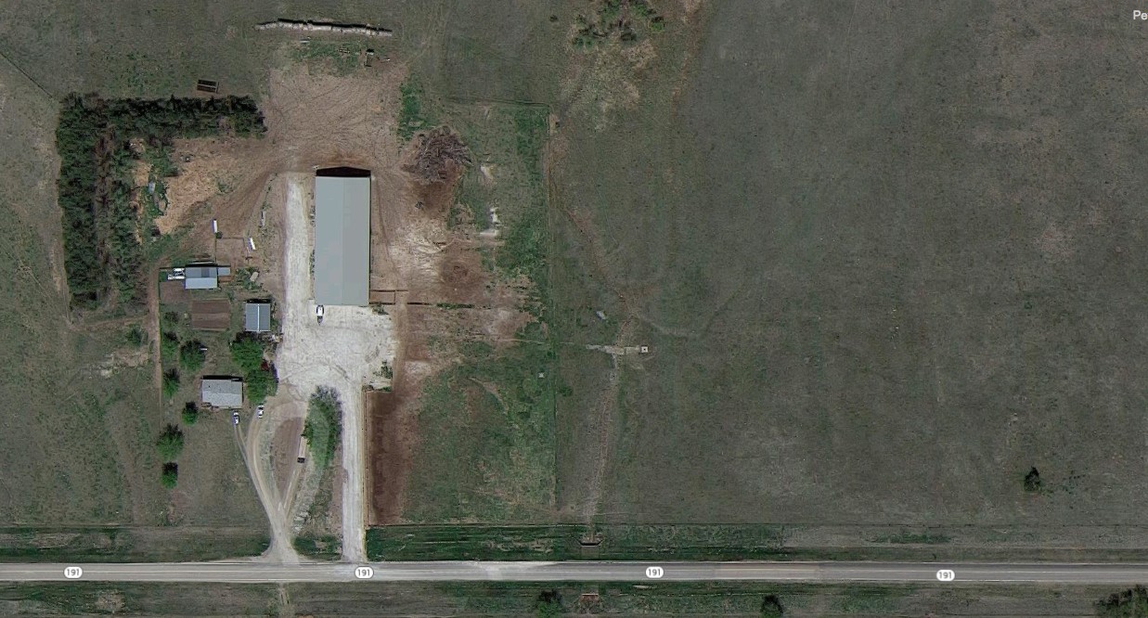
Manhole Cover
Notes:
Manhole cover filter illustrated Catalonian tradition

Slide 33
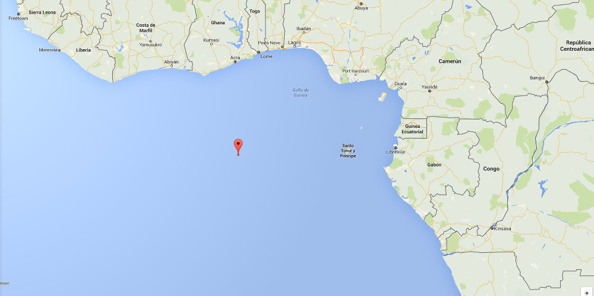
Manhole Cover
Notes:
Null Island

Slide 34
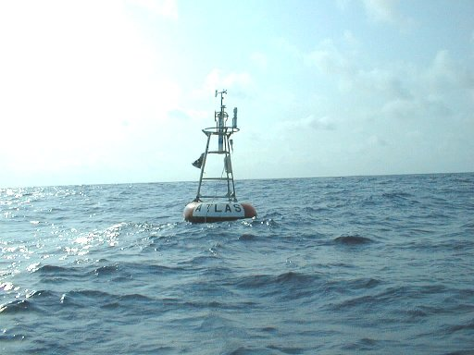
Manhole Cover
Notes:
The PIRATA weather sensor buoy @ 0/0

Slide 35
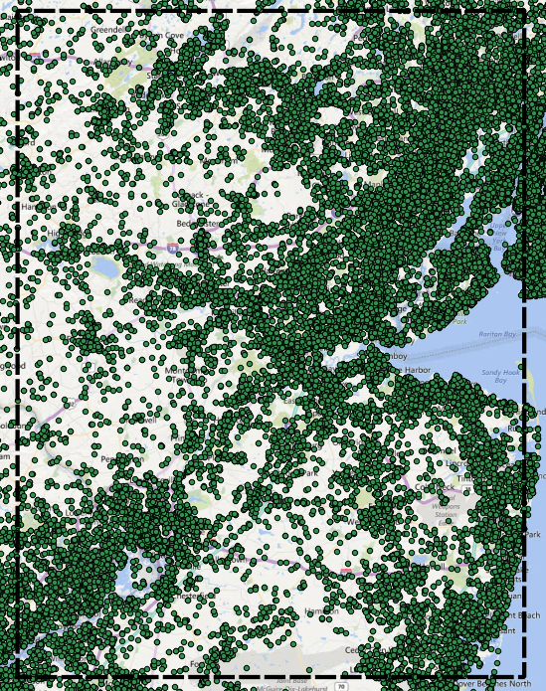
The Grid
Notes:
Hyperlocal data v. a Mesolocal grid

Slide 36
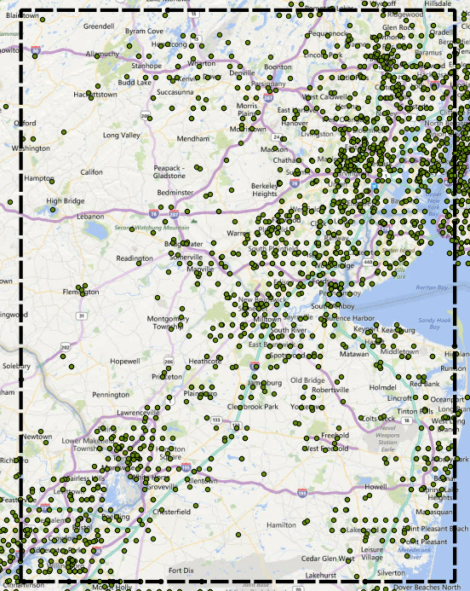
The Grid
Notes:
Hyperlocal data v. a Mesolocal grid

Slide 37
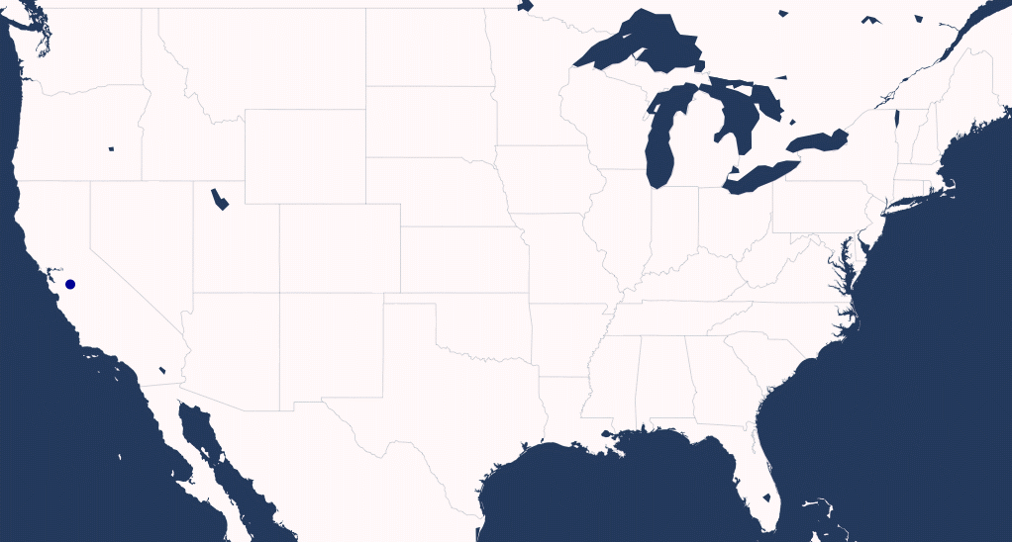
Superman Filter
Notes:
Superman Filter illustration from Dec 2014

Slide 38
5. Use the right tool for the job

Slide 39

Uncle Jessie (PR Tree)

Slide 40
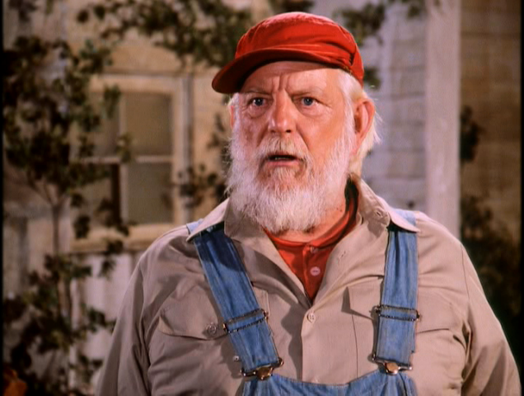
Uncle Jessie (PR Tree)

Slide 41
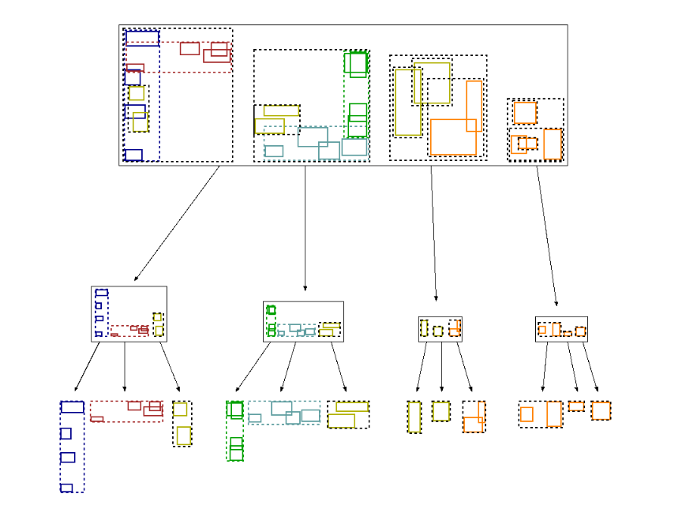
Uncle Jessie

Slide 42
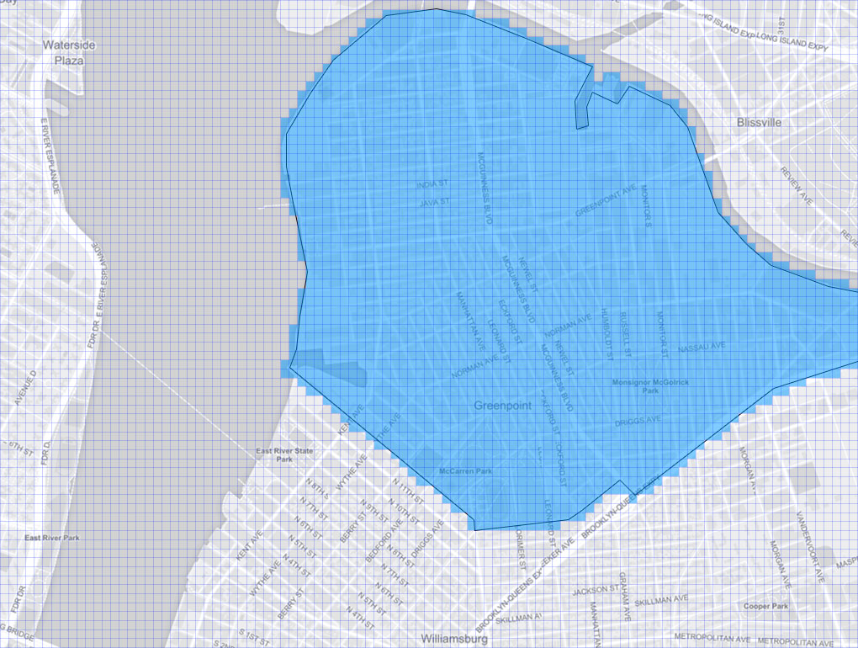
Geotiles
Notes:
MGRS Grid cartoon

Slide 43
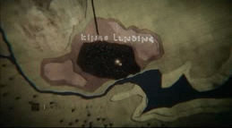
Geotiles
Notes:
MGRS Grid cartoon

Slide 44
0. Spatial is a special class of data
1. Ask how it was collected
2. Think about how you visualize
3. Be skeptical about locations
4. You can be picky
5. Use the right tool for the job

Slide 45
Peter E Lenz
Senior Geospatial Analyst
plenz@dstillery.com

