Slide 1
Marquez:
A Metadata Service for Data Abstraction, Data Lineage, and Event-based Triggers
Data Platform
DataEngConf NYC ‘18

Slide 2
Hey!
I’m Willy Lulciuc
Data Engineer
Marquez Team, Data Platform
@wslulciuc
Data Platform
Notes:
Story telling, from day to day … people can engage (ask some questions) ..
What i work on. Order shirts
Hive metra store
Apache atals
Its still early days for us, core areas, keep high level

Slide 3
01
Space
02
Community
03
Services
Data Platform

Slide 4
268,000
members globally
287
physical locations
72
cities
23
countries
Data Platform

Slide 5
@wslulciuc
AGENDA
01
Why metadata?
02
Room bookings pipeline (naïve)
03
Intro to Marquez
04
Room bookings pipeline (take 2)
05
Future work
Data Platform

Slide 6
01
Why metadata?

Slide 7
Why manage and utilize metadata?
Data quality
Data lineage
Democratize
Build trust in data
Add context to data
Self-service data culture
Data Platform

Slide 8
… creating a healthy data ecosystem

Slide 9
A healthy data ecosystem
Self-service
Freedom
Accountability
Discover
Explore
Global context
Experiment
Flexible
Self-sufficient
Cost
Trust
Data Platform

Slide 10
Let’s get booking!
Data Platform

Slide 11
01
Location + floor
Data Platform

Slide 12
01
Location + floor
02
Open time slot
Data Platform

Slide 13
01
Location + floor
02
Open time slot
03
Duration
Data Platform

Slide 14
01
Location + floor
02
Open time slot
03
Duration
04
Confirm
Data Platform

Slide 15
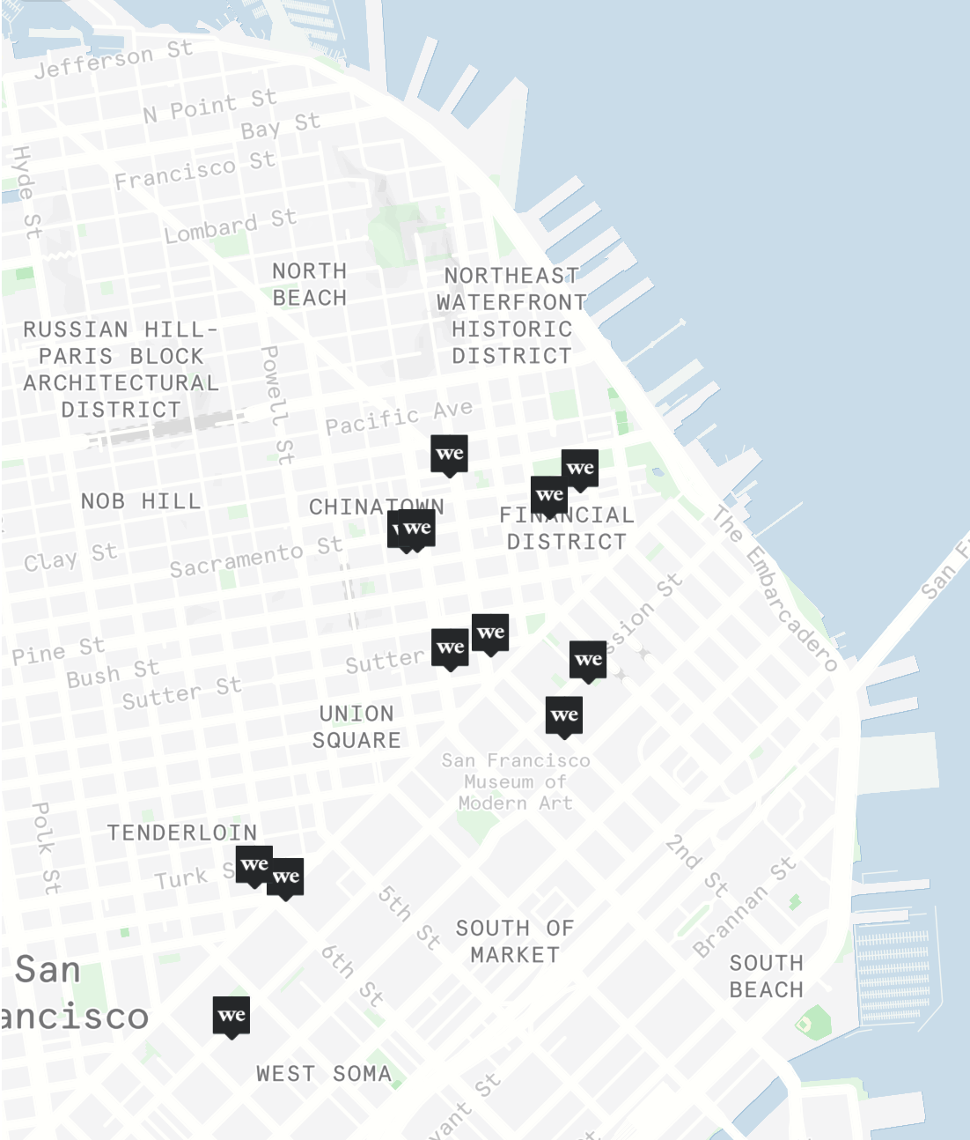
Which location has the most bookings?
Data Platform

Slide 16
Set[RoomBooking] LocationID

Slide 17
02
Room bookings pipeline (naïve)

Slide 18
Example: Room bookings pipeline (naïve)
@wslulciuc
Requirements
Read room bookings
Sum room bookings by location
Write top location
Run once an hour
Start
Read
Sum
Write
Data Platform

Slide 19
Example: Room bookings pipeline (naïve)
@wslulciuc
S3
.csv
.csv
Postgres
Data Platform

Slide 20
Example: Room bookings pipeline (naïve)
@wslulciuc
LOCATION
TS
ROOM
S3
.csv
b648485,1541501885,9
b940314,1541624285,2
.csv
b648485,1541710685,4
Postgres
Data Platform

Slide 21
Example: Room bookings pipeline (naïve)
@wslulciuc
LOCATION
TS
ROOM
S3
.csv
b648485,1541501885,9
b940314,1541624285,2
.csv
b648485,1541710685,4
Postgres
ID
LOCATION
TS
BOOKINGS
1 b648485 1541721600 2
Data Platform

Slide 22
Example: Room bookings pipeline (naïve)
@wslulciuc
We’re live!
Scheduler
Job
S3
Job
Postgres
Archival
Room Bookings
Top Locations
Upstream
Workflow
Downstream
Data Platform
Notes:
Context to dotted line

Slide 23
Example: Room bookings pipeline (naïve)
@wslulciuc
Problems
What’s our job’s input dataset?
Does the dataset have an owner?
How often is the dataset updated?
Data Platform
Notes:
Read from, who owns it, how often is it updated, if issues who do we contact

Slide 24
Example: Room bookings pipeline (naïve)
@wslulciuc
Curses, our job’s failing …
Scheduler
Job
S3
Job
Postgres
Archival
Room Bookings
Top Locations
Upstream
Workflow
Downstream
Data Platform
Notes:
Context to dotted line

Slide 25
Example: Room bookings pipeline (naïve)
@wslulciuc
Oh, might be our input data!
Scheduler
Job
S3
Job
Postgres
Archival
Room Bookings
Top Locations
Upstream
Workflow
Downstream
Data Platform
Notes:
Context to dotted line

Slide 26
Example: Room bookings pipeline (naïve)
@wslulciuc
Room field is of type
int
string
LOCATION
TS
ROOM
S3
.csv
b648485,1541501885,9A
.csv
b940314,1541624285,2G
b648485,1541710685,4F
Data Platform

Slide 27
Example: Room bookings pipeline (naïve)
@wslulciuc
Problems
What’s our job’s input dataset?
Does the dataset have an owner?
How often is the dataset updated?
Coordinate changes
Data Platform

Slide 28
Example: Room bookings pipeline (naïve)
@wslulciuc
Ugh, gaps in output data
Scheduler
Job
S3
Job
Postgres
Archival
Room Bookings
Top Locations
Upstream
Workflow
Downstream
Data Platform
Notes:
Context to dotted line

Slide 29
Example: Room bookings pipeline (naïve)
@wslulciuc
Backfills!
00h
01h
02h
03h
04h
05h
06h
07h
08h
09h
time partitions
latest
Data Platform
Notes:
Context to dotted line

Slide 30
Example: Room bookings pipeline (naïve)
@wslulciuc
Problems
What’s our job’s input dataset?
Does the dataset have an owner?
How often is the dataset updated?
Coordinate changes
Figure out backfills
Data Platform

Slide 31
Example: Room bookings pipeline (naïve)
@wslulciuc
What we have so far …
Scheduler
S3
Job
Postgres
Room Bookings Workflow
Data Platform

Slide 32
Example: Room bookings pipeline (naïve)
@wslulciuc
What we have so far …
Problems
What’s our job’s input dataset?
Does the dataset have an owner?
How often is the dataset updated?
Coordinate changes
Figure out backfills
Scheduler
S3
Job
Postgres
Room Bookings Workflow
Data Platform

Slide 33
… writing a job shouldn’t be this hard!

Slide 34
04
Intro to Marquez

Slide 35
Marquez: Design
@wslulciuc
Metadata Service
Clients
(JVM)
Clients
(Python)
Centralized metadata management
Jobs
Datasets
Modular
Data discovery
Data health
Data triggers
REST API
Marquez
Search
Health
Triggers
Data Platform

Slide 36
Marquez: Data discovery
@wslulciuc
Module: Search
Unified search
Documentation
Owner
Schema
Datasource
Marquez
Search
Health
Triggers
Data Platform

Slide 37
Marquez: Data discovery
@wslulciuc
room bo
Search
All
Room Bookings (SF)
Tags
S3
Datasets
All San Francisco room bookings
created: jul. 8, 2018
Room Booking Metrics (GLBL)
Global room booking metrics
created: feb. 15, 2010

Slide 38
Marquez: Data health
@wslulciuc
Module: Health
Owner
Team / project
Schema
Location
Description
Size
Growth over time
Number of records
Lineage
Marquez
Search
Health
Triggers
Data Platform

Slide 39
Data graph
Dataset
Job

Slide 40
Lineage queries!
Lineage
Dataset
Job

Slide 41
Marquez: Data triggers
@wslulciuc
Module: Triggers
Timely processing of data
No polling!
Reduce manual handling of backfills
Reduce production of bad data
Incomplete data
Low-quality data
Marquez
Search
Health
Triggers
Data Platform

Slide 42
Upstream failure detection!
Job failure
Dataset
Job

Slide 43
Affected paths!
Job failure
Dataset
Job

Slide 44
Cascading triggers!
Trigger
Dataset
Job

Slide 45
Core concepts

Slide 46
Marquez: Core concepts
@wslulciuc
Job + Datasets
Input Dataset
Job
Output Dataset
Data Platform

Slide 47
Marquez: Core concepts
@wslulciuc
Dataset versions!
A dataset version contains a complete snapshot of data as of some point in time
v1
Job
v1
v2
v2
v3
Data Platform

Slide 48
Marquez: Core concepts
@wslulciuc
Deltas “diffs”!
INSERT INTO room_bookings (location, bookings)
VALUES (b648485, 2)
v1
Job
v1
v2
v2
v3
Data Platform

Slide 49
Marquez: Core concepts
@wslulciuc
Deltas “diffs”!
INSERT INTO room_bookings (location, bookings)
VALUES (b648485, 2)
Δ_{v2￫v3}
v1
Job
v1
v2
v2
v3
Data Platform

Slide 50
Marquez: Core concepts
@wslulciuc
Job versions!
v1
Job v1
v1
v2
v2
Job v2
v3
A job version is created when business logic has changed
Data Platform

Slide 51
Marquez: Core concepts
@wslulciuc
Job runs!
v1
Job v1
v1
v2
v2
Job v2
v3
Job
New
Run
Dataset
Data Platform

Slide 52
Marquez: Core concepts
@wslulciuc
Job runs!
v1
Job v1
v1
v2
v2
Job v2
v3
v4
Job
New
Run
Dataset
Data Platform

Slide 53
Marquez: Core concepts
@wslulciuc
Job runs!
v1
Job v1
v1
v2
v2
Job v2
v3
v4
Job
New
Run
Finish
Dataset
Update
Data Platform

Slide 54
Marquez: Core concepts
@wslulciuc
Data triggers!
Job v7
v1
Job v1
v1
v2
v2
Job v2
v3
v4
Job v10
Job
New
Run
Finish
Dataset
Update
Trigger
Data Platform

Slide 55
Marquez: Core concepts
@wslulciuc
Job failures!
v1
Job v1
v1
v2
v2
Job v2
v3
v4
Job
New
Run
Failure
Dataset
Data Platform

Slide 56
Marquez: Core concepts
@wslulciuc
Delayed datasets!
v1
Job v1
v1
v2
v2
Job v2
v3
v4
Job
New
Run
Failure
Dataset
Delay
Data Platform

Slide 57
Marquez: Core concepts
@wslulciuc
Design benefits
Early upstream failure detection
Debugging
What job version(s) produced / consumed dataset version X?
Recoverability
Full / incremental processing
Coordination
Data Platform

Slide 58
Data model

Slide 59
Marquez: Data model
@wslulciuc
Job
1
*
Dataset
*
1
JobVersion
1
1
*
*
DatasetVersion
*
1
JobRun

Slide 60
Marquez: Data model
@wslulciuc
Datasource Types
Job
1
*
DbTable
Dataset
*
1
JobVersion
1
1
*
*
Filesystem
DatasetVersion
*
1
JobRun
Stream

Slide 61
Metadata collection

Slide 62
Marquez: Metadata collection
@wslulciuc
How is metadata collected?
Marquez API
Language-specific SDKs
Java
Python
Marquez
record metadata
Job
Data Platform

Slide 63
Marquez: Metadata collection
@wslulciuc
Workflow
Register
Job
Job version
Inputs / outputs (logical names)
Owner
Description
Data Platform

Slide 64
Marquez: Metadata collection
@wslulciuc
Workflow
Register
Job
Register
Job Run
Job version
Inputs / outputs (logical names)
Owner
Description
Data Platform

Slide 65
Marquez: Metadata collection
@wslulciuc
Workflow
Register
Job
Register
Job Run
Start
Complete
Job version
Inputs / outputs (logical names)
Owner
Description
Update job run state to STARTED
Update job run state to COMPLETED
Data Platform

Slide 66
Marquez: Metadata collection
@wslulciuc
Workflow
Register
Job
Register
Job Run
Start
Complete
Register
Job Run Outputs
Job version
Inputs / outputs (logical names)
Owner
Description
Update job run state to STARTED
Update job run state to COMPLETED
Outputs (physical locations)
Data Platform

Slide 67
04
Room bookings pipeline (take 2)

Slide 68
Example: Room bookings pipeline (take 2)
@wslulciuc
Recall, we are tasked with analyzing room booking trends …
Data Platform

Slide 69
Example: Room bookings pipeline (take 2)
@wslulciuc
Recall, we are tasked with analyzing room booking trends …
Scheduler
S3
Job
Postgres
Top Locations
Room Bookings Workflow
Data Platform

Slide 70
Example: Room bookings pipeline (take 2)
@wslulciuc
Problems
What’s our job’s input dataset?
Does the dataset have an owner?
How often is the dataset updated?
Coordinate changes
Figure out backfills
Data Platform

Slide 71
Enter Marquez

Slide 72
Example: Room bookings pipeline (take 2)
@wslulciuc
room bo
All
Room Bookings (ALL)
S3
All room bookings since beginning of time
created: feb. 15, 2010
Room Bookings (SF)
S3
All San Francisco room bookings
created: jul. 8, 2018
Data Platform

Slide 73
Example: Room bookings pipeline (take 2)
@wslulciuc
room bo
All
Room Bookings (ALL)
Well, that was easy!
S3
All room bookings since beginning of time
created: feb. 15, 2010
Room Bookings (SF)
S3
All San Francisco room bookings
created: jul. 8, 2018
Data Platform

Slide 74
Example: Room bookings pipeline (take 2)
@wslulciuc
Room Bookings (ALL)
S3
All room bookings since beginning of time
created: feb. 15, 2010
Info
Owner: Data Engineering
Updated: Hourly
Location: s3://room_bookings/raw/
Schema: https://registry.wework.com/schemas/ids/1
Description: All room bookings since beginning of time
Data Platform

Slide 75
Example: Room bookings pipeline (take 2)
@wslulciuc
Room Bookings (ALL)
S3
All room bookings since beginning of time
created: feb. 15, 2010
Info
Owner: Data Engineering
Updated: Hourly
Location: s3://room_bookings/raw/
Schema: https://registry.wework.com/schemas/ids/1
Description: All room bookings since beginning of time
Data Platform

Slide 76
Example: Room bookings pipeline (take 2)
@wslulciuc
Room Bookings (ALL)
S3
All room bookings since beginning of time
created: feb. 15, 2010
Info
Owner: Data Engineering
Updated: Hourly
Location: s3://room_bookings/raw/
Schema: https://registry.wework.com/schemas/ids/1
Bonus!
Description: All room bookings since beginning of time
Data Platform

Slide 77
Example: Room bookings pipeline (take 2)
@wslulciuc
Problems
What’s our job’s input dataset?
Does the dataset have an owner?
How often is the dataset updated?
Coordinate changes
Figure out backfills
Data Platform

Slide 78
Example: Room bookings pipeline (take 2)
@wslulciuc
Problems
What’s our job’s input dataset?
Does the dataset have an owner?
How often is the dataset updated?
Coordinate changes
Figure out backfills
Data Platform

Slide 79
Example: Room bookings pipeline (take 2)
@wslulciuc
Problems
What’s our job’s input dataset?
Does the dataset have an owner?
How often is the dataset updated?
Coordinate changes
Figure out backfills
Data Platform

Slide 80
Example: Room bookings pipeline (take 2)
@wslulciuc
Problems
What’s our job’s input dataset?
Does the dataset have an owner?
How often is the dataset updated?
Coordinate changes
Figure out backfills
Data Platform

Slide 81
Example: Room bookings pipeline (take 2)
@wslulciuc
We also had to coordinate changes to our input data
Scheduler
S3
Job
Postgres
Top Locations
Room Bookings Workflow
Data Platform

Slide 82
Our view
Room bookings workflow
Job failure
Dataset
Job

Slide 83
Global view!
Room bookings workflow
Top locations dataset
Job failure
Dataset
Job

Slide 84
Example: Room bookings pipeline (take 2)
@wslulciuc
Room Bookings (ALL)
S3
All room bookings since beginning of time
created: feb. 15, 2010
Info
Owner: Data Engineering
Updated: Hourly
Location: s3://room_bookings/raw/
Schema: https://registry.wework.com/schemas/ids/2
Oh, version bumped!
Description: All room bookings since beginning of time
Data Platform

Slide 85
Patch, deploy, trigger!
Room bookings workflow
Top locations dataset
Trigger
Dataset
Job

Slide 86
Example: Room bookings pipeline (take 2)
@wslulciuc
Problems
What’s our job’s input dataset?
Does the dataset have an owner?
How often is the dataset updated?
Coordinate changes
Figure out backfills
Data Platform

Slide 87
Example: Room bookings pipeline (take 2)
@wslulciuc
Problems
What’s our job’s input dataset?
Does the dataset have an owner?
How often is the dataset updated?
Coordinate changes
Figure out backfills
Data Platform

Slide 88
Example: Room bookings pipeline (take 2)
@wslulciuc
Problems
What’s our job’s input dataset?
Does the dataset have an owner?
How often is the dataset updated?
Coordinate changes
Figure out backfills
Data Platform

Slide 89
@wslulciuc
RECAP
Make it trival to discovery datasets
Global context when debugging
Easily handle backfills
Datasets as dependencies
Data Platform

Slide 90
05
Future work

Slide 91
Marquez: Future work
@wslulciuc
WeWork + Marquez
Data platform built around Marquez
Internal integrations
Scheduling
Batching
Streaming
Data Platform

Slide 92
Marquez: Future work
@wslulciuc
Roadmap
Short-term
Release Marquez 0.1.0
Docs
Long-term
Marquez UI
Data Platform

Slide 93
github.com/MarquezProject
@MarquezProject
Notes:
Scan qr code?

Slide 94
Thanks!
Data Platform
DataEngConf NYC ‘18

Slide 95
We’re hiring!
contact: willy.lulciuc@wework.com
Data Platform

Slide 96
Questions?
Data Platform
DataEngConf NYC ‘18

