Slide 1
A pipeline for a modular, scalable & observable Internal Analytics platform
J.M. Saponaro
Data Engineer & Internal Analytics Team Lead @ Datadog

Slide 2
Agenda
WHAT we do and how
WHY ETTL: our challenges
HOW it solves them
MONITORING the whole thing

Slide 3
WHAT we do and how

Slide 4
Monitoring platform for cloud-scale infrastructures and applications
Notes:
Monitoring platform for cloud-scale infrastructures and applications that aggregates data from more than 200 technologies for troubleshooting, alerting, and graphing. We ingest trillions of data point per day through performance Metrics, Traces of the requests through your systems, and Logs.

Slide 5
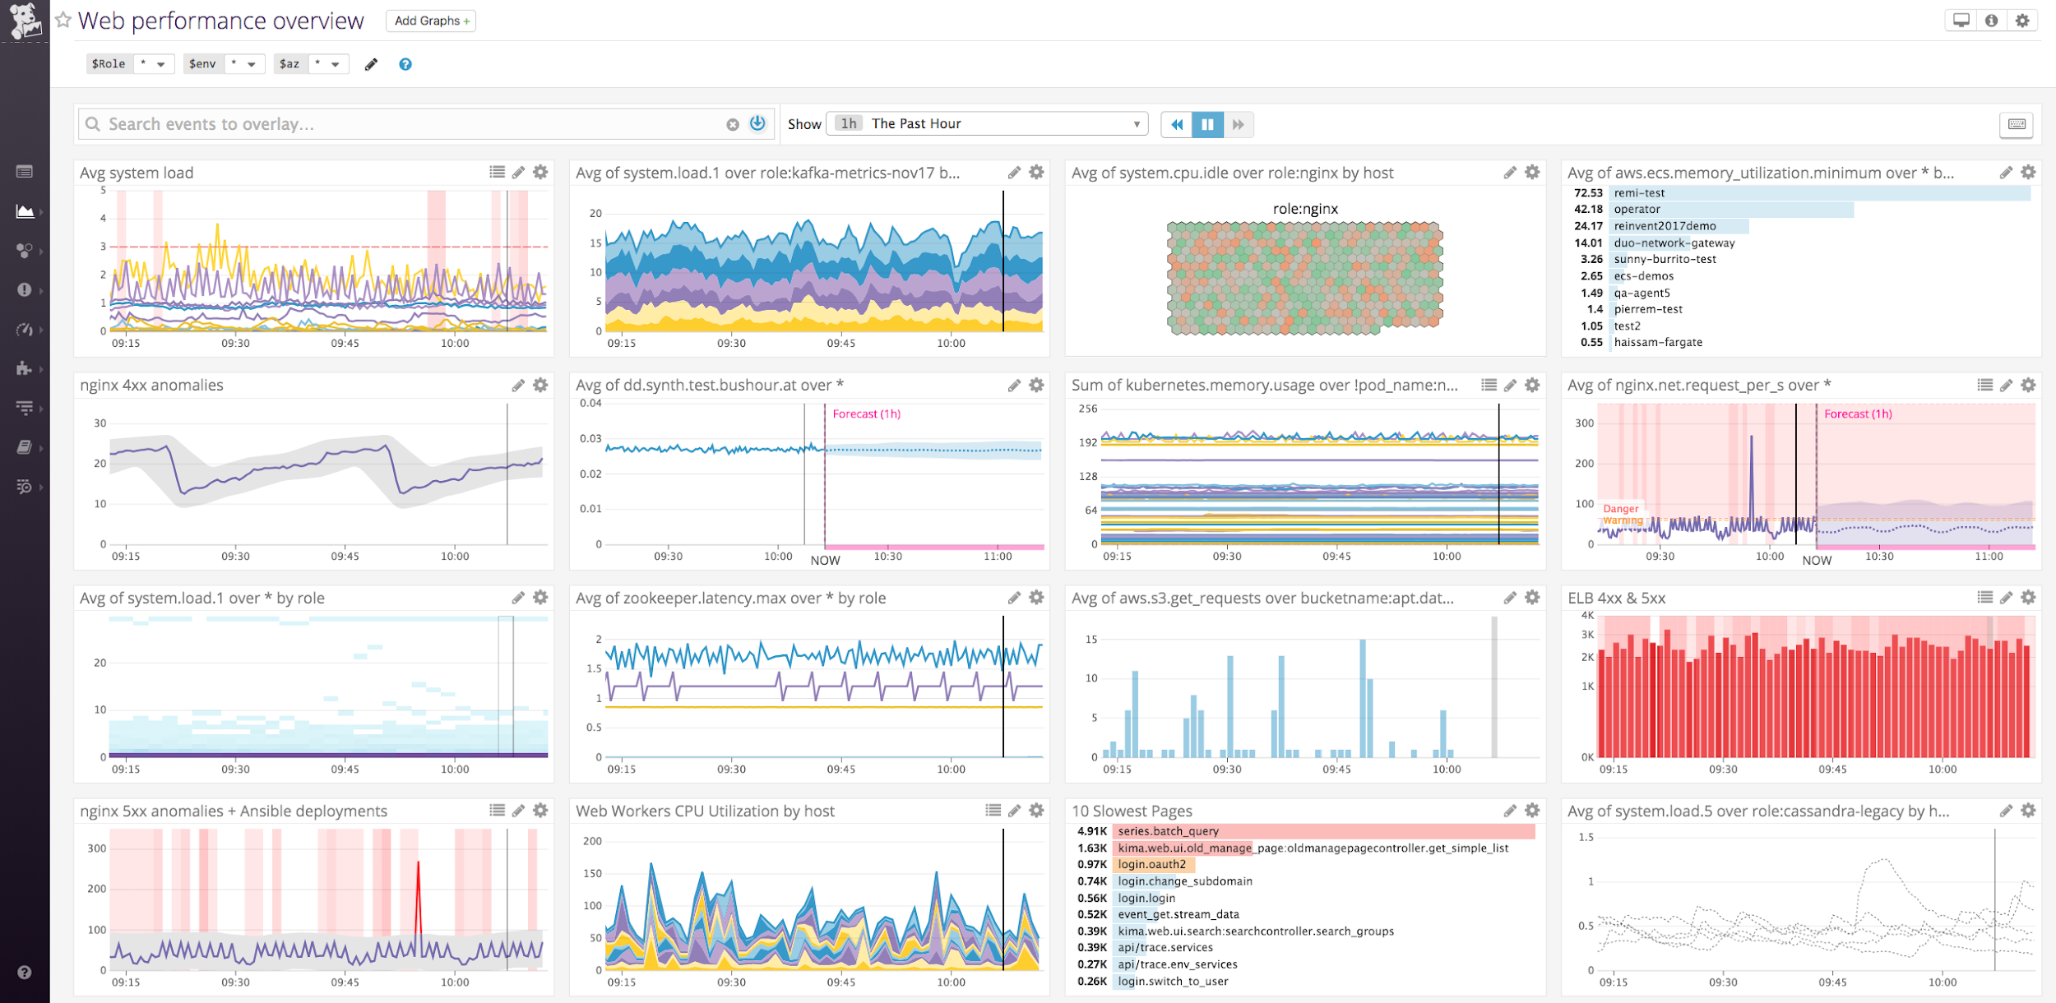
Notes:
Monitoring platform for cloud-scale infrastructures and applications that aggregates data from more than 200 technologies for troubleshooting, alerting, and graphing. We ingest trillions of data point per day through performance Metrics, Traces of the requests through your systems, and Logs.

Slide 6
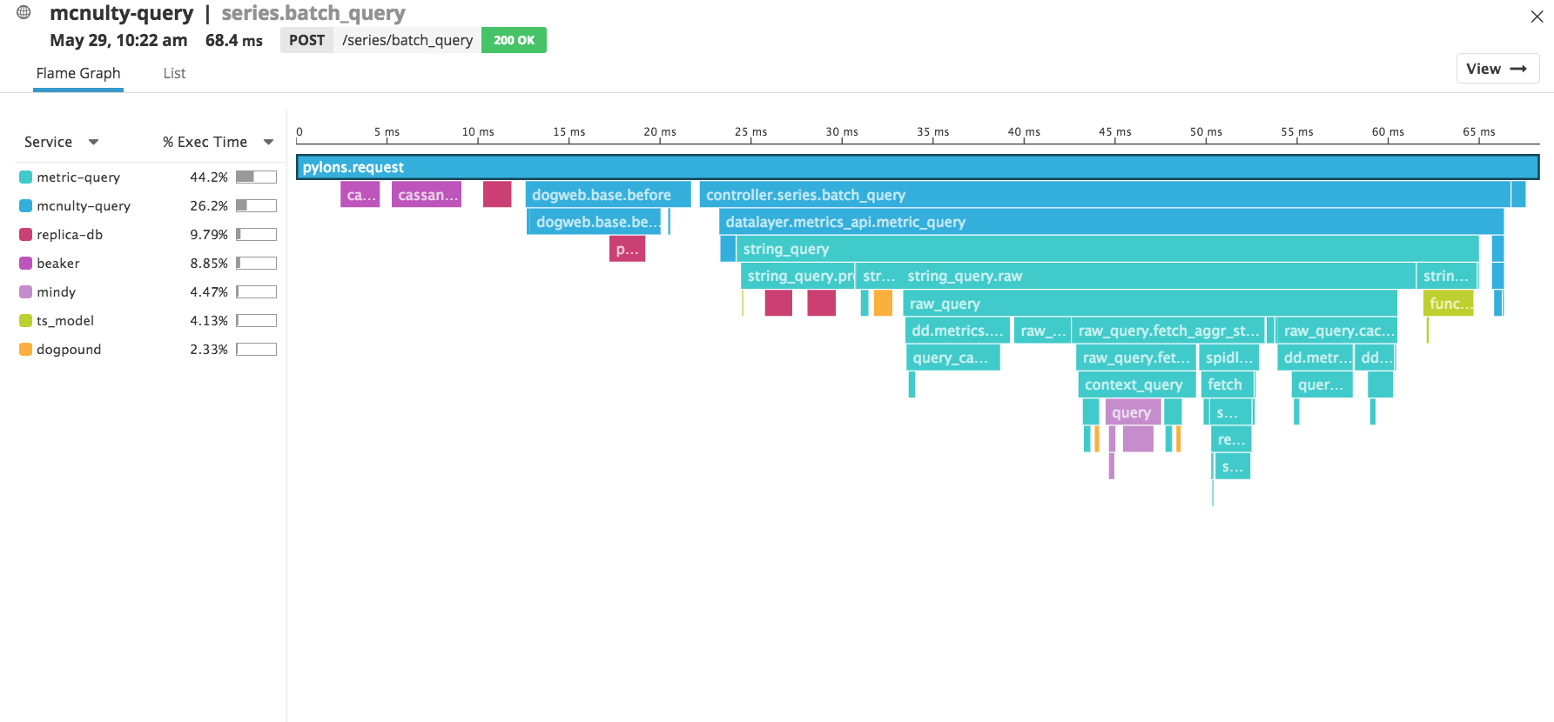
Notes:
Monitoring platform for cloud-scale infrastructures and applications that aggregates data from more than 200 technologies for troubleshooting, alerting, and graphing. We ingest trillions of data point per day through performance Metrics, Traces of the requests through your systems, and Logs.

Slide 7
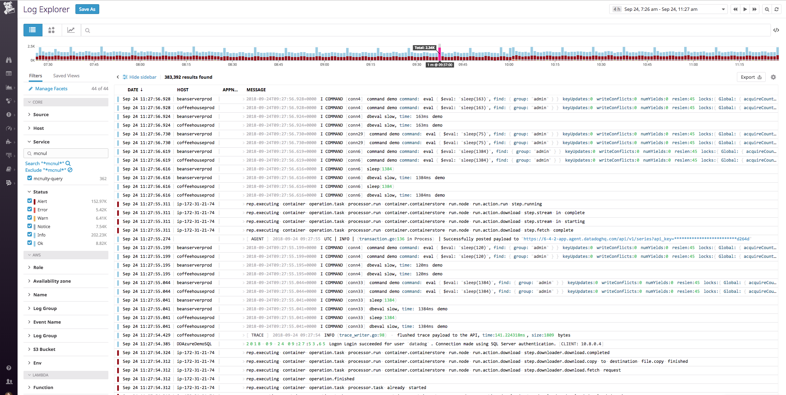
Notes:
Monitoring platform for cloud-scale infrastructures and applications that aggregates data from more than 200 technologies for troubleshooting, alerting, and graphing. We ingest trillions of data point per day through performance Metrics, Traces of the requests through your systems, and Logs.

Slide 8
Notes:
Monitoring platform for cloud-scale infrastructures and applications that aggregates data from more than 200 technologies for troubleshooting, alerting, and graphing. We ingest trillions of data point per day through performance Metrics, Traces of the requests through your systems, and Logs.

Slide 9
Internal Analytics team
Provide all other teams at Datadog with data and analytics to help them answer questions about business, operations & product usage
Notes:
Cerebral cortex of the company.

Slide 10
Internal Analytics team
Data Engineers + Data Analysts

Slide 11
Our data
40+ data sources
+ anywhere we can extract from

Slide 12
Our data
Products and features usage
Application and websites traffic
Signups Attribution
Revenue
Marketing efforts and performance
Sales pipeline
Cloud infrastructure costs

Slide 13
How we do it
Daily pipeline
Data sources
Workers
VMs
Storage
Clusters

Slide 14
How other teams access our data
Looker: pre-built reports + self-serve
SQL queries directly on the data warehouse
Outbound integrations in Salesforce, Zendesk...
Ingest it from S3
Notes:
S3: Not all the data we produce is use only for analytics reporting: teams created features based on our data. And that's because the structure of our pipeline that I’m going to present creates a nice interface with our data at different stages of its transformation.

Slide 15
WHY ETTL:
Challenges & Requirements

Slide 16
Highly diverse data sources
Evolving data sources
Constant need for new sources
Ease of backfilling
Long-term persistence
Several levels of sensitivity
Reliable and robust
Challenges

Slide 17
Traditional E.T. Hell 🔥
Evolving data sources = Changing the whole pipeline
Low resilience to changes in data sources
Cleaning and transformations duplicated
Parameters and functions all in one giant utils
One task fails → whole pipeline fails
Backfilling can take forever
Tasks dependencies nightmare
DataOps very complex
Notes:
ETL = established system where you simply pull data, do a bunch of transformation in one giant piece of code and then load the output to a data warehouse.

Slide 18
E T T L

Slide 19
Tiered Transform step
Data sources
Load to data warehouse
Bronze
Silver
Gold
Notes:
What we’re doing is that we’re going to persist the data at various points of the pipeline and that’s going to allow us to tackle our challenges.

Slide 20
Bronze = Data gathering
Data sources
Bronze bucket

Slide 21
Bronze = Data gathering
Bring data from all sources into one place
Raw extract: no transformation, no renaming, no filtering
Structured data
Notes:
We extract once and we don't care about what happens after in the source. Bronze persists the data, so we can always go back to this layer and rebackfill everything from it if something is wrong downstream.

Slide 22
Bronze = Data gathering
customer_hourly_usage
customer_id 22
name DatacatX
billing_plan_id 3
creation_tstamp 2018-01-14 10:15:34.171
hour_data 2018-10-24 15:00:00
server_count 154
country France
customer_hourly_usage
customer_id 22
name DatacatX
billing_plan_id 3
creation_tstamp 2018-01-14 10:15:34.171
hour_data 2018-10-24 15:00:00
server_count 154
country France

Slide 23
Silver = Normalization layer
S3 Bronze bucket
Silver bucket
1:1 object mapping

Slide 24
Silver = Normalization layer
Column selection, renaming, type casting
Schema evolutions (columns changing over time)
Shared first grooming in massive parallel:
filters
data cleaning
row-level operations
Notes:
In Silver can be re-used: 1 silver object is likely to be used by multiple tasks downstream

Slide 25
Silver = Normalization layer
customer_hourly_usage
customer_id 22
name DatacatX
billing_plan_id 3
creation_tstamp 2018-01-14 10:15:34.171
hour_data 2018-10-24 15:00:00
server_count 154
country France
clean_customer_hourly_usage
customer_id 22 int
customer_name datacatx string
billing_plan pro string
creation_timestamp 2018-01-14 10:15:34 timestamp
hour 2018-10-24 15:00:00 timestamp
server_count 154 int

Slide 26
Gold = Analytics layer
S3 Silver bucket
Gold bucket
Output = Final objects including the ones that will be loaded into the data warehouse

Slide 27
Gold = Analytics layer
clean_customer_hourly_usage
customer_id 22
customer_name datacatx
billing_plan pro
creation_timestamp 2018-01-14 10:15:34
hour 2018-10-24 15:00:00
server_count 154
fact_usage_daily
customer_id 22 int
customer_name datacatx string
billing_plan pro string
usage_date 2018-10-24 date
is_in_trial false boolean
server_count_max 175 int
server_count_avg 141.5 float
clean_customer_trials
customer_id 22
date 2018-01-14
is_in_trial false

Slide 28
Load to data warehouse
S3 Gold bucket
Different objects in Gold → Different load strategies:
Truncate & Insert: for dim / attribute tables
Insert only
Replace
Upsert

Slide 29
1:1 object mapping
Complex dependencies
Data sources
Load to data warehouse
Bronze
Silver
Gold
Data gathering
Normalization
Analytics logic

Slide 30
Our dependency graph
370 tasks
Up to 30 dependencies

Slide 31
Our dependency graph

Slide 32
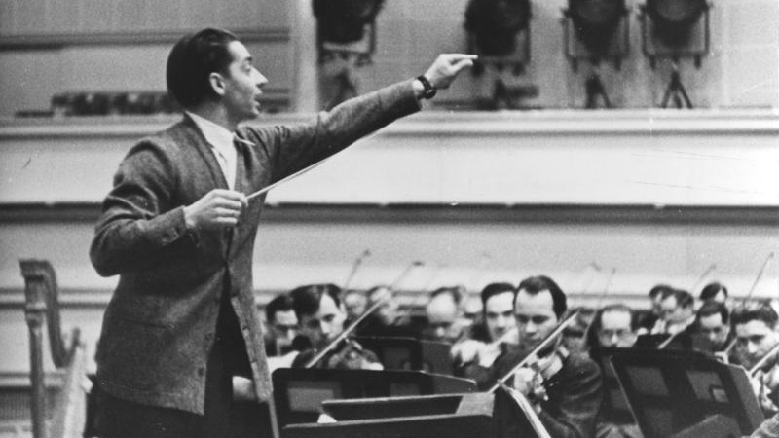
The orchestra maestro

Slide 33
Holds logic between the tasks
and chains them together
based on a dependency graph
Notes:
Open source project originally created at Spotify.

Slide 34
import luigi
class MyTask(luigi.Task):
param = luigi.Parameter(default=42)
def requires(self):
return OtherTask(self.param)
def run(self):
f = self.output().open('w')
print >>f, "hello world"
f.close()
def output(self):
return luigi.S3Target('s3://bucket/folder/file-%s.csv' % self.param)
if __name__ == '__main__':
luigi.run()
Parameters
Not powerful enough for us
Which other tasks it depends on
Task logic
Where it writes the output

Slide 35
Bronze
same day
pageviews
today
Bronze
same day
user_infos
most recent
fact_pageview
same day
3-day window
Bronze
usage_rollup
today
page_categories
Bronze
same day
pages_attributes
whole history

Slide 36
Our extended framework: Abstraction
1 data source = 1 base class
Inputs are parameters
Notes:
We developed libraries with parameters and functions specific to each tier that we simply have to extend.

Slide 37
Dev process
Silver
versioned
S3 folders
Gold
versioned
S3 folders
Redshift
versioned
tables
Bronze
jm
meghan
aaron
jm
meghan
aaron
jm
meghan
aaron

Slide 38
HOW ETTL solves our challenges

Slide 39
Highly diverse data sources
Evolving data sources
Constant need for new sources
Ease of backfilling
Long-term persistence
Several levels of sensitivity
Reliable and robust
Challenges
accepted

Slide 40
One base task per data source in Bronze
Objects are separated until Silver
But they end up in the same form in Silver
Column evolution is taken care of in Silver

Slide 41
Highly diverse data sources
Evolving data sources
Constant need for new sources
Ease of backfilling
Long-term persistence
Several levels of sensitivity
Reliable and robust
Challenges
accepted
Notes:
Oops. there is a bug → Backfill everything for the past few months. In the meantimes, people need the data!

Slide 42
Tiers ~ Checkpoints
Logic is wrong or we have to tweak our objects?
We only need to backfill from the tier that was impacted by the change

Slide 43
Adding new columns
Bronze
Silver
Gold

Slide 44
Tweaking business logic
Bronze
Silver
Gold

Slide 45
Highly diverse data sources
Evolving data sources
Constant need for new sources
Ease of backfilling
Long-term persistence
Several levels of sensitivity
Reliable and robust
Challenges
accepted

Slide 46
Notes:
WE DIDN'T have a way to go back in time on SF data before.

Slide 47
Data change in the source?
We have the whole history in Bronze and Silver
→ We can investigate historical state of the data at any point in time
Data sources
=
Bronze

Slide 48
ETTL rocks!

Slide 49
Safeguards on crucial parts:
We can easily rebuild everything from Bronze
Yes Bronze has backups
Data warehouse tables also have backups when relevant
Notes:
S3 is not always perfectly reliable → backups for Bronze

Slide 50
Highly diverse data sources
Evolving data sources
Constant need for new sources
Ease of backfilling
Long-term persistence
Several levels of sensitivity
Reliable and robust
Challenges
accepted

Slide 51
Different
buckets & roles (IAM)
Different
schemas
Different
connections & permissions

Slide 52
Highly diverse data sources
Evolving data sources
Constant need for new sources
Ease of backfilling
Long-term persistence
Several levels of sensitivity
Reliable and robust
Challenges
accepted

Slide 53
Monitoring & Alerting

Slide 54
Monitoring: data should be fresh
Alerts on Pipeline failures

Slide 55
Monitoring: data should be fresh
+ Preventive alerts:
Missing or improperly formatted data in source extracts
Notes:
We want the pipeline to fail only when it’s worth it.

Slide 56
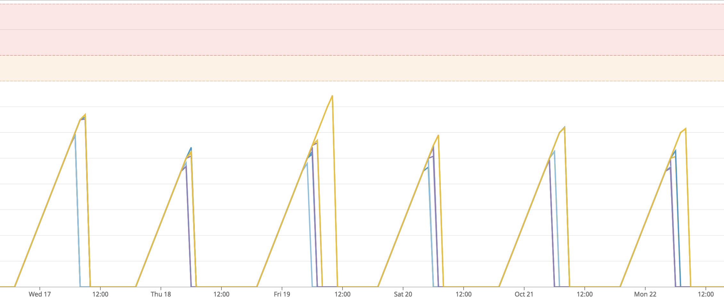
Monitoring: data should be fresh
Data latency
Age of the data (hours)

Slide 57
Monitoring: data should be accessible
Infrastructure monitoring: Redshift & Looker

Slide 58
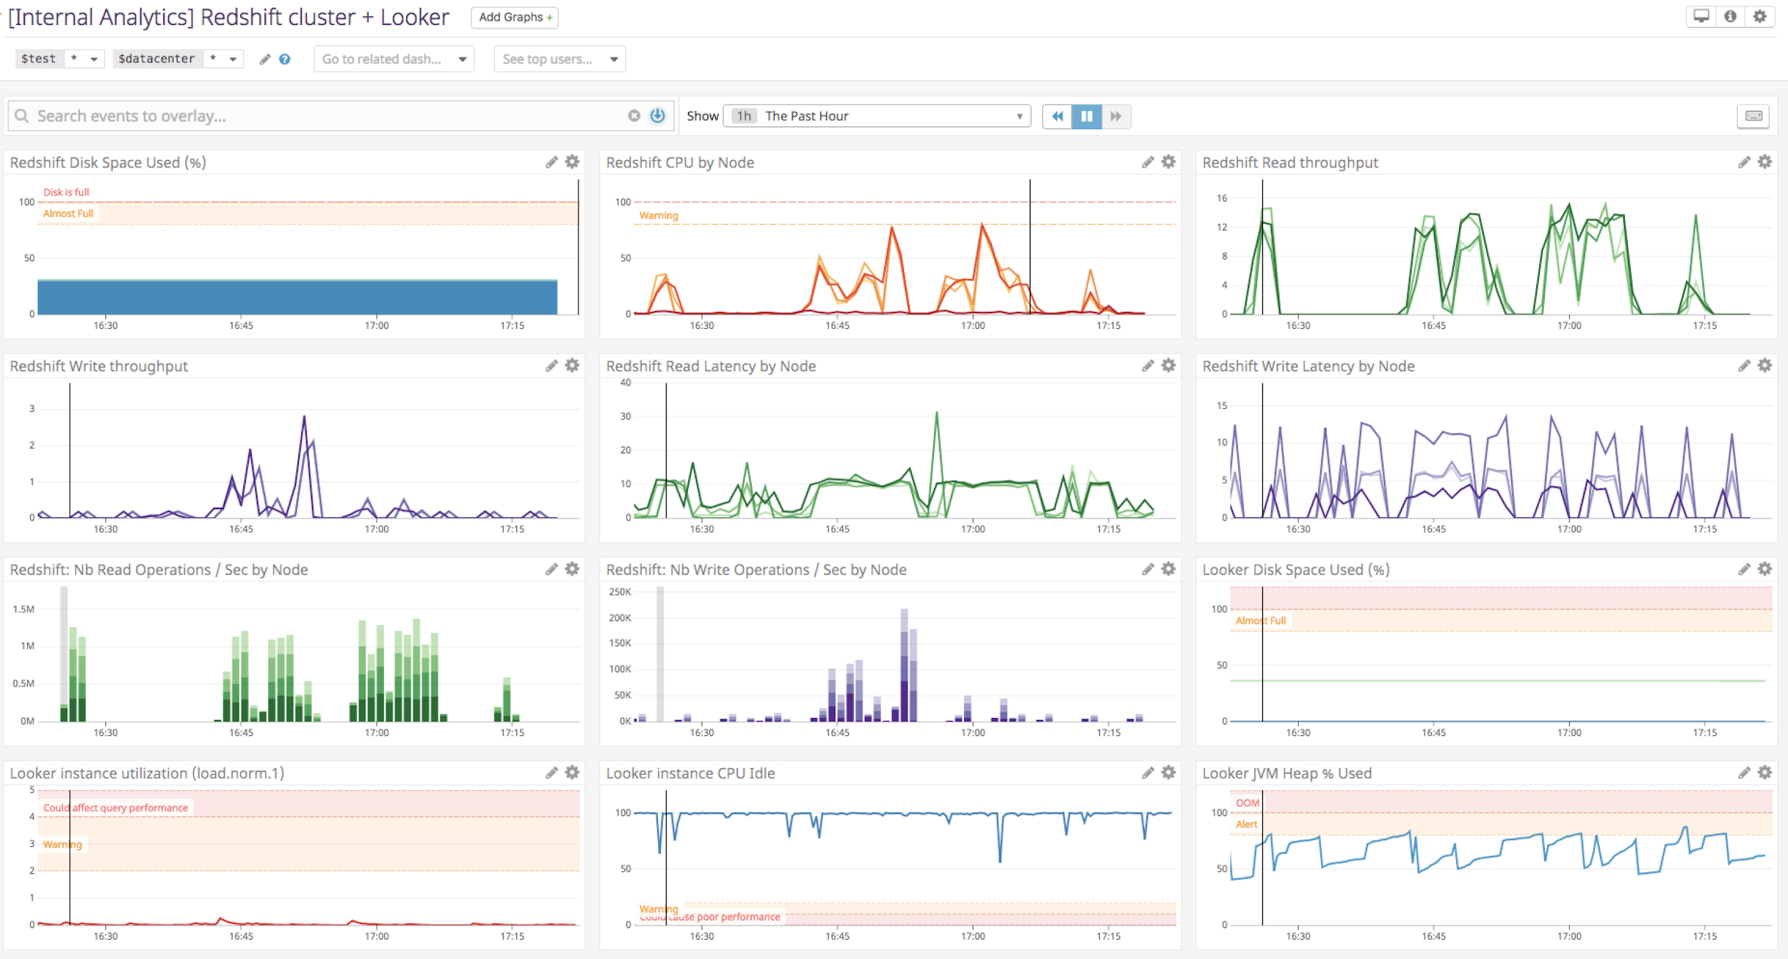
Monitoring: data should be accessible

Slide 59
Monitoring: data query is performant
Monitor:
Redshift queries performance
Redshift Workload Management (WLM)
Looker dashboard load
→ Datadog custom metrics

Slide 60
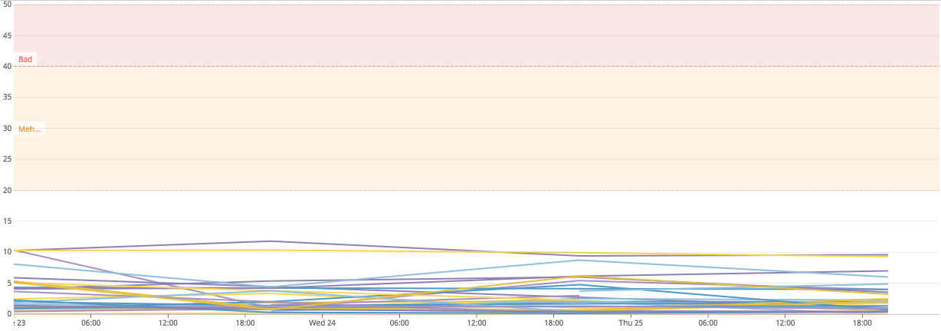
Monitoring: data query is performant
Query execution time SLI

Slide 61
Monitoring: data should be accurate
We monitor not only our stack, but also the data itself

Slide 62
Monitoring: data should be accurate
Monitor rows inserted into the final data warehouse → Anomaly Detection

Slide 63
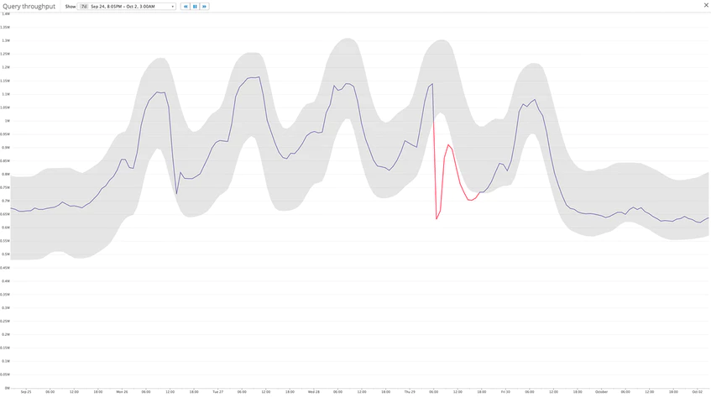
Anomaly Detection
Takes into account seasonalities
fact_pageviews

Slide 64
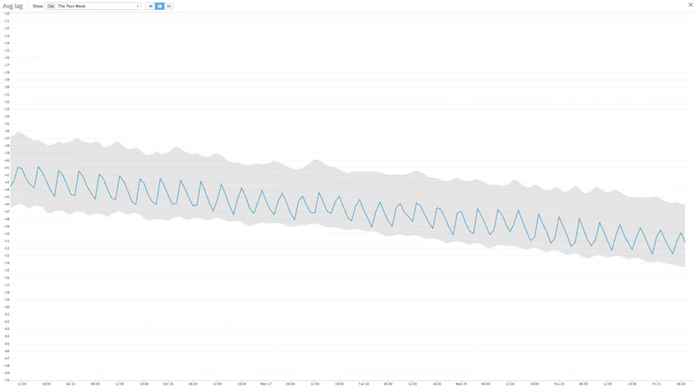
Takes into account trends

Slide 65
Monitoring: data should be accurate
Spot missing dates

Slide 66
Monitoring: data should be accurate
Spot duplicates in Gold + in data warehouse tables

Slide 67
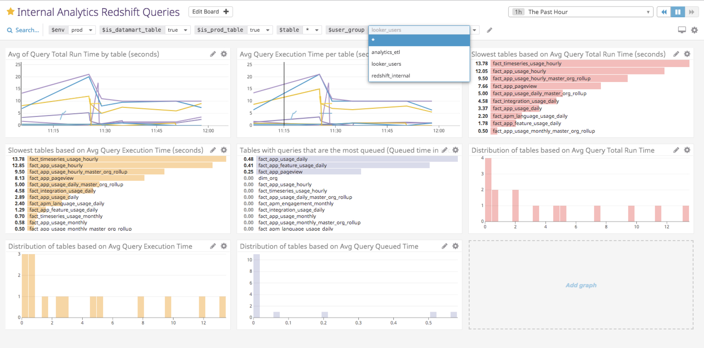
The power of Tags

Slide 68
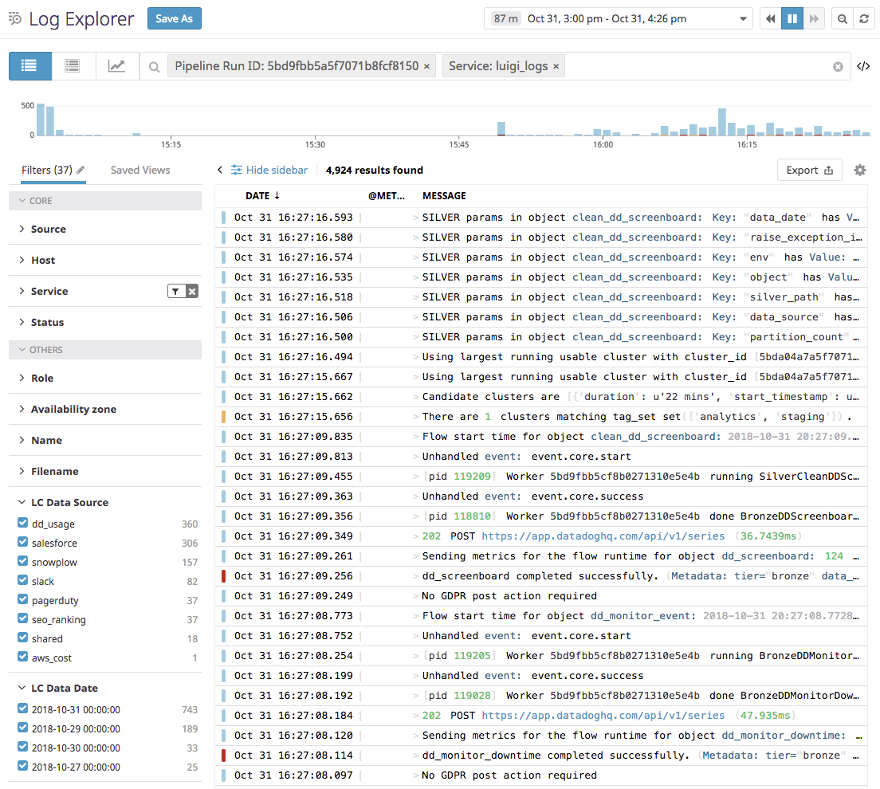
Logs + Tags

Slide 69
Logs + Tags

Slide 70
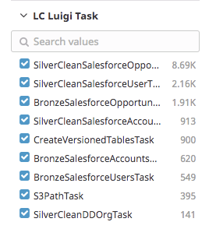
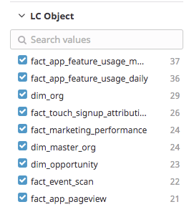
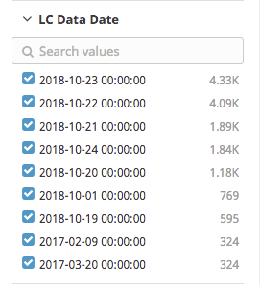
Logs + Tags

Slide 71
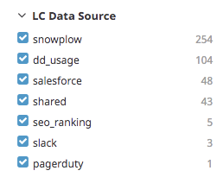
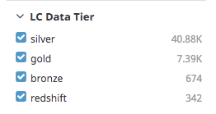
Logs + Tags

Slide 72
Conclusion
Data sources
Load to data warehouse
Bronze
Silver
Gold
Monitoring

Slide 73
We’re hiring!
Join us in building a first-class Analytics Data Pipeline
datadoghq.com/careers
Swing by our booth

Slide 74
Thank you!
Questions?
jm@datadoghq.com

