Slide 1
DataEngConf NYC 2018 | AI track
Running Effective Machine Learning Teams: Common Issues, Challenges and Solutions
Gideon Mendels,
CEO & Co-founder,
gideon@comet-ml.com
Notes:
Thank you for coming
My name is Gideon Mendels and I’m the CEO of Comet.ml -> we like…
I started my career as a software engineer but have been focused on ML for the past 5 years.
Grad student here at Columbia, Google and Groupwize

Slide 2
Agenda
Advances in deep learning
Case study from Google
Main Problems — Visibility, Reproducibility, Collaboration
Questions
Notes:
In today’s talk i’ll cover some of the advances we’ve seenn in DL
I’ll share a case study of my team’s efforts on building ML models
And then i’ll address the main problems as we see them - visibility, reproducibility, collaboration

Slide 3
The Deep Learning Revolution
In recent years, we’ve seen Deep Learning methods significantly outperform major benchmarks
Notes:
We’ve all heard about deep learning the AI revolution but sometimes it’s hard to distinguish between what’s hype and what’s real progress.
From an academic perspective we’ve seen DL methods outperform major benchmarks in a variety of fields.
Indeed there’s a gap when it comes to extracting business value and we’ll talk later about some of the reasons for that.
But just to walk you through how substantial this is i’ll cover a couple of examples

Slide 4
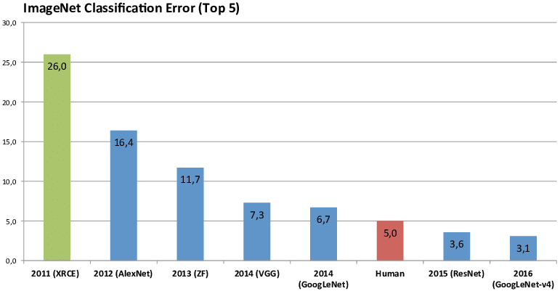
The Deep Learning Revolution: ImageNet
Notes:
reference
Describe:
14m Images with 1000 classes.
Dog breeds to objects.
It’s been a common benchmark for computer vision
AlexNet was built by Alex Krizhevsky who was Geoffrey’s hinton student and what was really innovative was
The use of GPUs to train his network.
AlexNet is the name of a convolutional neural network, designed by Alex Krizhevsky,^{[1]} and published with Ilya Sutskever and Krizhevsky's PhD advisor Geoffrey Hinton,^{[2][3]} who was originally resistant to the idea of his student.^{[1]}

Slide 5
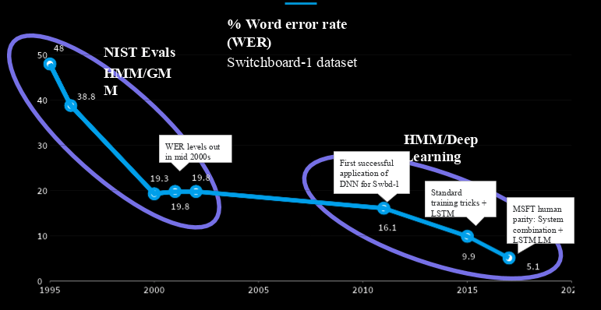
The Deep Learning Revolution: Switchboard
Notes:
reference
Switchboard dataset - 260 hours of natural speech from 540 speakers
Microsoft human parity in 2016.
Add an example
https://catalog.ldc.upenn.edu/desc/addenda/LDC97S62.wav

Slide 6
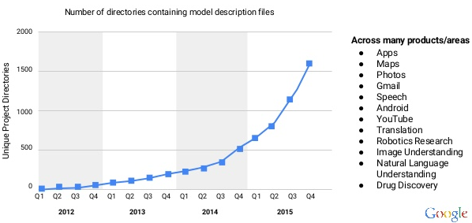
The Deep Learning Revolution: At Google
Notes:
reference
https://confengine.com/odsc-india-2018/proposal/7319/the-deep-learning-revolution-in-automatic-speech-recognition

Slide 7
We live in the Machine Learning Pioneering Age
but...
while academic research has been improving consistently, we’re still struggling with translating ML to business value.
the biggest obstacles are our processes and tools
Visibility, Reproducibility, and Collaboration

Slide 8
Case Study
What are the dynamics of a machine learning team in real life?

Slide 9
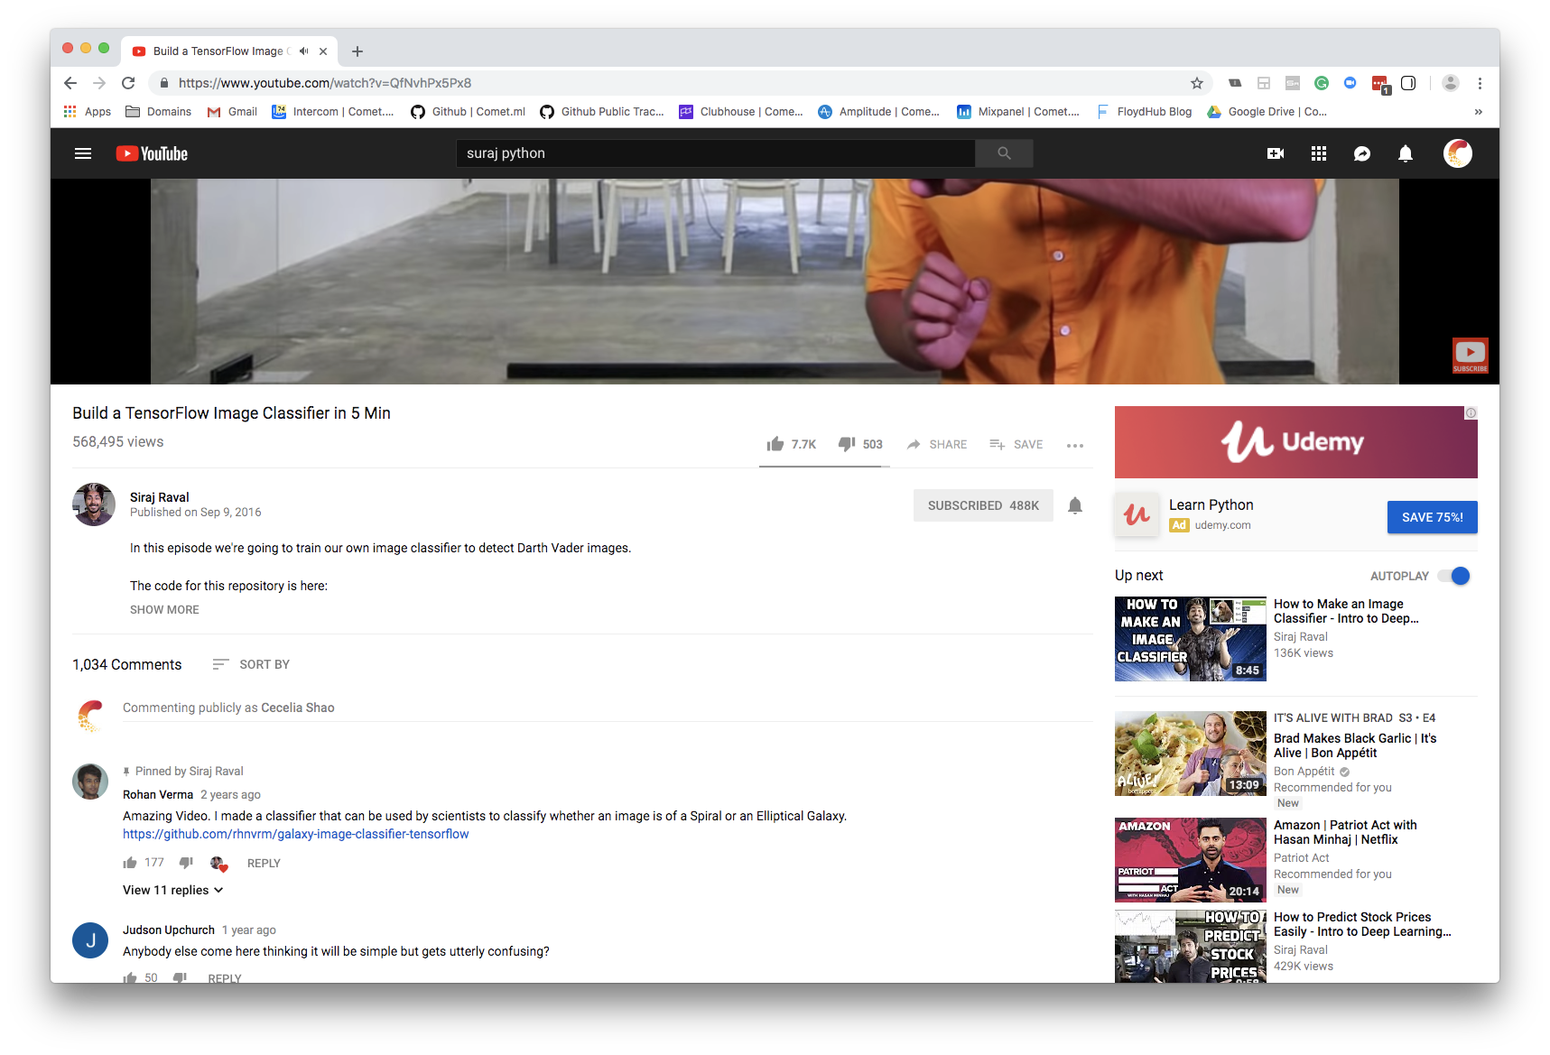
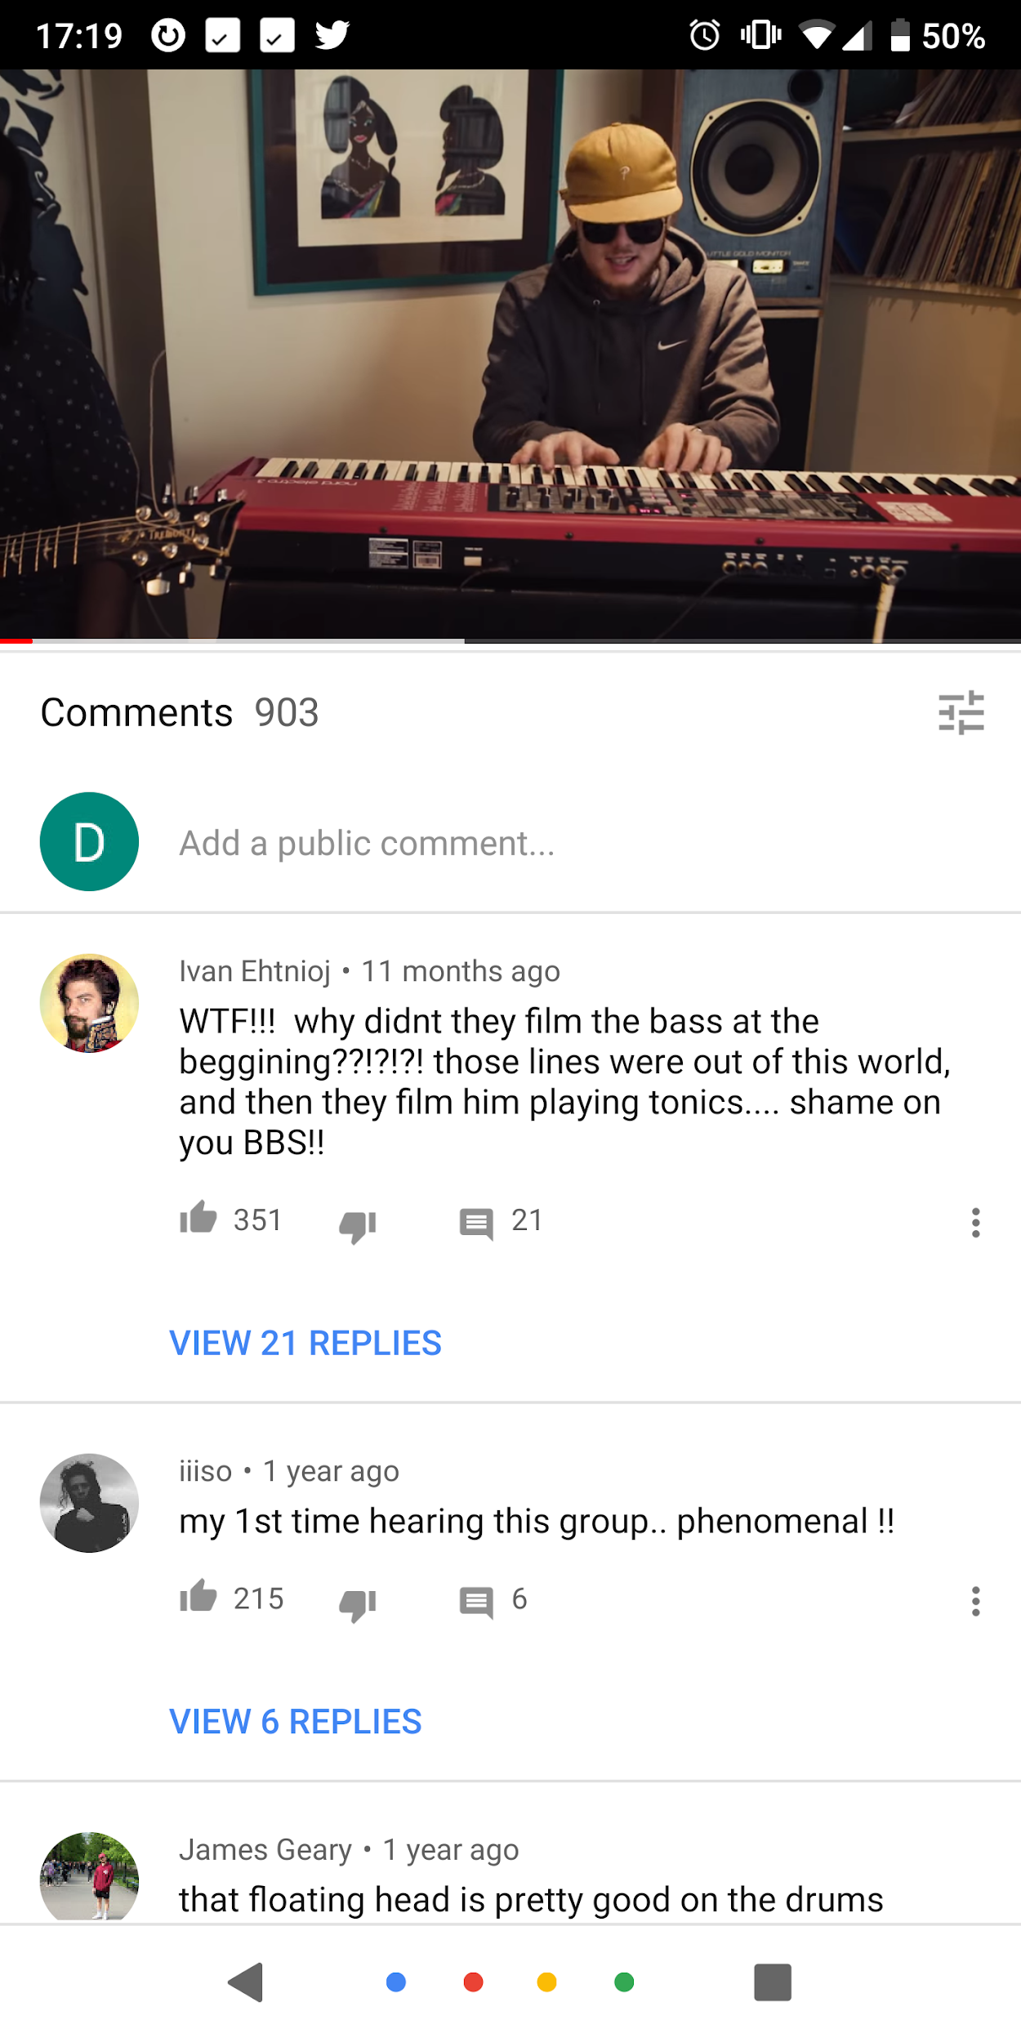
Case Study: Hate Speech Classification
Basic Model Loop:
Goal: detecting hate speech in Youtube comments
Problem Definition: given a Youtube comment, identify if it contains hate speech (Binary Classification)
Dataset: Only a few thousand labeled comments
Goal = outperform production model performance
Model
True
False

Slide 10
Case Study: Production Model
Solid place to start?
Training code was available in Version Control
Data was available in a file but not clear which specific version was used to train the production model.
Hyperparameters were originally fed in as command line arguments and were now lost
Results (accuracy only) were found in an email sent to the team
What’s running in production?
Data
Training Code
Results
?
?
Hyperparameters
Model Binary
X
Notes:
Need to find all the pieces
Does this sound familiar?

Slide 11
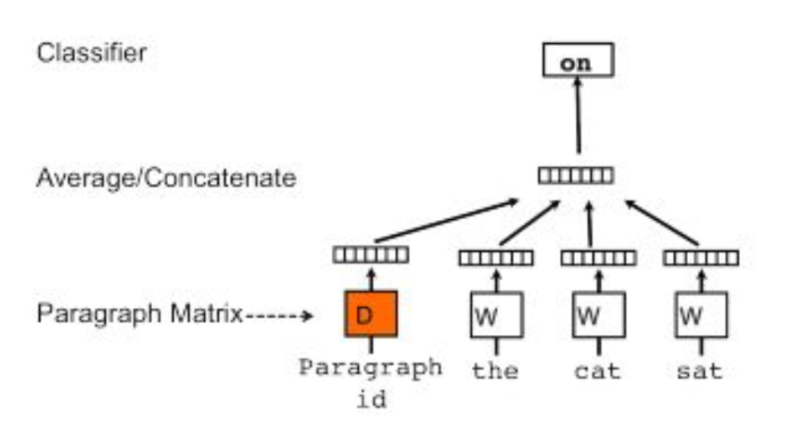
Case Study: Production Model
Paragraph Vectors as features
Unsupervised algorithm to learn a feature vector given a document
We can learn the embeddings on the entire Youtube comments corpus (not just labeled data)
Support Vector Machines (SVM) as the classifier

Slide 12
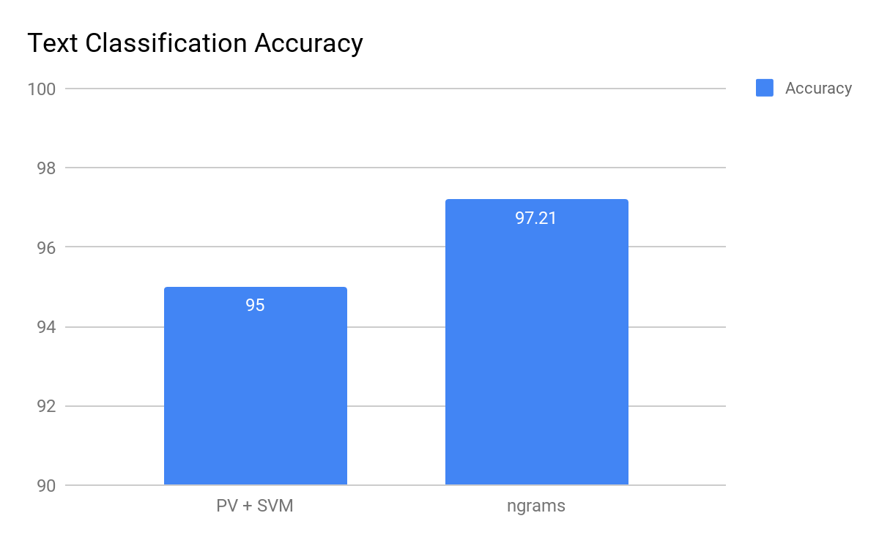
Production Model Performance
Our best attempt at reproducing the production model:
95% accuracy… not bad!
Production
Model
Notes:
Describe what is baseline

Slide 13
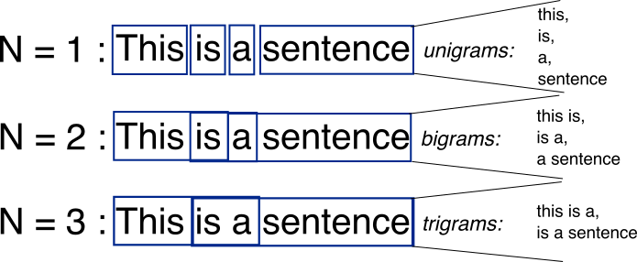
Case Study: Baseline Model
Baseline model = Ngrams + Stemming + Stop Words removal + TfIDF
Logistic Regression as the classifier
Ngrams:
Stemming
Lightweight
Processing
Lightweight
Process
Notes:
Add more information on what ngrams and stemming are
https://www.google.com/search?q=ngrams&source=lnms&tbm=isch&sa=X&ved=0ahUKEwibg6D5usDeAhUnqlkKHShoDEUQ_AUIFSgD&biw=1440&bih=767&dpr=2#imgrc=Gg47q31rH0xCgM:

Slide 14
Production vs Baseline
Simpler model outperforms production model
Production
Model
Baseline
Model
Notes:
Describe what is baseline

Slide 15
Case Study: Can we do even better?
Try using a state of the art CNN
Model | Accuracy
BoW | 68.89
ngrams TFIDF | 68.51
Conv Net | 71.20
Notes:
Convert results table to accuracy (100 - value)
BOW
Ngrams tfidf
LG. Conv. Th

Slide 16
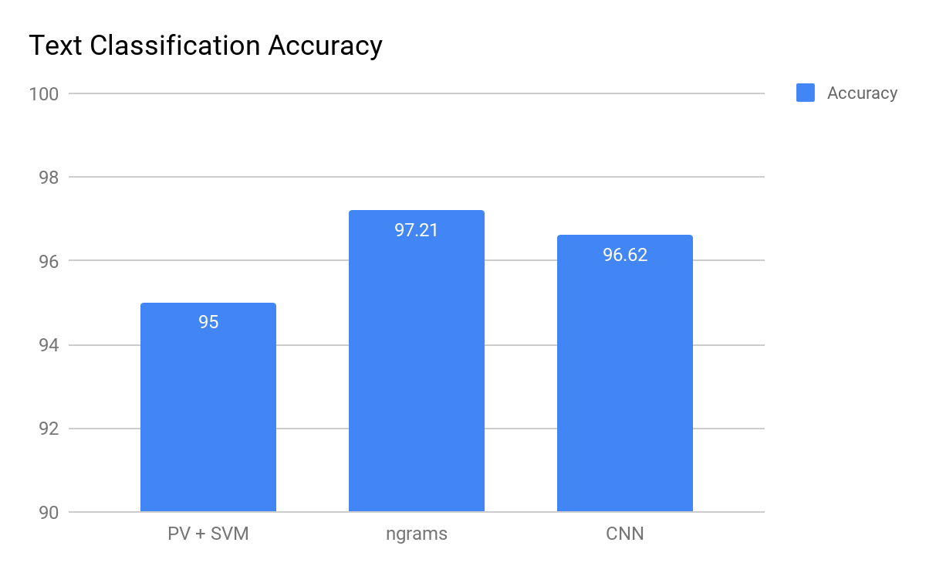
Testing Another Approach
Production
Model
Baseline
Model
Paper CNN
Notes:
@cece: This one can be static. Don’t hit the update button.

Slide 17
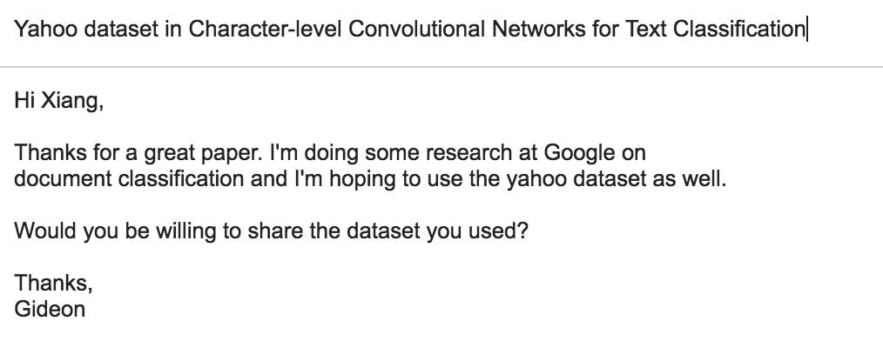
Case Study: Obtaining original data

Slide 18
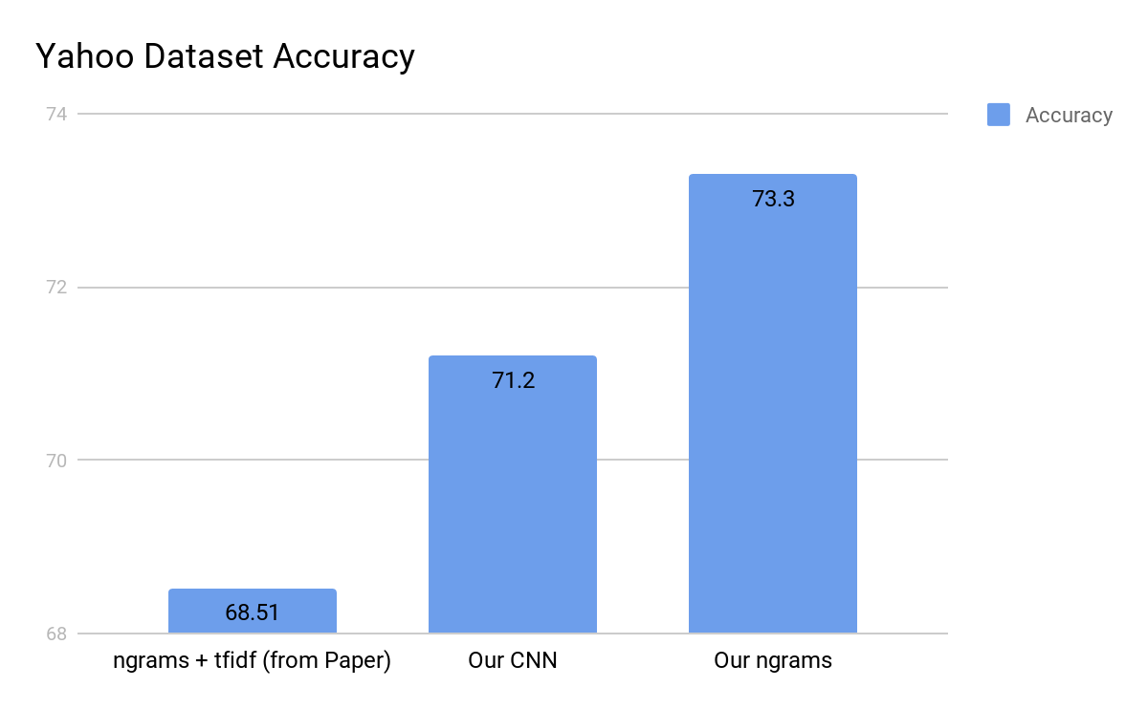
Yahoo Dataset Results
Paper ngrams
Paper/our CNN (same result)
Our ngrams

Slide 19
Summary
While the CNN result in the paper was reproducible, their ngram model wasn’t.
We spent months of research chasing the wrong technique due to lack of visibility
If we only had full visibility into the process this back-and-forth could have been avoided.

Slide 20
What does visibility mean in ML?
The ability to access, view, and react to Machine Learning processes and deliverables.
Ask yourself:
Can the team manager observe what ML engineers are training?
What model is running production?
What’s your models’ performance?
What metric was used to optimize a model?
What data was used to train a model?
What hyperparameters were used to train a model?
What happens when a teammate quits?
Notes:
The ability to access, view and react to Machine Learning processes and deliverables.
Can a Manager observe what ML engineers are training?
What model is running production?
What’s our models’ performance?
What metric was used to optimize a model?
What data was used to train a model?
What hyperparameters were used to train a model?
Teammates churn about every 18 months

Slide 21
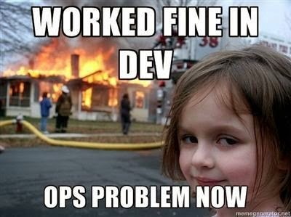
Barriers to visibility
1
2
3
4
Decoupled pieces: data, code, configuration, and results are generated at different steps
Siloed functions: the Machine Learning workflow is spread across different teams (DBA, Research, Software Engineers, and DevOps)
Different tools: Multiple tools, libraries, and infrastructure providers
Outdated and sparse documentation in a different place from the actual workflow artifacts
Notes:
https://cdn-images-1.medium.com/max/1600/1*6Kh0EXVHQ9zmau8kLs4pzQ.jpeg

Slide 22
What is reproducibility?
Reproducibility = the cornerstone of science. It’s the ability to take an experiment, repeat the steps and get to the same conclusion
Reproducibility
Replicability
Perform two separate independent or different experiments that prove the same thesis
Use the same procedures and get the same outcome
* Drummond et al
Notes:
“So we'll start with the formal definition because we are scientists after all (Joke about computer science?).
reproducibility is really one of the cornerstones of science. The ability to take an experiment, repeat the steps and get to the same conclusion. If flip a coin enough times I'm pretty confident that about 50% of the observations would be tails.
Now there's long discussion whether reproducibility is the same thing as replicability. An interesting paper by Chris Drummond ( http://cogprints.org/7691/7/ICMLws09.pdf) separates the two. replicability which is the ability to take an experiment recipe, repeat the steps and get the same outcome. And reproducibility which is the ability to perform two or different and independent experiments that proves the same thesis. For example in physics - X,Y.
In machine learning most of the discussion is around replicability but the underlying importance is much much than just simply being able to recreate the same result twice. “
Methods repro:
Being able to take a method and apply it on a different
Replicability is not Reproducibility - http://cogprints.org/7691/7/ICMLws09.pdf
https://retractionwatch.com/2016/06/01/what-does-reproducibility-mean-new-paper-seeks-to-standardize-the-lexicon/
Reproducibility in Machine Learning-Based Studies: An Example of Text Mining - https://openreview.net/pdf?id=By4l2PbQ-
https://petewarden.com/2018/03/19/the-machine-learning-reproducibility-crisis/
https://www.coursera.org/learn/data-results/lecture/v27fG/reproducibility-and-data-science
https://towardsdatascience.com/data-sciences-reproducibility-crisis-b87792d88513
https://determined.ai/blog/reproducibility-in-ml/

Slide 23
Barriers to reproducibility
1
2
3
4
5
Run-to-run variation comes from many factors:
Changes in incoming/connected data
Example: additional training data not specified in root path; random dataset shuffling
Inconsistent hyperparameters
Changes in ML frameworks
Example: updates/versions of ML frameworks; Keras with different backends
Noisy hidden layers in NN architectures
Example: dropout layers
Variant compute architectures for CPUs and GPUs

Slide 24
Collaboration
Many Machine Learning teams are a group of lone wolves sitting in the same room.
Machine Learning processes involve multiple units that needs an easy easy to communicate.
Notes:
Lone wolf meme?
Team churn

Slide 25
Wait...isn’t this a solved problem?

Slide 26
Can we solve this with Git?
Can we solve this with GIT?
$ git checkout -b new-experiment-1
$ python train.py --data path/to/data --learning_rate 0.01 --num_layers 3 --output results.txt
Training… Test Accuracy: 97%
$ git add results.txt
$ git commit -m "new result"
$ git push origin new-experiment-1
Create Branch
Run Code
Commit Results
Push Branch
Notes:
https://www.reddit.com/r/MachineLearning/comments/85pxck/d_the_machine_learning_reproducibility_crisis/
http://dataconomy.com/2017/07/10-rules-results-data-science/

Slide 27
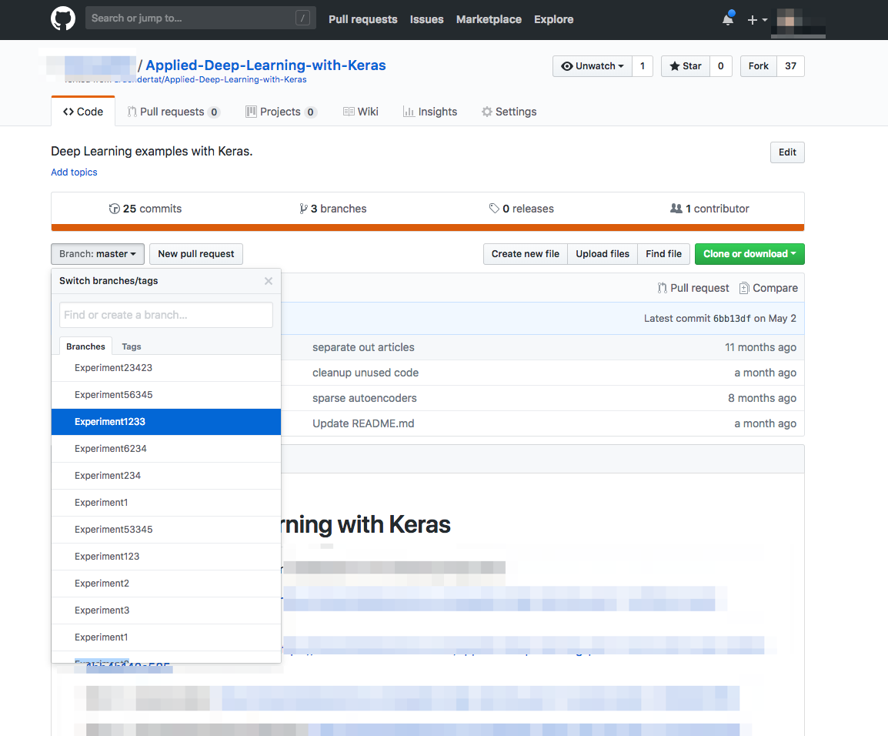
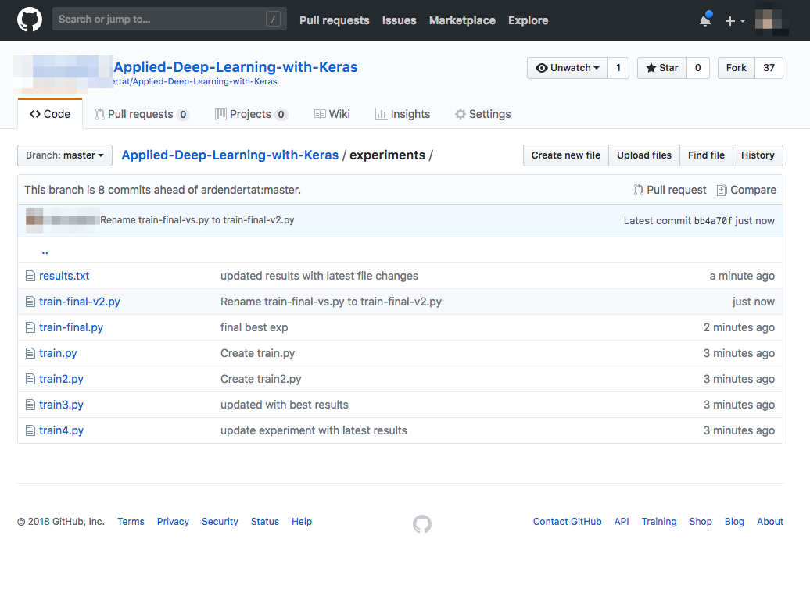
Can we solve this with Git?
Git doesn’t scale.
Impossible to understand the relationship between files or look across experiments
Notes:
Can you make two screenshots:
The github branch drop down with experiment1, experimeet2 …
A github view of a code folder with the following files:
train.py
train2.py
results.txt
The idea behind 1 is to show you can’t find your stuff if you use branches
And behind 2 that you’re not sure why of the files (train1,train2) actually created the result file

Slide 28
Software Engineering Pipeline
Development
Commit
Build
Test
Stage
Deploy
Production
The tools we have been building for the past 50 years are oriented towards software engineering.
Notes:
Software Engineering Workflow:
https://www.google.com/search?q=software+engineering+ci+cd+coding+testing&source=lnms&tbm=isch&sa=X&ved=0ahUKEwiwsvbVg77eAhXOc98KHRyHDA0Q_AUIEygB&biw=1920&bih=947#imgrc=MawA-Ky8VYXJbM:
Recreate without logos and noise (just pipeline)
ML Worfklow: http://fgiasson.com/blog/index.php/2017/03/10/a-machine-learning-workflow/

Slide 29
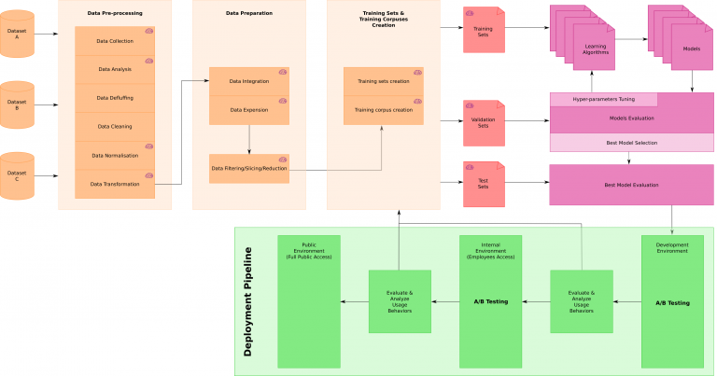
Machine Learning Pipeline

Slide 30
So what does the ideal solution look like?
Automated. Not manually enforced discipline
Needs to foster the inherent creative iterative aspect of machine learning
Works with any type of infrastructure, tool or library
Notes:
Transition?

Slide 31
{
A solution for reproducibility will give you much more than just that...
Conduct meta analysis
Increased visibility
Collaboration
Easy comparison
Efficient debugging
Notes:
-- Data scientist can use this to show results in meetings
- should/will be the baseline in the future
- get your competitive advantage now

Slide 32
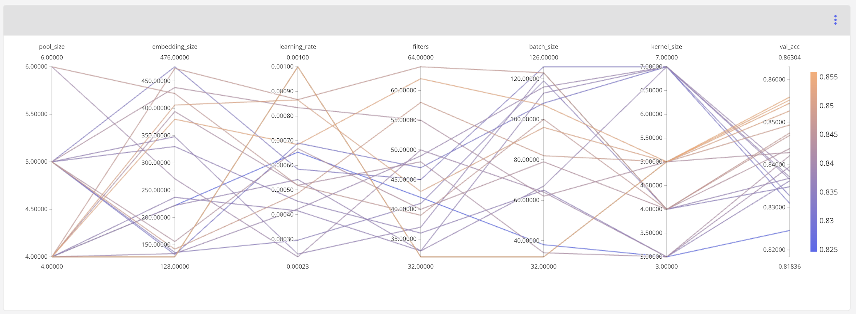
Hyperparameter space

Slide 33
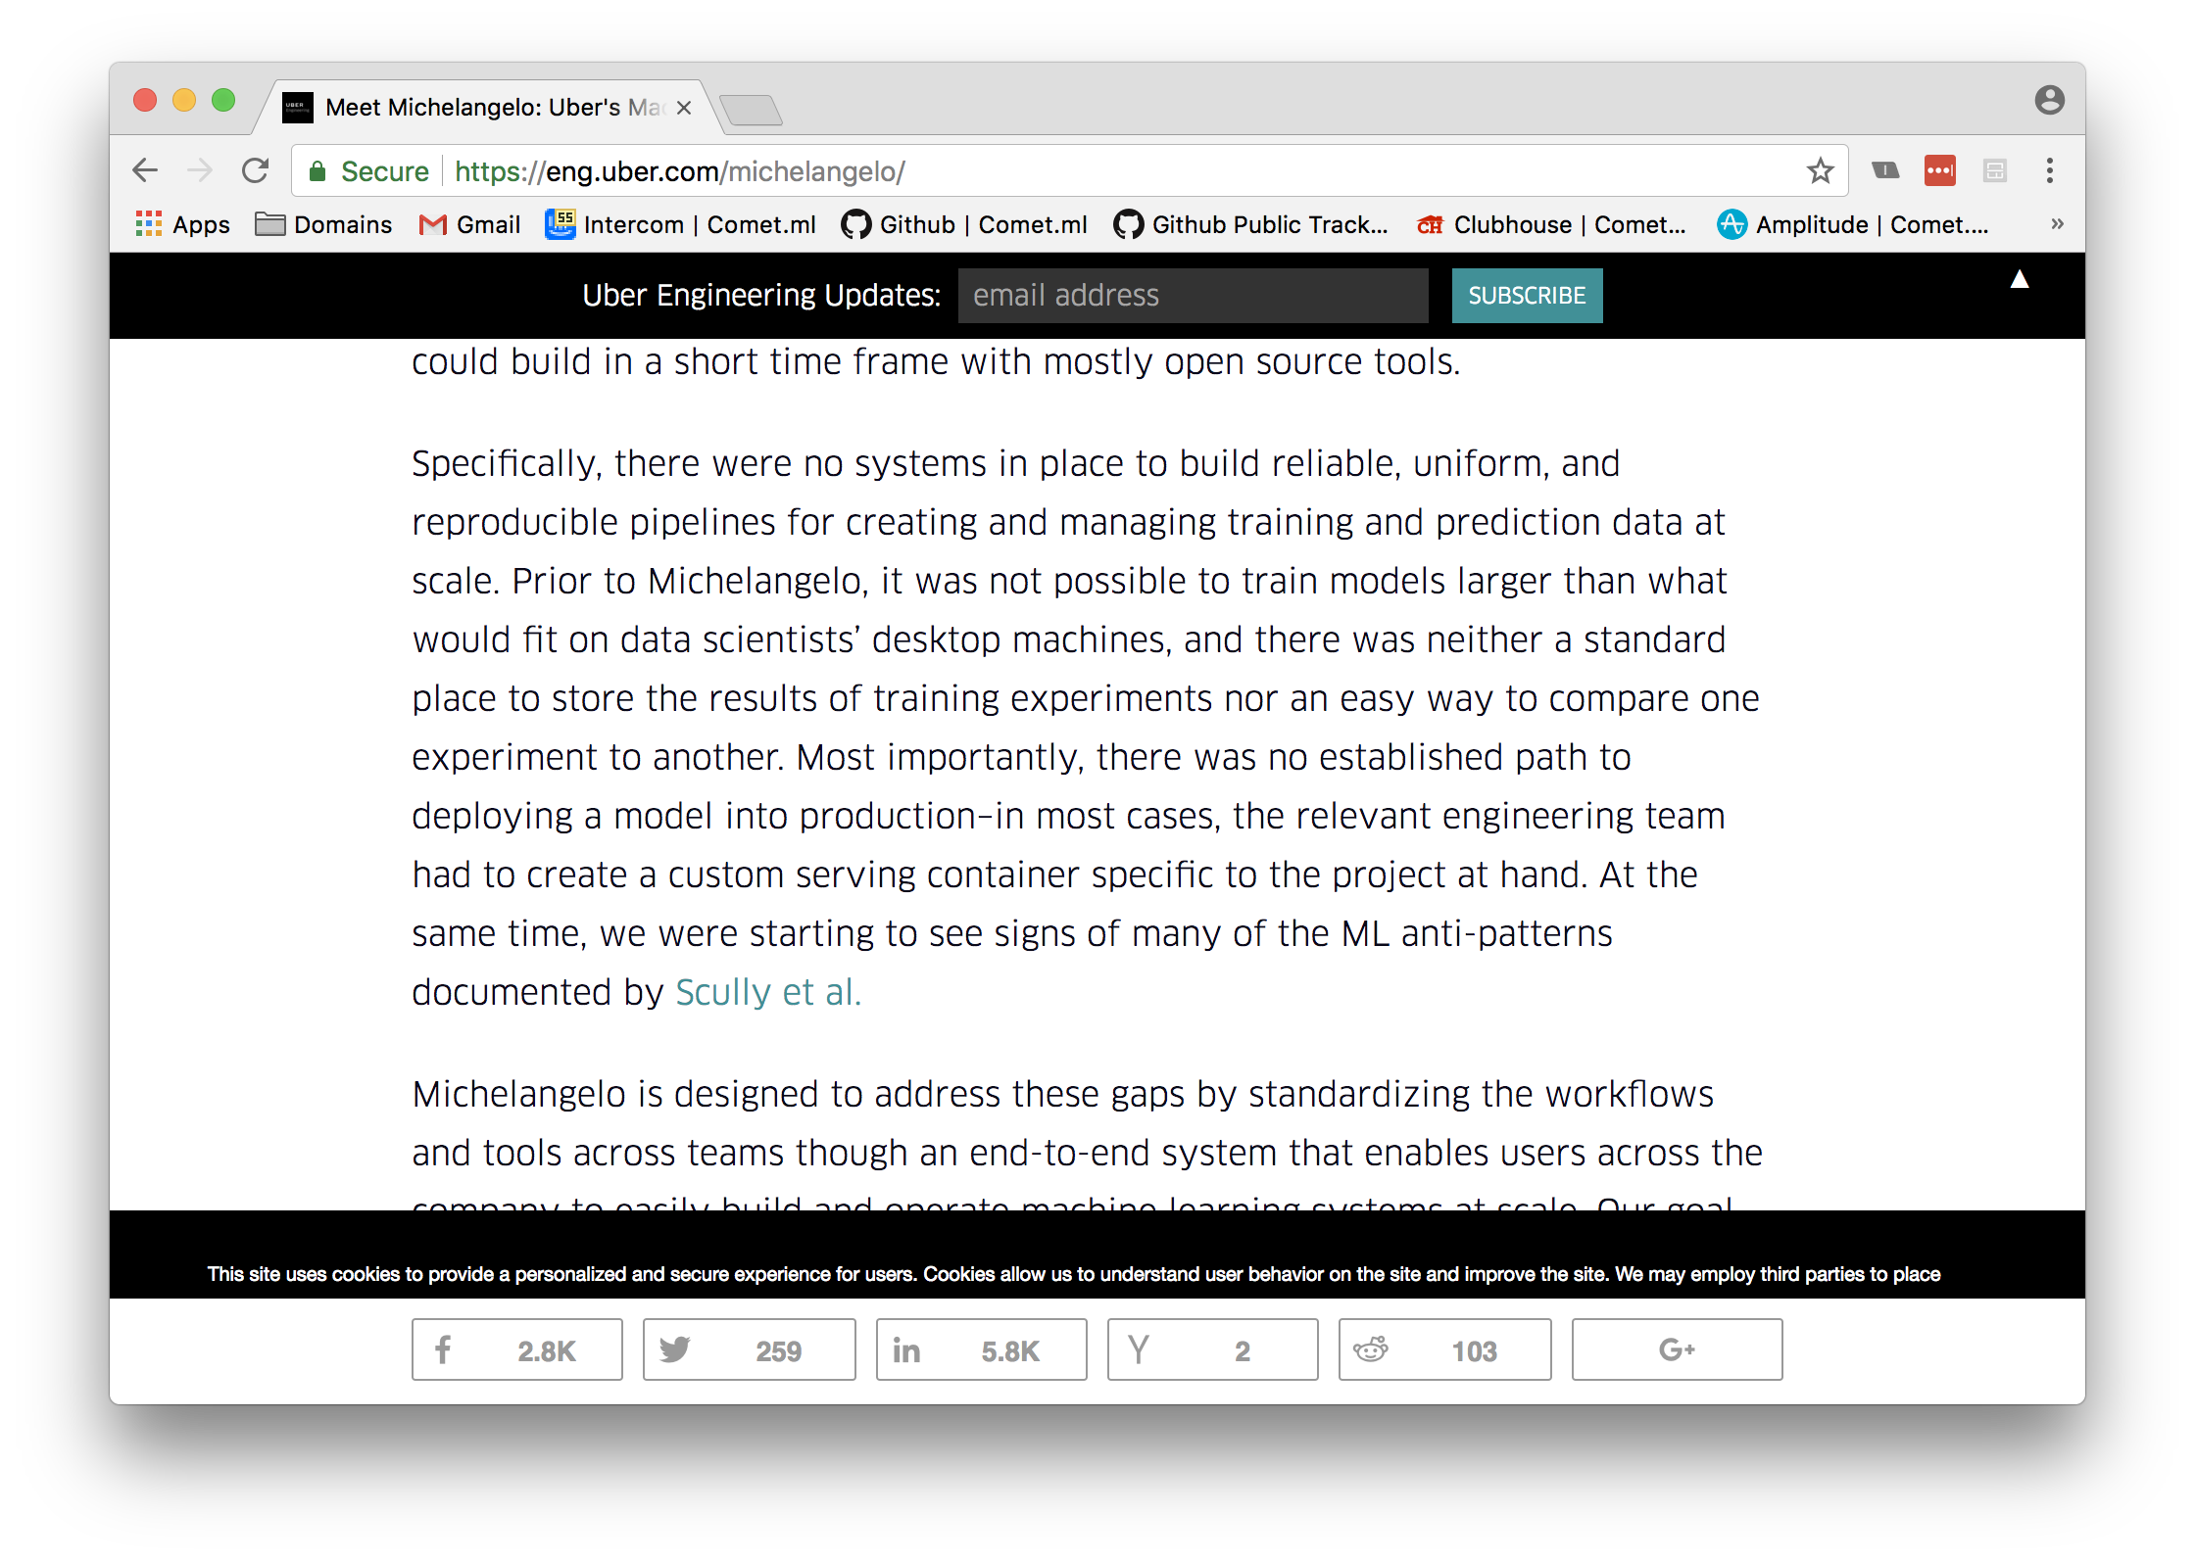
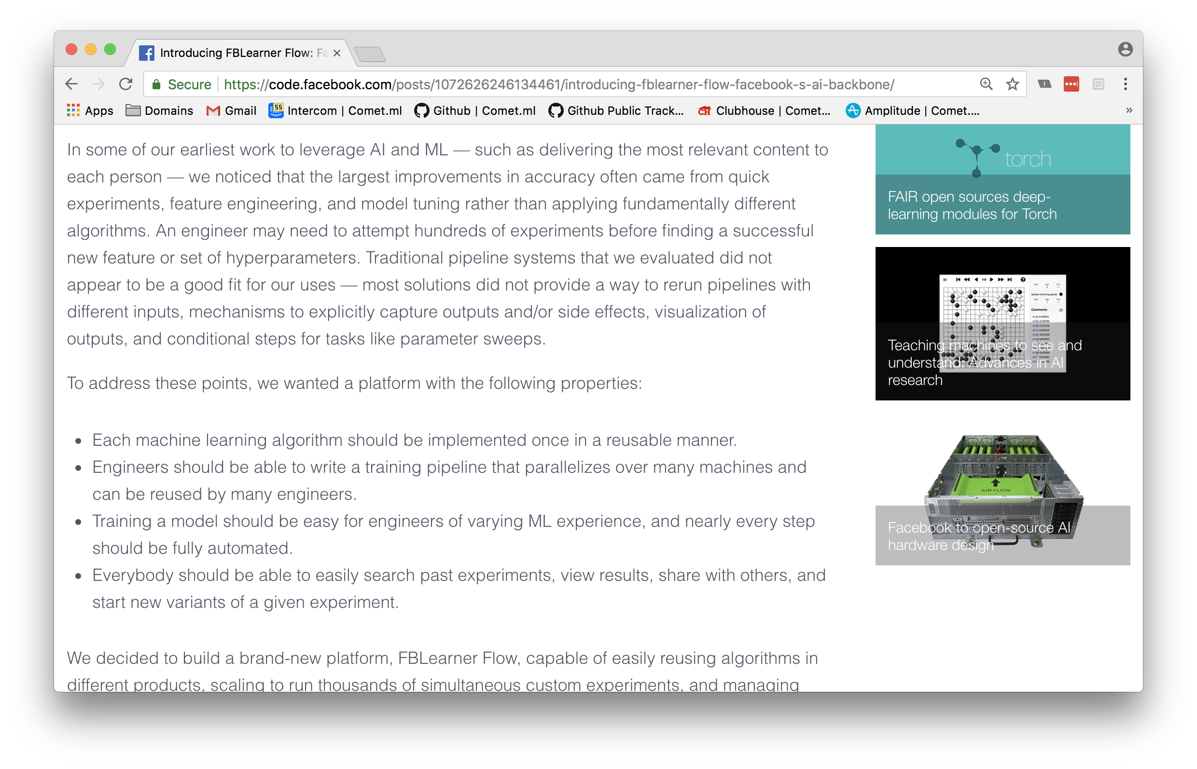
Top companies are building out internal solutions for this problem
Notes:
https://eng.uber.com/michelangelo/
https://code.facebook.com/posts/1072626246134461/introducing-fblearner-flow-facebook-s-ai-backbone/

Slide 34
In the near future, these machine learning tools and processes will become standardized.
Your adoption (or not) will impact your team’s productivity, your success with candidates, and ultimately, your company’s competitive advantage.
Notes:
** Connect back to google story
Software engineering parallel

Slide 35
Thank you for attending!
Questions?
Office Hours @ 2-2:40 PM
Email: gideon@comet-ml.com
Notes:
Mention office hours

