Slide 1
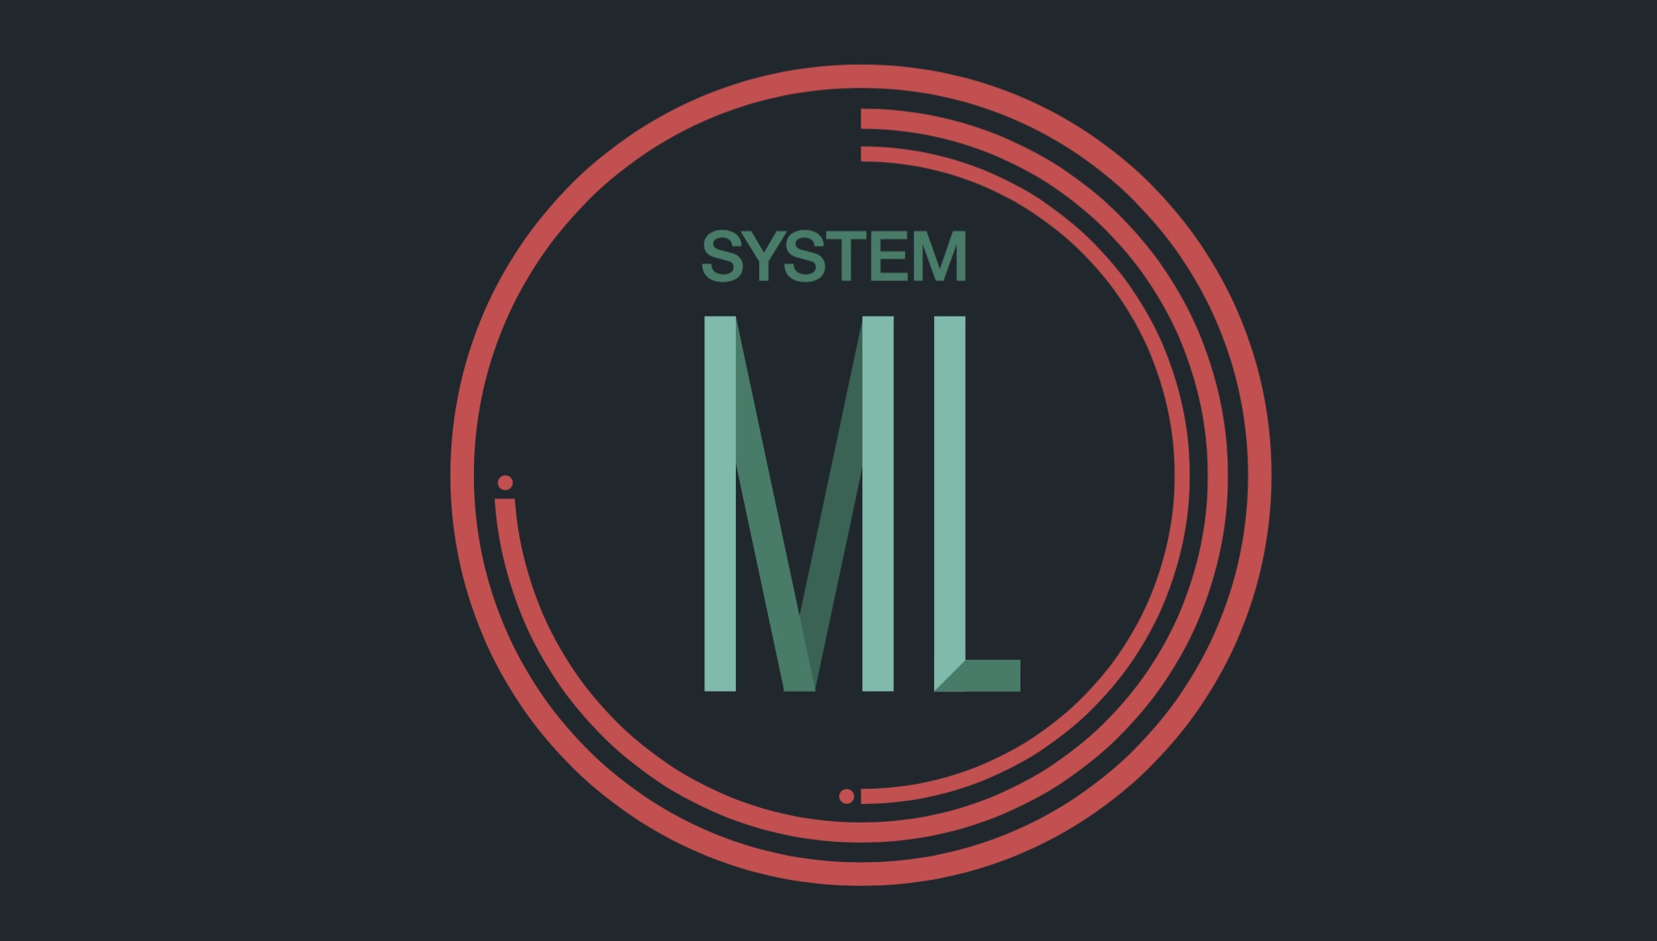
Fred Reiss, Chief Architect
Member of the IBM Academy of Technology
Accelerating Data Science
with Apache SystemML
Jerome Nilmeier
Senior Data Scientist
IBM Spark Technology Center
Speaking on behalf of the SystemML Team:

Slide 2

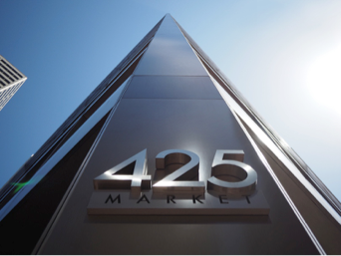
Spark Technology Center
IBM announces major commitment
to advance Apache® Spark™
…the most significant open source project of the next decade.
IBM Spark Technology Center
San Francisco
Growing pool of contributors
~100 world wide, and 3 committers
Apache SystemML now an official Apache Incubator project
Founding member of AMPLab
Founding member of Scala Center
Partnerships in the ecosystem
Notes:
A brief (8 minutes) presentation of the high level purpose of the Spark Technology Center, and the projects, contributions, and research completed and planned. Goal is to inform people who don’t understand the concrete work of the Spark Technology Center as to what we actually do.

Slide 3

Spark Technology Center Mission
Contribute intellectual and technological capital to the Spark community
Expand the core technology to make it enterprise and cloud ready
Accelerate the business value of Spark
Build data science skills to drive intelligence into business applications
Notes:
A brief (8 minutes) presentation of the high level purpose of the Spark Technology Center, and the projects, contributions, and research completed and planned. Goal is to inform people who don’t understand the concrete work of the Spark Technology Center as to what we actually do.

Slide 4
Spark Technology Center - Project Focus Areas
Machine Learning
  SystemML
  MLLib
  Spark and R
SQL
  SparkSQL Standardization
  TPC-DS scale up and scale out
Streaming
  Latency improvements
  Complex event processing
Enterprise Adoption
  Reference Application Templates
  Package management
  Sample Applications
Application Support
  Job server throughput
  Connectors

Slide 5
The SystemML Project

Slide 6
2009-2010: Through engagements with customers, we observe how data scientists create machine learning algorithms.
2007-2008: Multiple projects at IBM Research – Almaden involving machine learning on Hadoop.
2009: We form a dedicated team for scalable ML
2007
2008
2009
2010

Slide 7
Research
2011
2012
2013
2014

Slide 8
Apache SystemML
June 2015: IBM Announces open-source SystemML
November 2015: SystemML enters Apache incubation
June 2016: Second Apache release (0.10)
September 2015: Code available on Github
February 2016: First release (0.9) of Apache SystemML
2015
2016

Slide 9
Common Patterns Across Customers
Domain
Specific
Machine
Learning
Changes in feature set
Changes in data size
Algorithm customization
Quick iteration

Slide 10
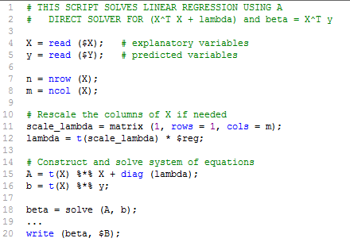
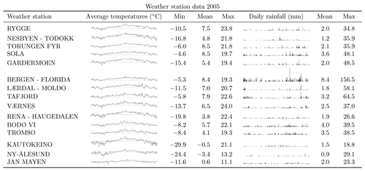
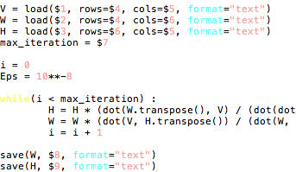


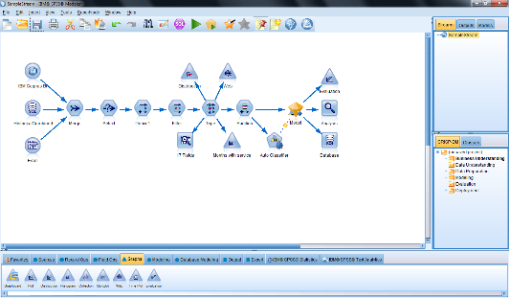
Exploratory Data Analysis Today
Data
R
R
Python
Python
Data
Scientist
Data
Scientist
Personal
Computer
Others
Others

Slide 11
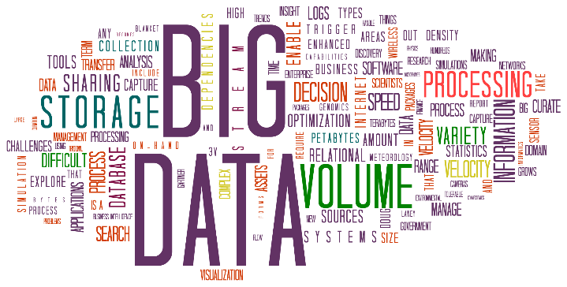
Data Analysis Meets Big Data
R
Python
Data
Scientist
Personal
Computer
Others

Slide 12
Data Analysis Meets Big Data
R
😞 Days or weeks per iteration
😞 Errors while translating algorithms
Python
Data
Scientist
Personal
Computer
Others

Slide 13






Current Best Practice for Big Data Analysis
R
Data
Scientist
Hadoop
Programmer
Python
Data
Scientist
Spark
Programmer
Others
Data
Scientist
MPI
Programmer

Slide 14
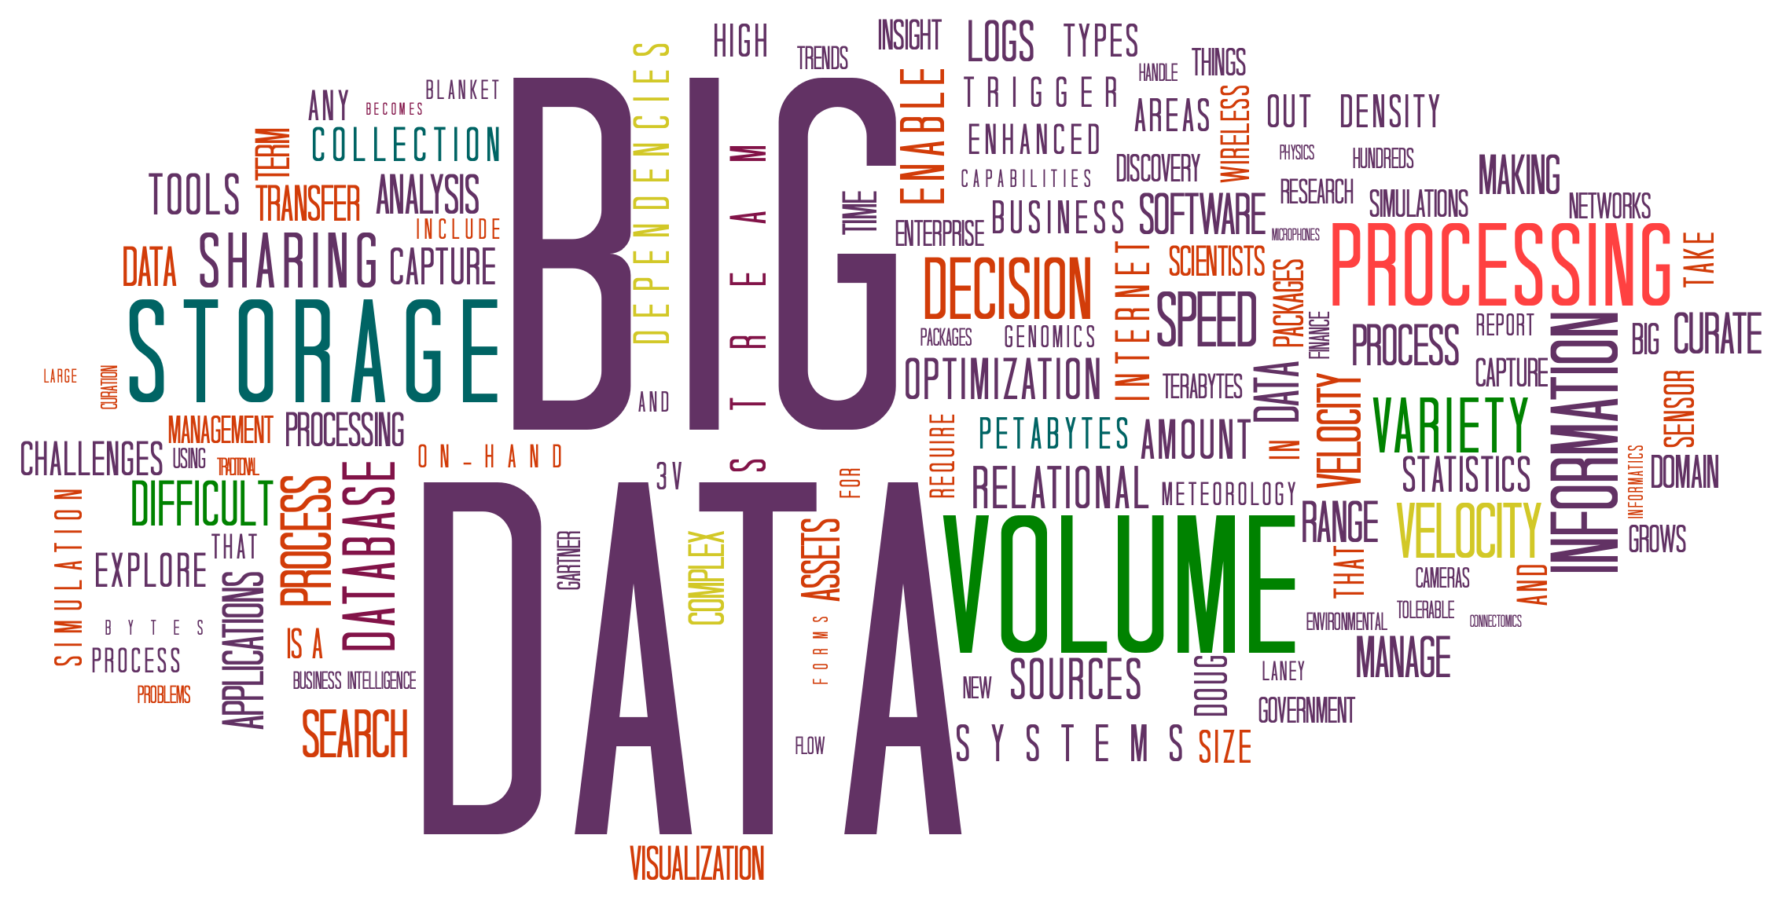
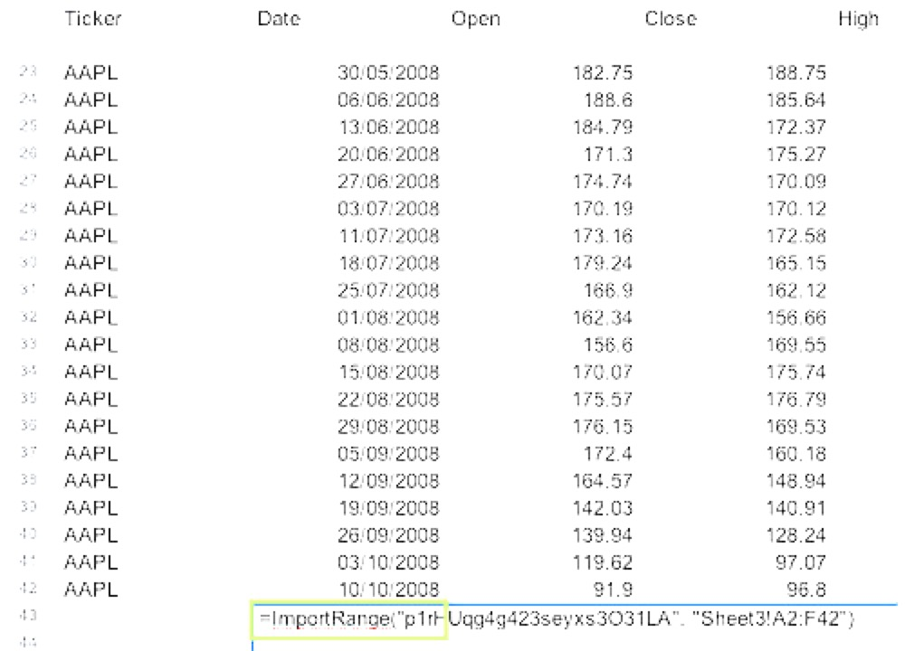
The SystemML Vision
Data
Scientist
SystemML
R or
Python
Results

Slide 15





Vision: Declarative Machine Learning
R
PC
Python
Query Optimization
Scale-up
Data
Scientist
Others
Cluster

Slide 16
Vision: Declarative Machine Learning
R
PC
Python
Query Optimization
Scale-up
Data
Scientist
Others
Cluster

Slide 17
Vision: Declarative Machine Learning
R
😃 Fast iteration
😃 Same answer
PC
Python
Query Optimization
Scale-up
Data
Scientist
Others
Cluster

Slide 18
Requirements to Support Domain-Specific ML
High-level semantics
  Understand, debug and control algorithm behavior
Flexibility
  Specify new / customize existing ML algorithms
Data independence
  Hide physical data representation
  (sparse/dense, row/column-major, blocking, partitioning, caching, compression)
Scale independence
  Use the same code during small-scale exploration and large-scale evaluation
  Pure in-memory, single node computation provides high efficiency on “small“ use cases

Slide 19




The SystemML Approach
High-level language front-ends
Cost
Based
Optimizer
High-Level Operations (HOPs)
General representation of statements in the data analysis language
Low-Level Operations (LOPs)
General representation of operations in the runtime framework
Multiple execution
environments

Slide 20
Example SystemML Rewrite: wdivmm
t(W) %*% (V/(W%*%H) + epsilon))
t(W) %*% (V/(W%*%H)))
H
V
W × H
Large dense intermediate
/
W
Can compute directly from V, W, and H!
×
t(W)
t(W)×(V/(W×H)))
Rewrite depends on:
Presence of pattern
Dimensions of operands
Sparsity of operands

Slide 21
SystemML in Action

Slide 22
A Common Scenario
Start with a textbook problem that has a textbook solution.
Make a small change to the problem.
Suddenly the textbook solution no longer works.

Slide 23
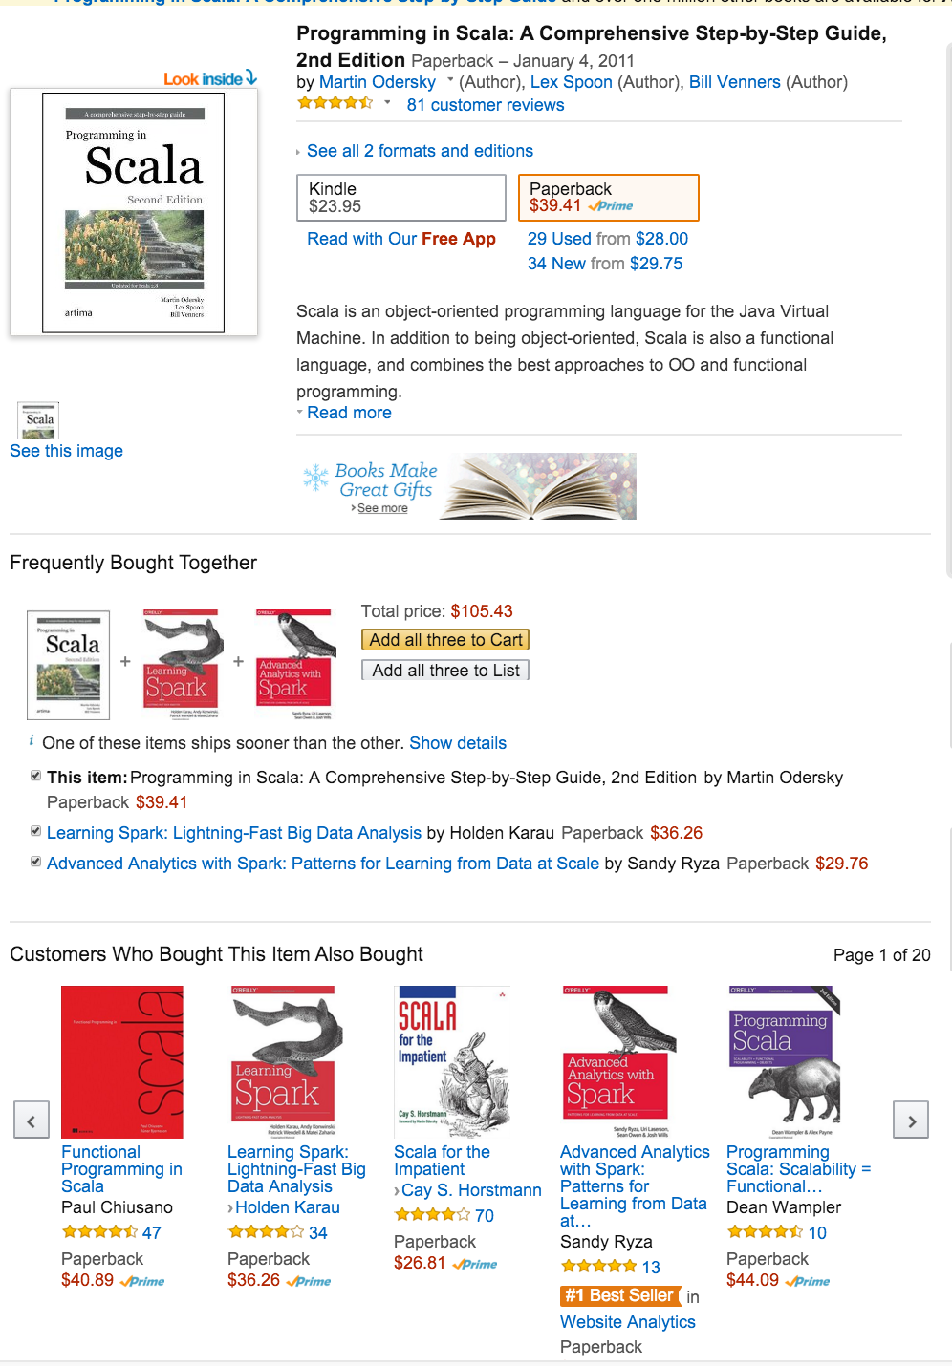
Product Recommendations

Slide 25
Alternating Least Squares (in R)
U = rand(nrow(X), r, min = -1.0, max = 1.0);
V = rand(r, ncol(X), min = -1.0, max = 1.0);
while(i < mi) {
i = i + 1; ii = 1;
if (is_U)
G = (W * (U %*% V - X)) %*% t(V) + lambda * U;
else
G = t(U) %*% (W * (U %*% V - X)) + lambda * V;
norm_G2 = sum(G ^ 2); norm_R2 = norm_G2;
R = -G; S = R;
while(norm_R2 > 10E-9 * norm_G2 & ii <= mii) {
if (is_U) {
HS = (W * (S %*% V)) %*% t(V) + lambda * S;
alpha = norm_R2 / sum (S * HS);
U = U + alpha * S;
} else {
HS = t(U) %*% (W * (U %*% S)) + lambda * S;
alpha = norm_R2 / sum (S * HS);
V = V + alpha * S;
}
R = R - alpha * HS;
old_norm_R2 = norm_R2; norm_R2 = sum(R ^ 2);
S = R + (norm_R2 / old_norm_R2) * S;
ii = ii + 1;
}
is_U = ! is_U;
}
SystemML can compile and run this algorithm at scale
No additional performance code needed!
Notes:
And we are done, no changes are required
We can compile and run this program on top of Spark, at Scale, in Parallel
No additional performance code is necessary
And we can run on small data, big data, medium data
Laptop, clusters, and anywhere in between
And we can quickly iterate to solutions
At this point, the question that typically comes up is, yes you can compile, you can run at scale…. But is it going to be fast ? Is the speed going to be comparable with what you would get with that 800 line implementation of the algorithm in a low level language ?
----
Subset of R
Basic operation around linear algebra primitives, matrixes, vectors, scalars, limited string operations and core utility functions like rowsum, colsum
What is not available are the 3rd party libraries, particularly the ones that are implemented in C
In summary you will need to write algorithym in R using linear algebra primitives today

Slide 26
Alternating Least Squares (in R)
U = rand(nrow(X), r, min = -1.0, max = 1.0);
V = rand(r, ncol(X), min = -1.0, max = 1.0);
while(i < mi) {
i = i + 1; ii = 1;
if (is_U)
G = (W * (U %*% V - X)) %*% t(V) + lambda * U;
else
G = t(U) %*% (W * (U %*% V - X)) + lambda * V;
norm_G2 = sum(G ^ 2); norm_R2 = norm_G2;
R = -G; S = R;
while(norm_R2 > 10E-9 * norm_G2 & ii <= mii) {
if (is_U) {
HS = (W * (S %*% V)) %*% t(V) + lambda * S;
alpha = norm_R2 / sum (S * HS);
U = U + alpha * S;
} else {
HS = t(U) %*% (W * (U %*% S)) + lambda * S;
alpha = norm_R2 / sum (S * HS);
V = V + alpha * S;
}
R = R - alpha * HS;
old_norm_R2 = norm_R2; norm_R2 = sum(R ^ 2);
S = R + (norm_R2 / old_norm_R2) * S;
ii = ii + 1;
}
is_U = ! is_U;
}
1
Start with random factors.
Hold the Movies factor constant and find the best value for the Users factor.
(Value that most closely approximates the original matrix)
Hold the Users factor constant and find the best value for the Movies factor.
Repeat steps 2-3 until convergence.
4
2
3
4
2
3
4
Every line has a clear purpose!
Notes:
Note that we have been highlighting the regions of the script as we go trough the steps
And the key thing to note here is that except for some curly braces, every single script line has it’s clear purpose.
This is because high level languages like R or Python are a really good way to describe these algorithms, they are concise and yet they maintain all the important semantic details
Contrast this kind of concise representation with what you get when you implement this with a low level api such as Spark RDDs
Next Slide

Slide 27
Performance Comparison: ALS
>24h
>24h
OOM
OOM
Details:
Synthetic data, 0.01 sparsity, 10^5 products × {10^5,10^6,10^7} users. Data generated by multiplying two rank-50 matrices of normally-distributed data, sampling from the resulting product, then adding Gaussian noise. Cluster of 6 servers with 12 cores and 96GB of memory per server. Number of iterations tuned so that all algorithms produce comparable result quality.
Notes:
Systemic Data set so we can control problem characteristic and the problem size very precisely
We generated three different data sets :
Small -> was sized so that the problem, the matrix once it’s unpacked into memory, fit very well in one machine
Medium -> was sized so that you need the entire memory of our 6 node spark cluster to fit the problem into memory
Large -> was sized so that data that represents the problem you would spill out of memory, and you need to go to disk be able to run ALS for that large data set
And we compared three different systems, running two different algorithms
R and SystemML -> running the algorithm from previous slides
MLLib running the high performance implementation of ALS in Spark ML
And we were measuring time to converging
First the results from R , Second MLLIb then SystemML

Slide 28
A Slightly Different Problem
Build a product co-purchasing matrix.
Complete this matrix to find suggested product pairings.
Top Factor
×
Multiply these two factors to produce a less-sparse matrix.
Products
j
How often product i bought after product j.
i
Left Factor
Products
New nonzero values become product pairing suggestions.

Slide 29
Poisson Nonnegative Matrix Factorization in R
H
i = 0
while(i < max_iterations) {
H = (H * (t(W) %*% (V/(W%*%H + epsilon))))
/ (t(matrix(colSums(W),nrow=1))
%*% matrix(rep(1,m),nrow=1))
W = (W * ((V/(W%*%H + epsilon )) %*% t(H)))
/ (matrix(rep(1,n),nrow=n)
%*%t(matrix(rowSums(H),nrow=rank)))
i = i + 1;
}
V
W

Slide 30
Result Quality
No answers for remaining 380,000 products

Slide 31
State of the Art
This is where we would normally bring in a Spark expert.
We’d have the expert implement efficient parallel Poisson Nonnegative Matrix Factorization on Spark.
What happens if we have SystemML?

Slide 32
Poisson Nonnegative Matrix Factorization in R
H
i = 0
while(i < max_iterations) {
H = (H * (t(W) %*% (V/(W%*%H + epsilon))))
/ (t(matrix(colSums(W),nrow=1))
%*% matrix(rep(1,m),nrow=1))
W = (W * ((V/(W%*%H + epsilon )) %*% t(H)))
/ (matrix(rep(1,n),nrow=n)
%*%t(matrix(rowSums(H),nrow=rank)))
i = i + 1;
}
V
W

Slide 33
Poisson Nonnegative Matrix Factorization in
SystemML’s R-like Syntax
H
i = 0
while(i < max_iterations) {
H = (H * (t(W) %*% (V/(W%*%H + epsilon))))
/ t(colSums(W))
W = (W * ((V/(W%*%H) + epsilon) %*% t(H)))
/
t(rowSums(H))
i = i + 1;
}
V
W
Can directly divide a matrix by a row vector.

Slide 34
Scalability Comparison

Slide 35
Scalability Comparison, Continued

Slide 36
Result Quality

Slide 37
Summary
Slight variant of a textbook problem.
Canned library algorithm ➔ Poor model quality.
Custom algorithm in R ➔ Poor scalability.
Custom algorithm with SystemML ➔ Quality and scalability.
How about using SystemML from the beginning?

Slide 38
End-to-End Development with SystemML
SystemML supports all phases of algorithm development.
  Runs well on laptops and individual servers, as well as Spark and Hadoop clusters.
  Integrated debugger for ensuring correctness.
  Built-in utilities for scalable data transformation.
  Built-in performance measurement tools.
SystemML ships with many algorithms.
  Implemented in SystemML’s high-level language.
  Suitable substitutes for a low-level ML library in many cases.
  Useful as example code for customizing or building new algorithms.

Slide 39
Learn More about SystemML’s Optimizer
Lots of additional material available!
Recording of a 1-hour meetup talk:
https://youtu.be/PV-5pZboo4A
Journal paper:
http://sites.computer.org/debull/A14sept/p52.pdf
Source code:
https://github.com/apache/incubator-systemml

Slide 40
  What’s Next for SystemML

Slide 41
Open-Sourcing SystemML
SystemML is open source!
  Announced in June 2015
  Available on Github since September 1
  First open-source binary release (0.8.0) in October 2015
  Entered Apache incubation in November 2015
  First Apache open-source binary release (0.9) in progress
We are actively seeking contributors and users!

Slide 42
SystemML on Spark
Spark backend for SystemML
  Original system used Hadoop MapReduce
  Take advantage of caching, faster scheduling
  Hybrid backend: Automatically shift computation between driver and executors
Project status: Spark backend
  Started late 2014
  Spark backend shipped with SystemML 0.8.0 in late 2015
  Performance improvements in SystemML 0.9.0, shipped in February 2016
  Research paper under submission with detailed performance comparisons
Contributing SystemML technology to Apache Spark
  Ongoing discussions
  2016 goal: connect SystemML linear algebra primitives to Spark MLLib

Slide 43
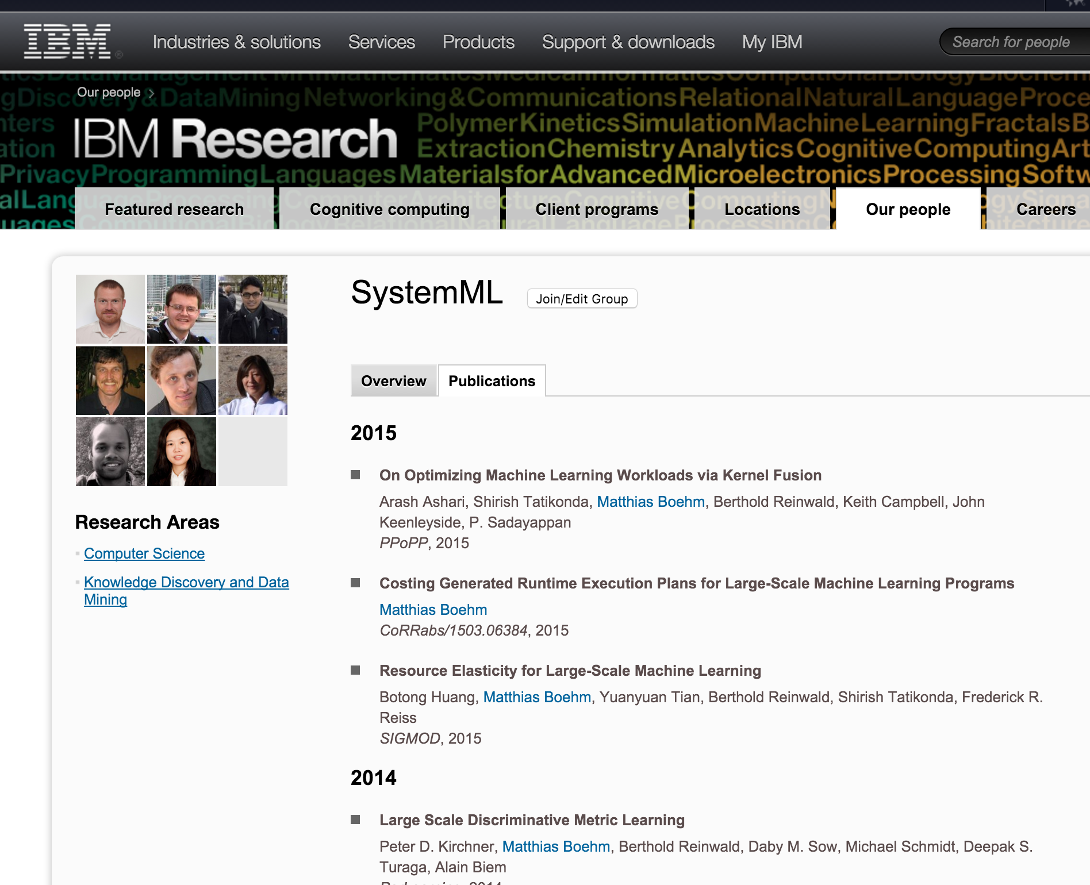
Ongoing Research around SystemML
  http://researcher.watson.ibm.com/researcher/view_group.php?id=3174

Slide 44
Thank you!
For more information:
  IBM Spark Technology Center web site:
  http://spark.tc
  Apache SystemML home page:
  http://systemml.apache.org
  Apache SystemML Git repository:
  https://github.com/apache/incubator-systemml

