Slide 1
COMPUTATIONAL SOCIAL SCIENCE: EXCITING PROGRESS AND FUTURE CHALLENGES
Duncan J. Watts
Microsoft Research

Slide 2
What Makes Social Science “Social”?
Social phenomena arise when individuals interact to produce collective behavior
Networks → Emergence (aka “Micro-Macro” problem)
Social phenomena are hard to study empirically
Difficult to collect observational data about individuals, networks, and populations at same time
Even more difficult to do “macro” scale experiments
Hard to do science when you can’t measure what you care about and can’t do experiments

Slide 3
Rise of Computational Social Science
Web is lifting these historical barriers
Dramatic increase in the scale, scope and granularity of data
Email, e-commerce, search, social networking, social media, etc.
Web platforms also increasing the speed and scale of experiments
Traditional lab-style experiments + Field experiments
Result is a new field emerging at the intersection of social and computational sciences
“Computational Social Science” (Lazer et al 2009)

Slide 4
Outline for Rest of Talk
Will illustrate CSS with two types of examples
Social contagion using “big data”
Collective problem solving using “small data” from virtual labs
Research motivated by old questions but brings new capabilities to bear
Research also highlights some challenges for CSS

Slide 5
Social contagion using “big Data”

Slide 6
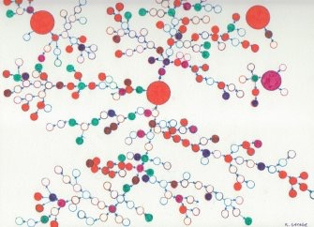
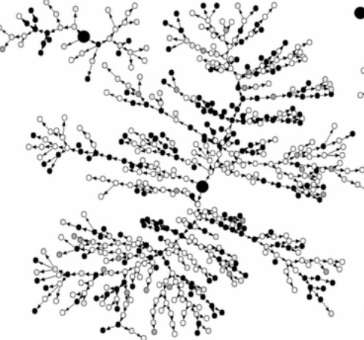
Mental Model of Contagion
“Contagion” implies large, multi-step, peer to peer spread
(aka “Diffusion,” “Going Viral,” “Social epidemics,” etc.)
Notes:
Explain RDS

Slide 7
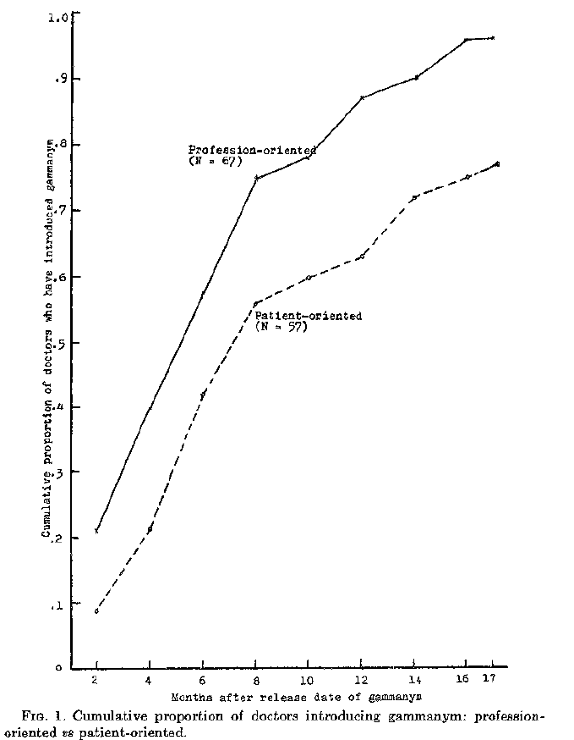
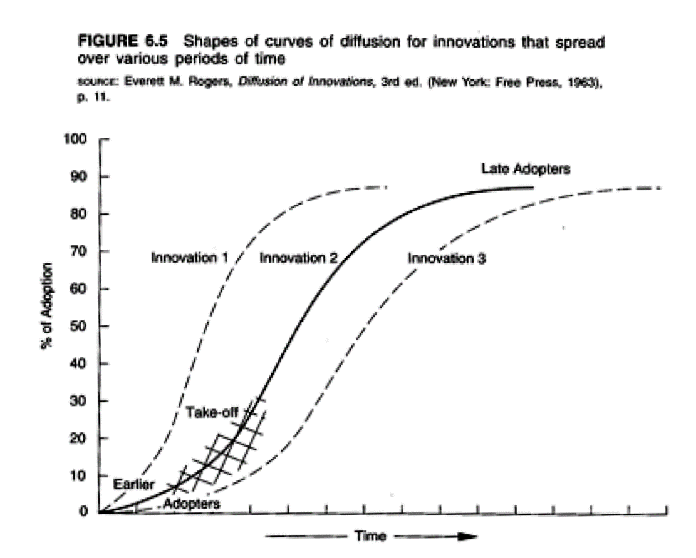
But Diffusion Data Often Looks Like This
Coleman, Katz, and Menzel (1957)
Rogers (1963)
“S-shaped curve” interpreted as evidence of contagion

Slide 8
Two Problems with S-Shaped Curves
1. Could result from many processes
Population heterogeneity (Chatterjee & Eliashberg, 1990)
Marketing efforts (Van den Bulte & Lilien, 2001)
2. Typically collected only for “successful” diffusion events
Many (most) attempts at diffusion fail
To understand the mechanisms of social contagion, need:
Individual-level (i.e. person-to-person) observations
Unsuccessful “attempts” as well as successes

Slide 9
Web Potentially Resolves Both Problems
Individual-level diffusion data now available online
Epidemics in Blog Space (Adar and Adam, 05)
Cascades of recommendations (Leskovec et al, 06, 07)
Transmission of Gestures in 2nd Life (Baksy et al, 09)
Diffusion of fan pages on Facebook (Sun et al, 09)
Diffusion of Tweets on Twitter (Bakshy et al, 11)
Questions:
How much diffusion is “viral”?
What does viral diffusion look like?

Slide 10
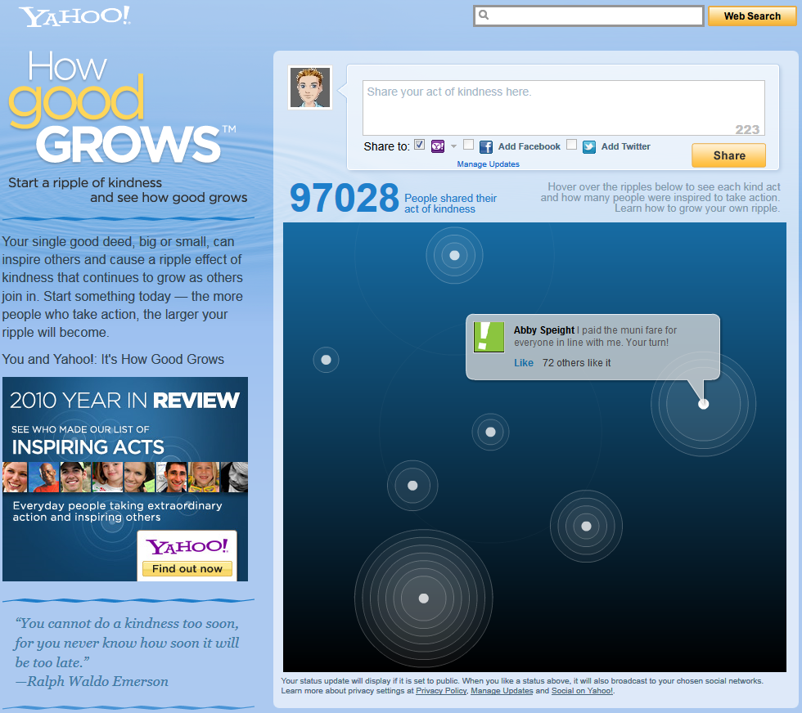
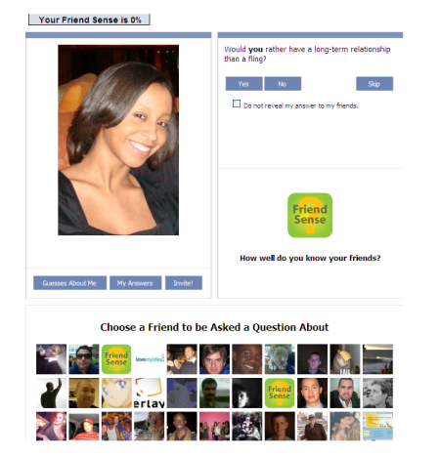
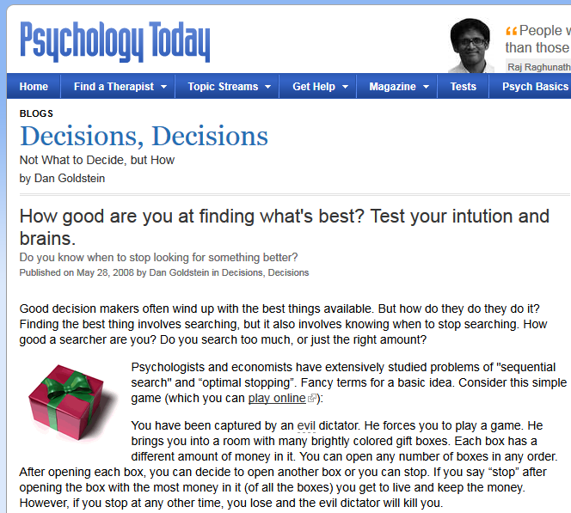
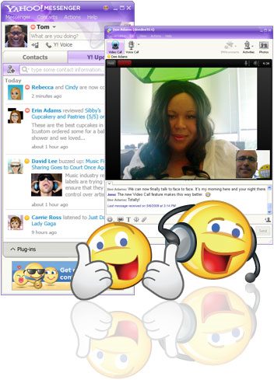
Online Diffusion Project Goel, Watts, Goldstein (EC, 2012)
Six unrelated projects, conducted over the past few years, all of which were in some way designed to “go viral”

Slide 11
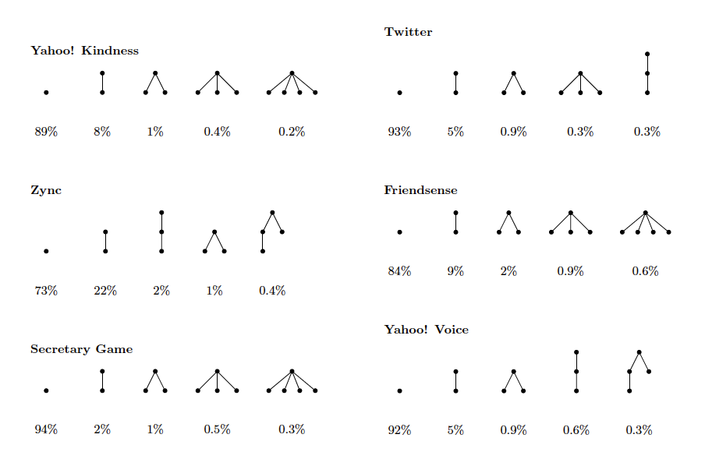
Almost all diffusion looks like this:

Slide 12
Not much “viral” in viral spreading
~ 99% of events involve ≤ two “viral” adoptions
~ 99% of adoptions are ≤ one hop from the seed

Slide 13
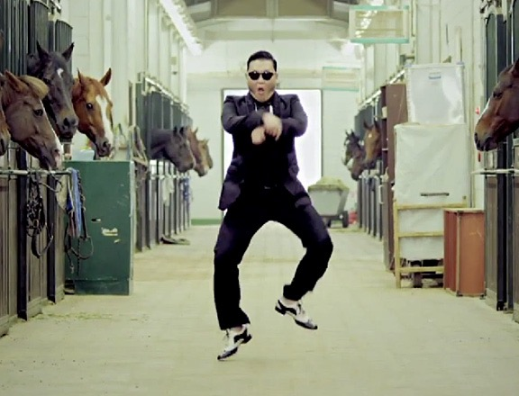
But still, what about those big events?

Slide 14
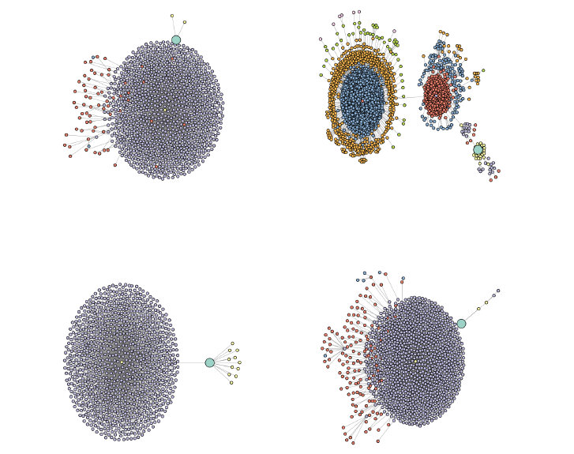
Viral or just Popular?

Slide 15
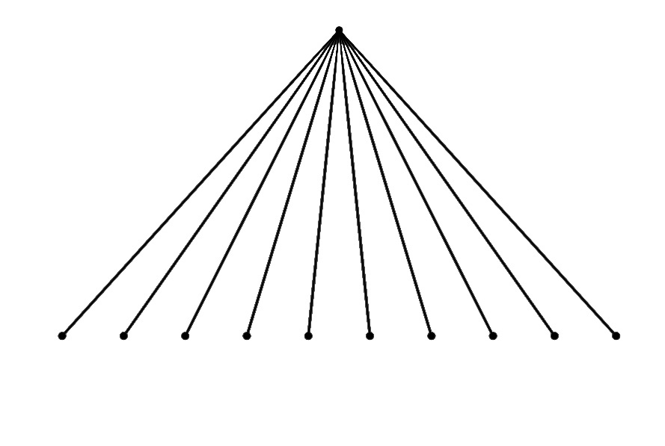
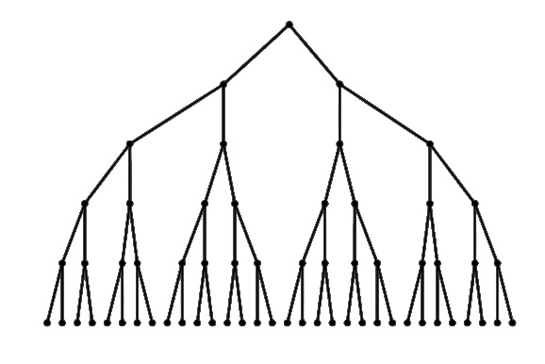
“Structural Virality” Project Goel, Anderson, Hofman, Watts (Man Sci, 2015)
Every video, news story, image, or petition posted to Twitter over 12 months (1.4 B observations)
Restrict to “popular” cascades (> 100 RTs; ~350K events)
For each event, can quantity its“structural virality”
Average Pairwise Shortest Path Length
Ranges from
≈2 (“broadcast”)
~log(N) (“viral”)
For these “popular” events can ask:
What diversity do we see with respect to structure?
What is the relationship between size and structural virality?
“Broadcast”
“Viral”

Slide 16
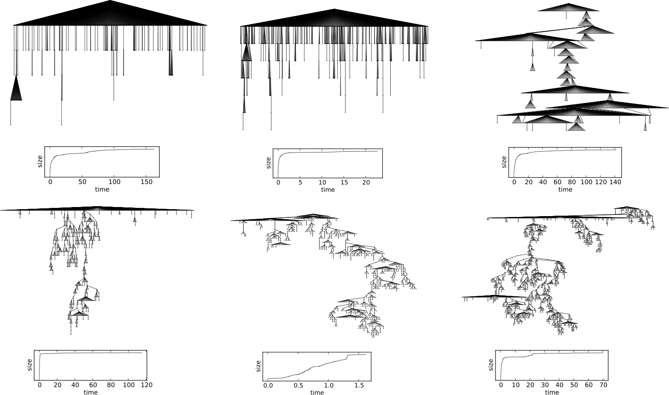
Diversity of Structural Virality

Slide 17
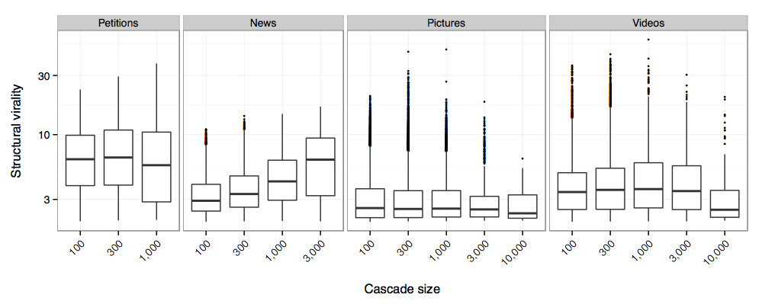
Popular ≠ Viral
Popularity driven mostly by the size of the largest broadcast

Slide 18
Theoretical Insights from “Big Data”
Contagion studies focus on triggering “social epidemics”
Exponential growth from a small “seed” (possibly just one person)
Our work suggests that epidemic analogy is misleading
Most contagion comprises small events within one step of seed
Largest events exhibit “dying out” boosted by occasional hub
Suggests new directions both for modeling and marketing
In social media ecosystems mass media remains critical
Also an example of where “big data” helps
For rare events, may actually need a billion observations

Slide 19
Virtual labs

Slide 20
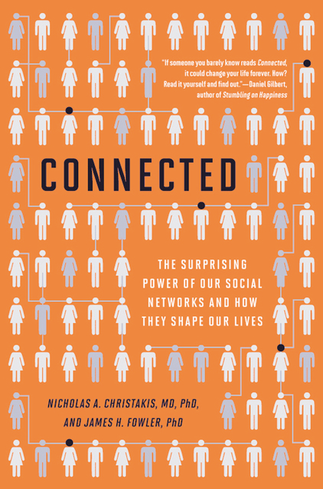
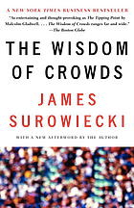
Team Problem Solving
What is the relation between team size and performance?
Bigger is better…
Division of Labor
Returns to specialization
Learning from others
…Except when it is worse
Free Riding / Social Loafing
Herding / Group Think
Coordination overhead
Hard to resolve with observational data
Need to do experiments!

Slide 21
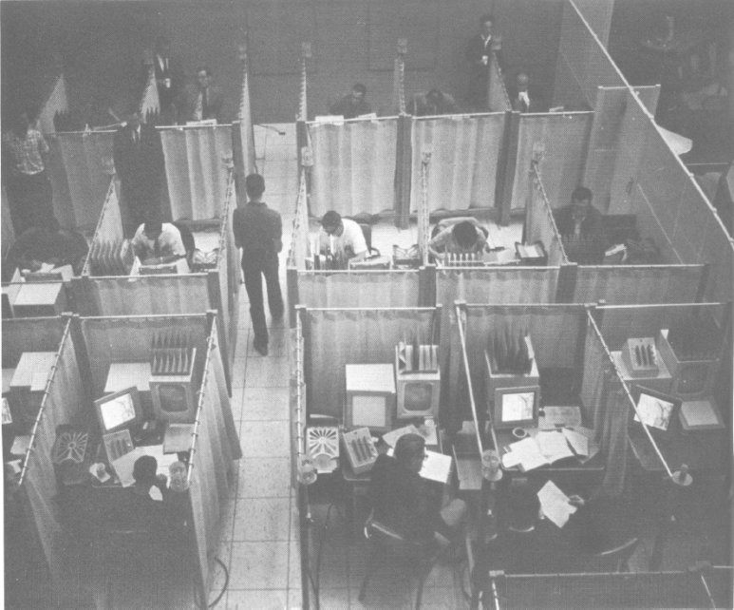
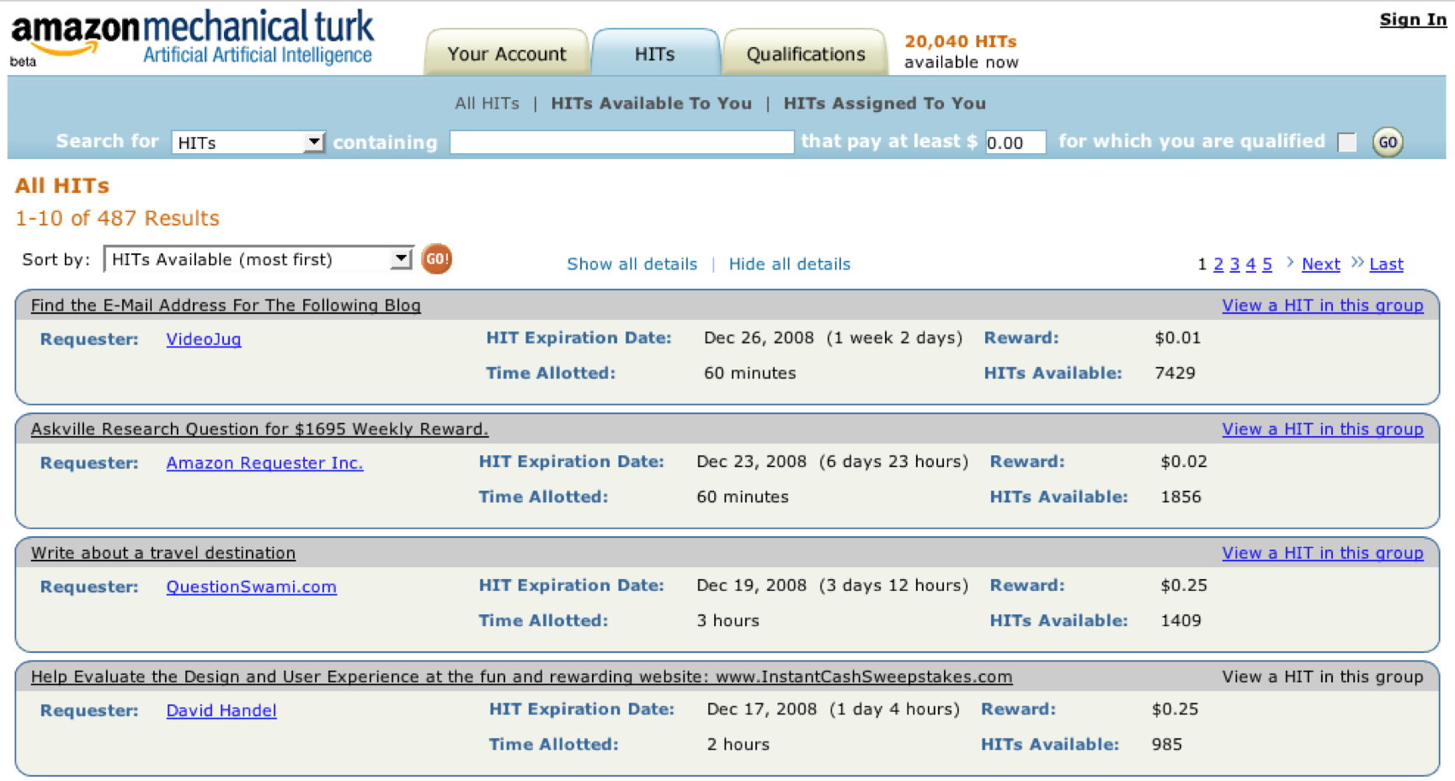
A “Virtual Lab” For Behavioral Experiments
Amazon Mechanical Turk started in 2005
Since developed into generic “crowd-sourcing” site
Now also a platform for recruiting and paying subjects
Hundreds of behavioral experiments since 2008
Notes:
“Requestors” post tasks called HITS
“Turkers” accept individual HITs
Payment is piece rate

Slide 22
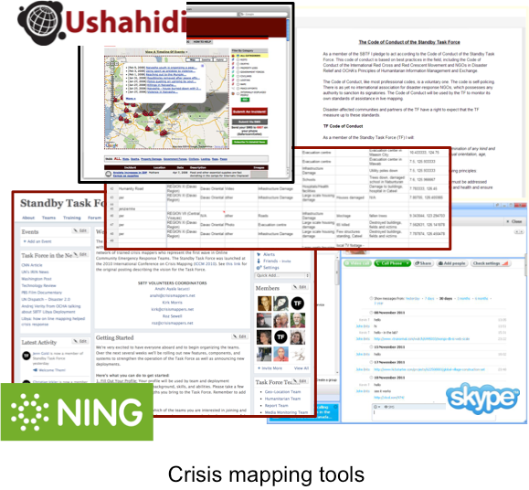
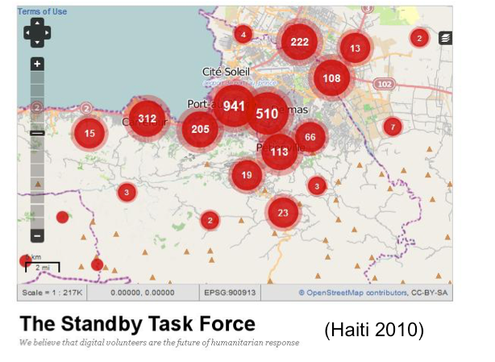
Crisis Mapping as “Model Problem”
A real task, natively online, simple yet “complex”

Slide 23
Crisis Mapping in the Lab Mao, Mason, Suri, Watts (PLoS One, 2016)

Slide 24
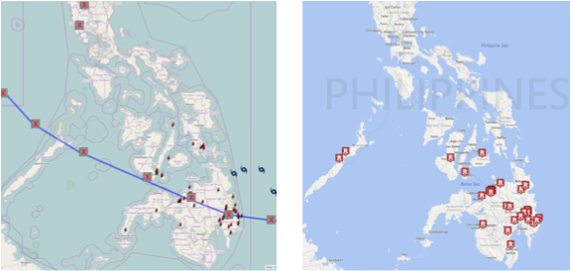
Field vs. Lab
SBTF: 18-32 volunteers
Over 12 hours, Dec 2012
Experiment:16 “Turkers”
Over 1 Hour, Aug 2014
SBTF, 2012
Team of 16 people in 1 hour
SBTF, 2012
Team of 16 people in 1 hour

Slide 25
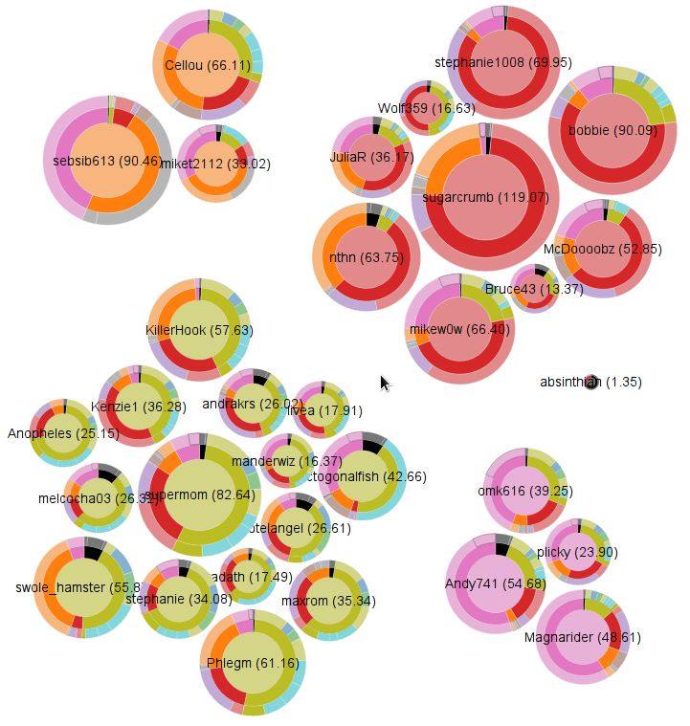
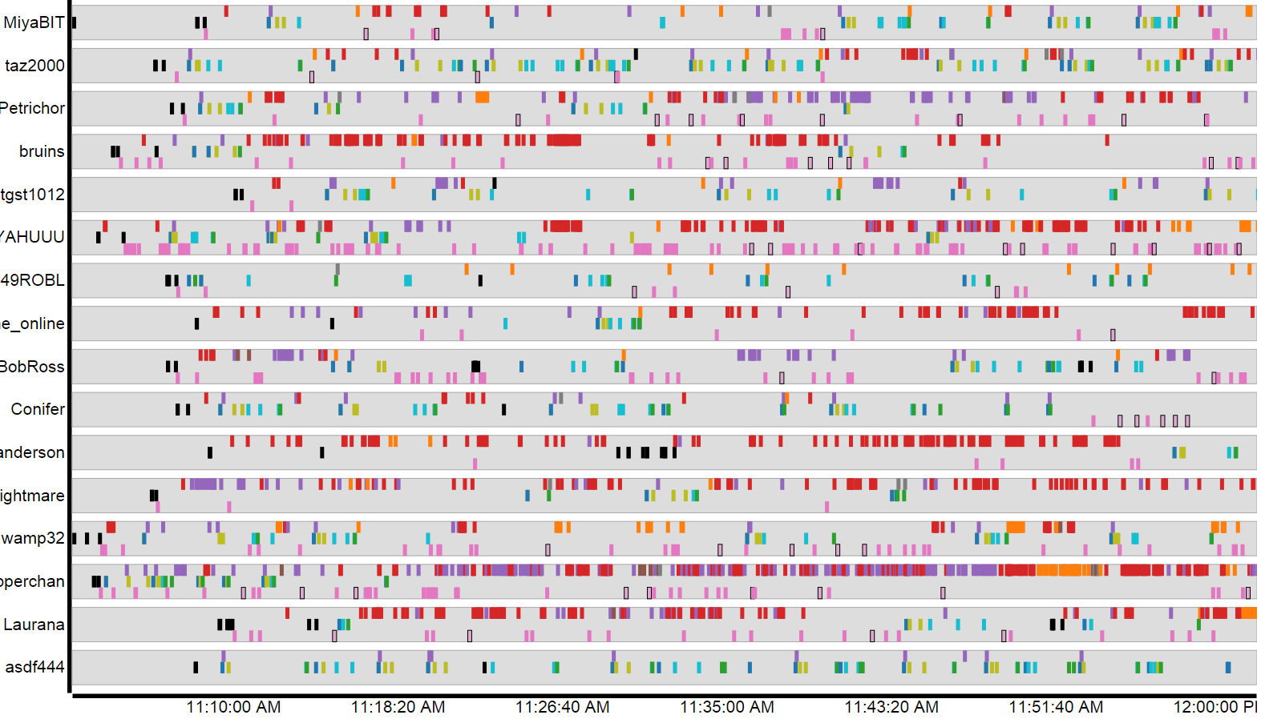
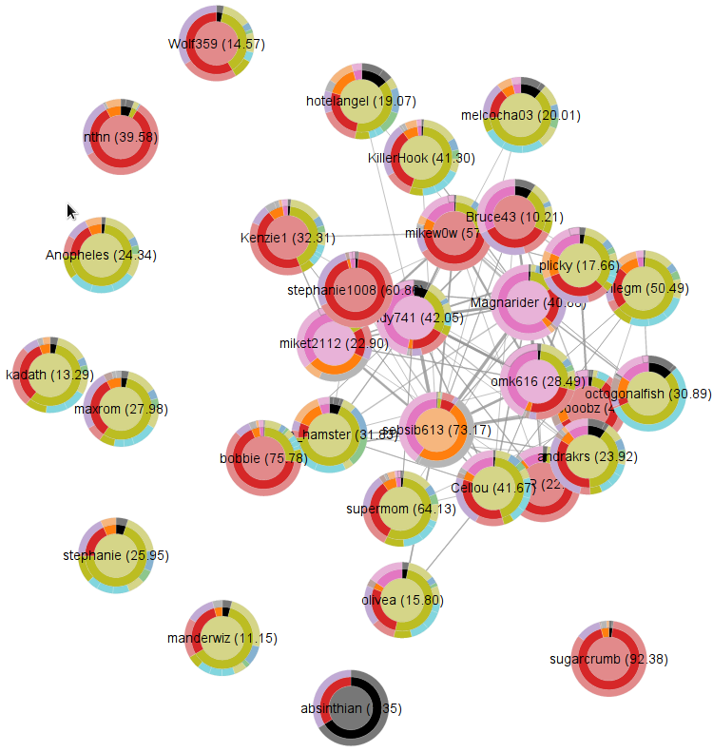
Highly Instrumented Environment
Division of labor
Filter |  | Check | Verify
Edit | Classify | Geolocate |  | Save
Chat |  | Directed Chat
Communication network
Notes:
If we take all the actions that people do and break them into broad categories, this is what it looks like

Slide 26
Experiment setup
Users trained on the task with an interactive tutorial
Experiment sessions with randomized assignment to groups of different sizes
Each group allowed 1 hour to work together
Payment based on individual effort and group performance
Group Size | # Groups | # Individuals
1 | 18 | 21
2 | 11 | 22
4 | 6 | 24
8 | 4 | 31
16 | 4 | 59
32 | 4 | 123
Total | 47 | 280
Notes:
Randomized to different groups
Every group allowed 1 hour to work together
Self organized – only what to do, not how to do it
Payment gives people incentive to help their team

Slide 27
Quantifying team performance
Construct “gold standard” map
Combine maps from all groups
De-duplicate event reports and hand check for validity
Measure group accuracy versus gold standard
Precision (P[event reported by group is in GS])
Recall (P[event in GS is reported by group])
F₁ score ( 2×P×R/(P+R) )
Since both false positives (incorrect reports) and false negatives (overlooked reports) matter, focus on F1 score
Notes:
First we have to quantify the performance of teams
We first construct the gold standard
Since both false positives (incorrect reports) and false negatives (overlooked reports) matter, focus on F1 score

Slide 28
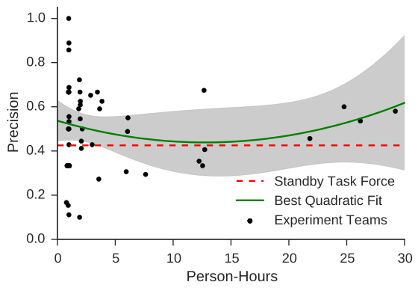
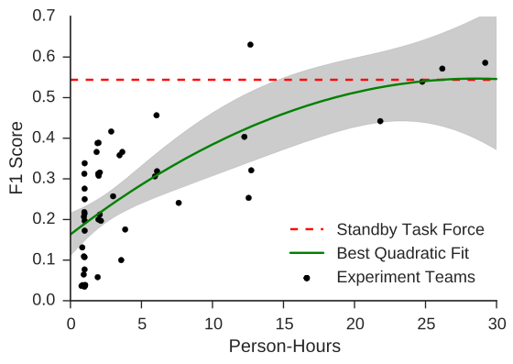
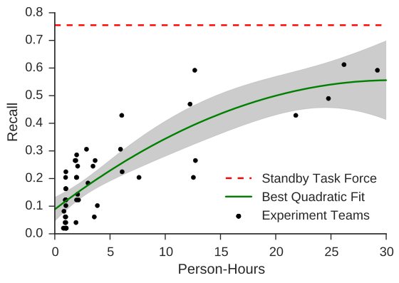
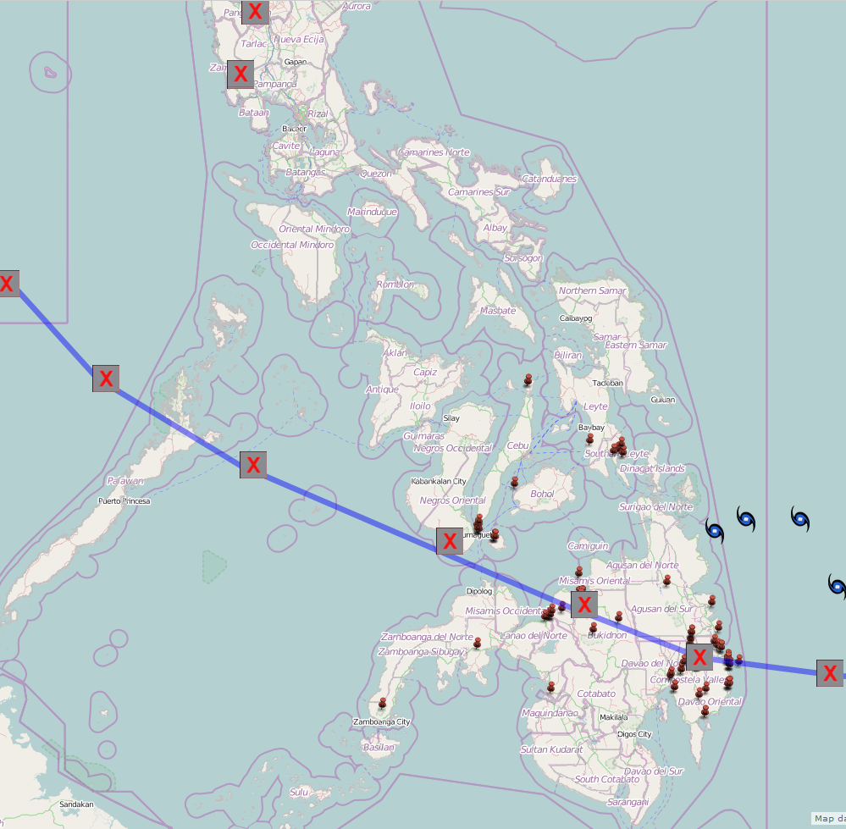
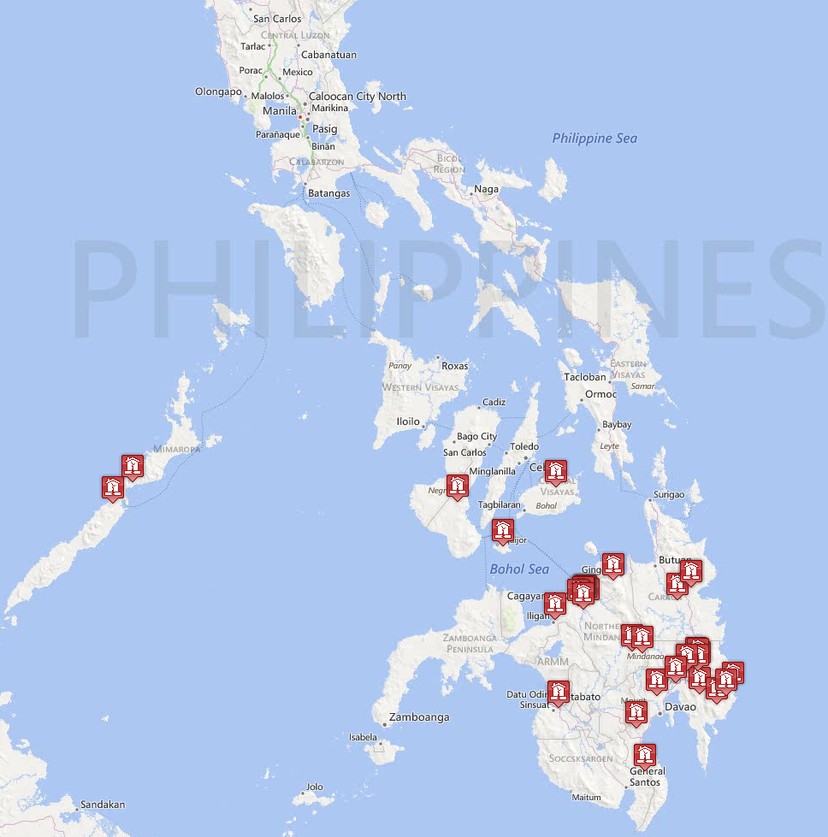
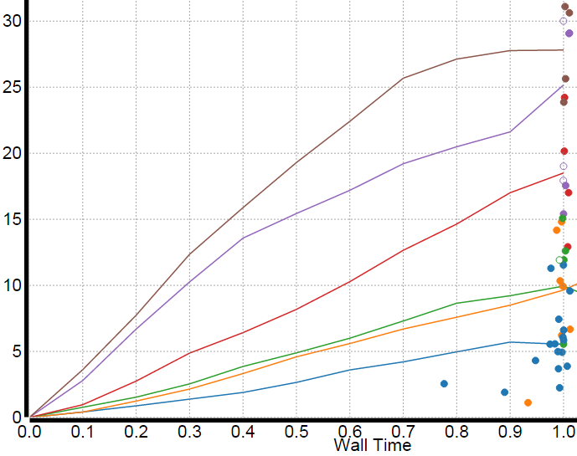
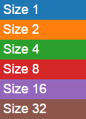
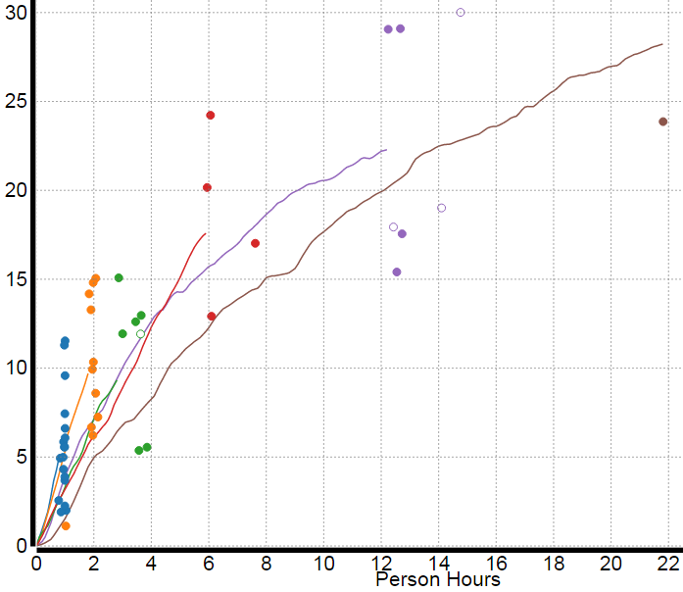
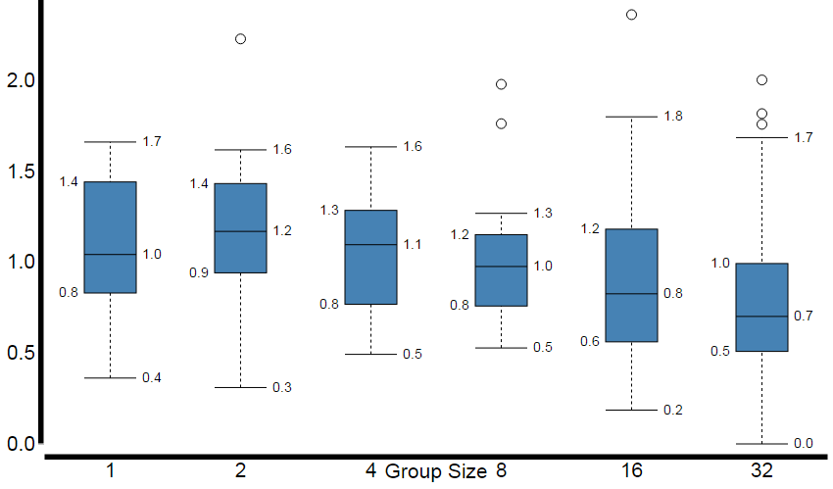
Group Size and Performance
Average performance vs. group size
Average performance vs. group size
Average performance vs. person-time
Average performance vs. person-time

Slide 29
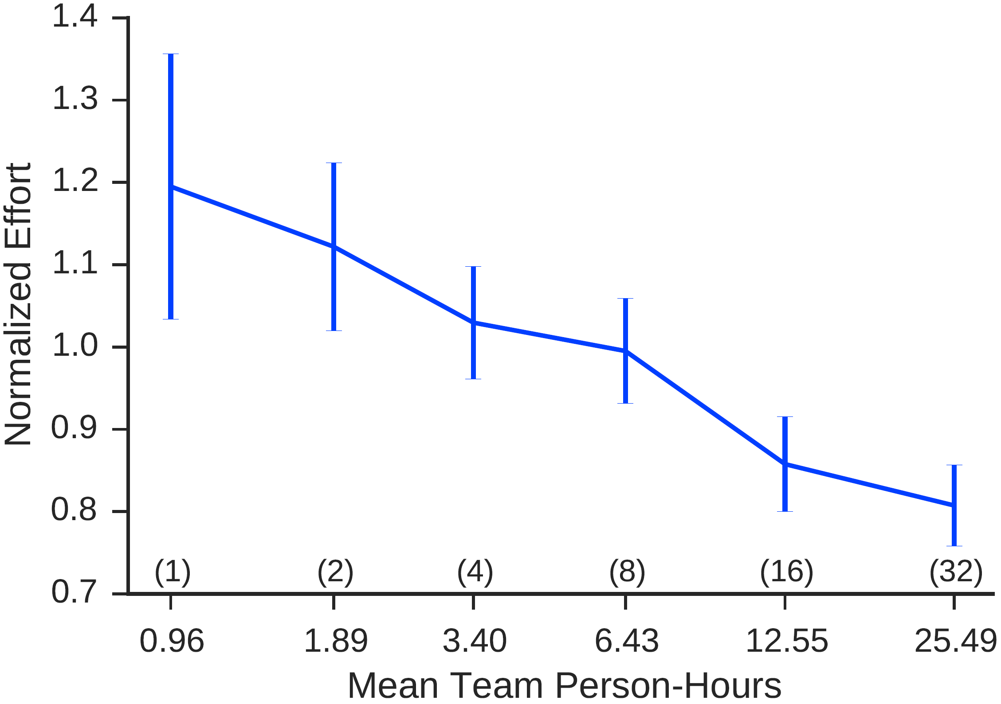
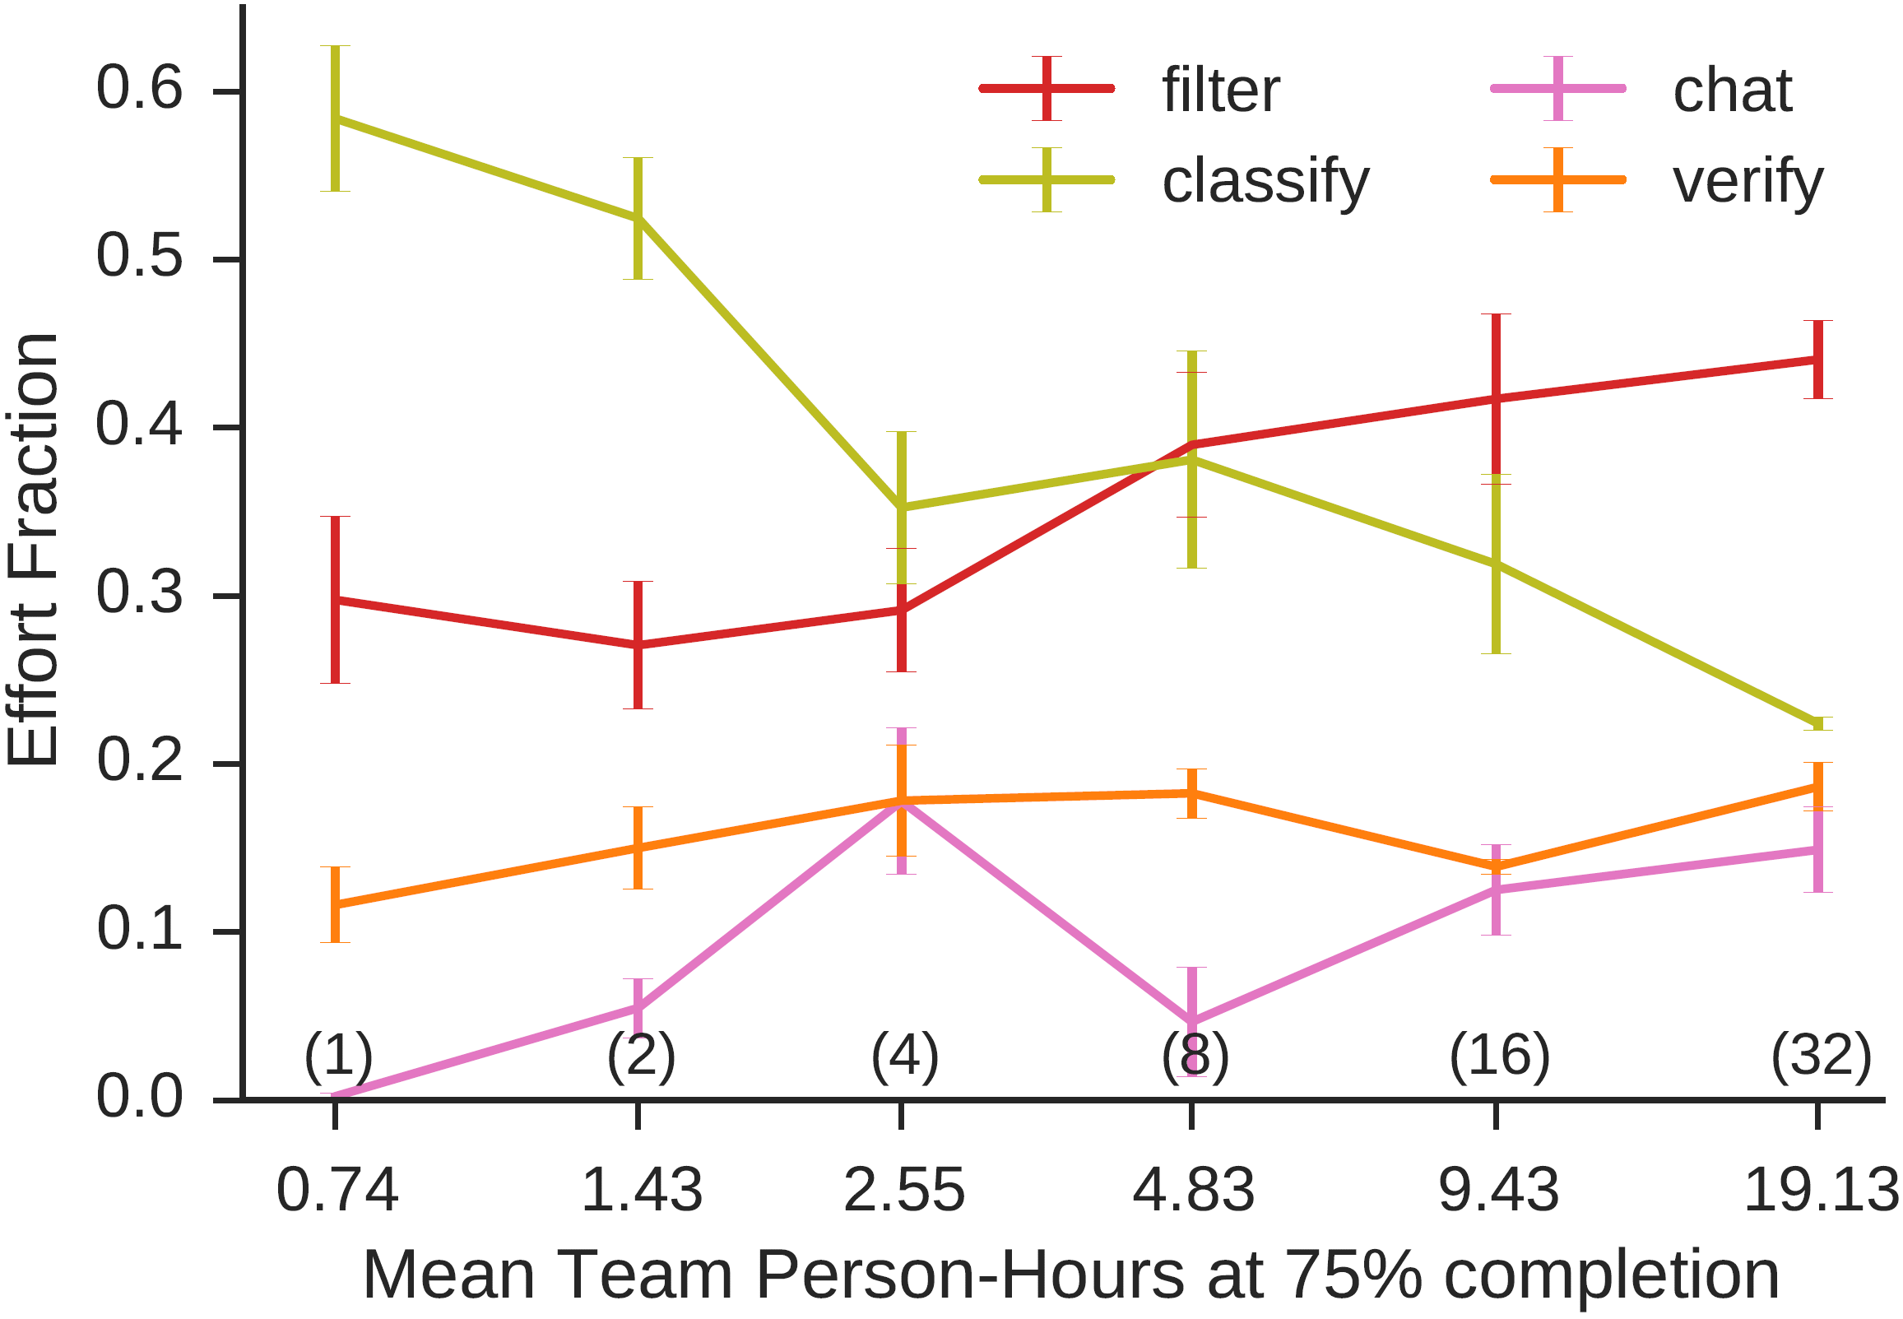
Effort diminishes, and also shifts
Effort = sum of tasks,
weighted by average task-time
Effort Allocation = % of group’s effort devoted
to one of four high-level sub-tasks
Notes:
We can measure what each person did. We look at the effort of people based on group size. Effort = take average time it takes to do different tasks, weighting each person’s output by these times. 1.0 is average amount of work by one person over all teams.
As you can see, effort decreases with size. This could be “social loafing”, but may include element of coordination costs
Supported by distribution of work as more people participate. Effort shirts from classification to filtering. This is interesting because classification requires more work and thinking.
So what happens as a team gets larger, is that people contribute less, but the fraction of work they do also changes.

Slide 30
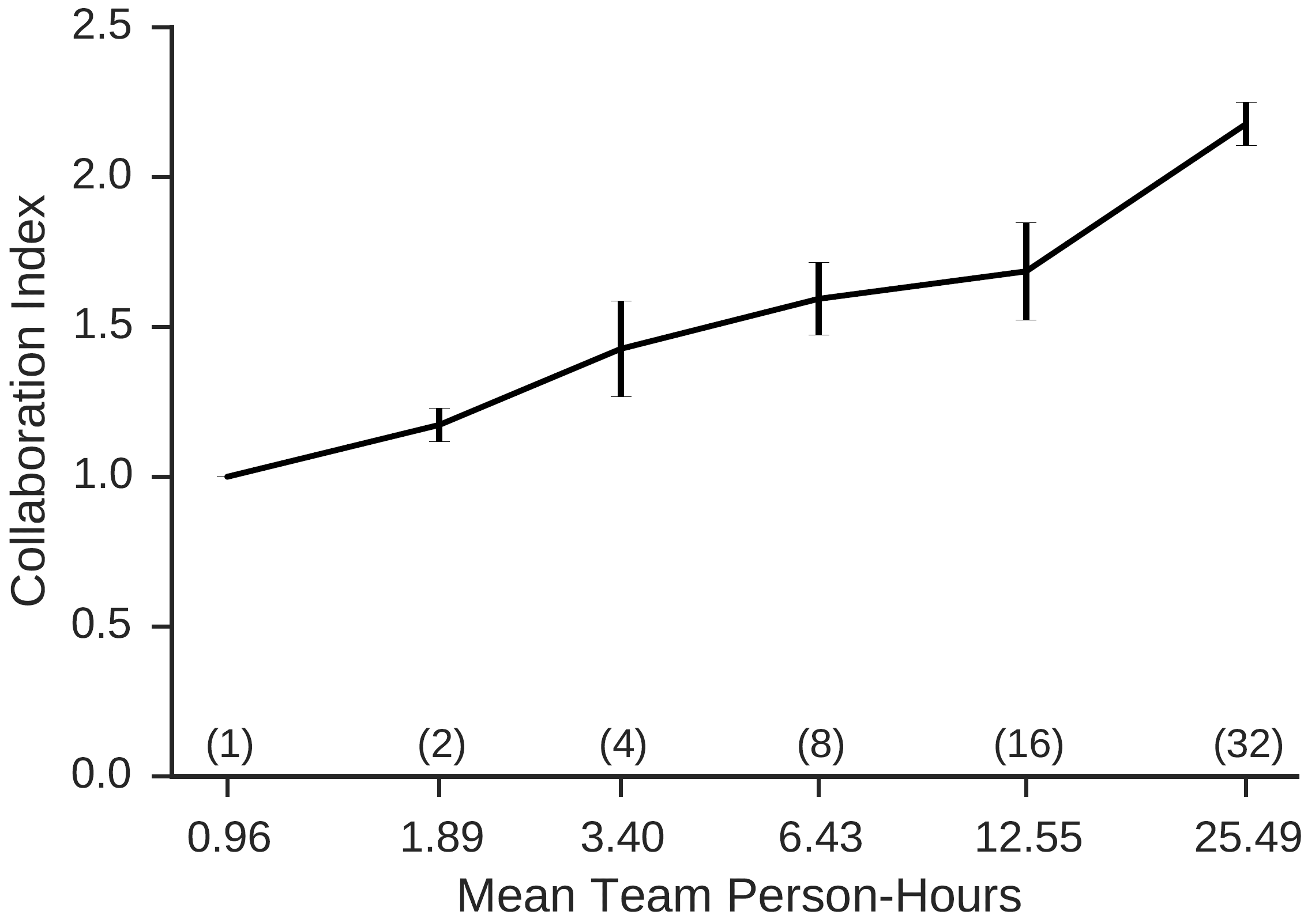
But Collaboration Increases
Collaboration =
(p_{k} = fraction of effort devoted to event by k^{th} person)

Slide 31
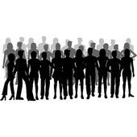
How to Compare Group Sizes?
Independent workers are more productive per-capita
They exert more effort
Allocated larger % of effort to the harder sub-task
But individuals in larger teams collaborate more
Could reduce errors and redundant effort
These effects not counted in per-capita productivity
To reconcile potentially competing effects
Create “synthetic” groups by combining output of N individuals (randomly sampled with replacement)
Compare combined output with output of same-sized experimental team
Synthetic Team
Experimental Team

Slide 32
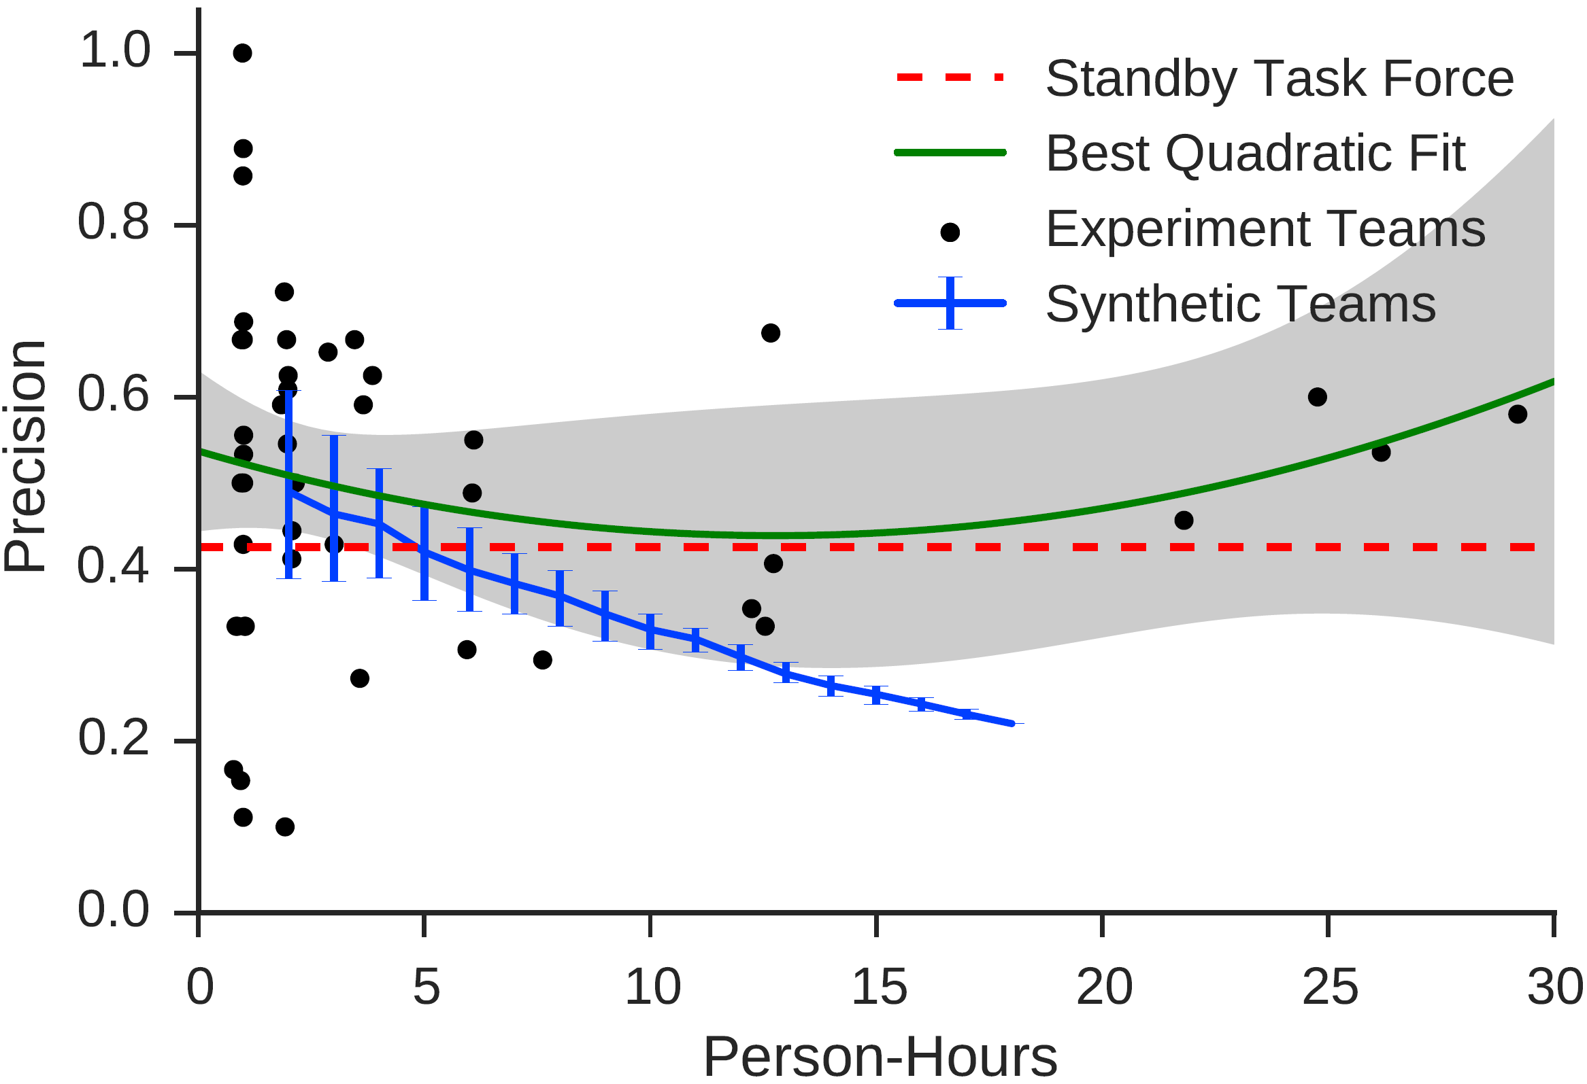
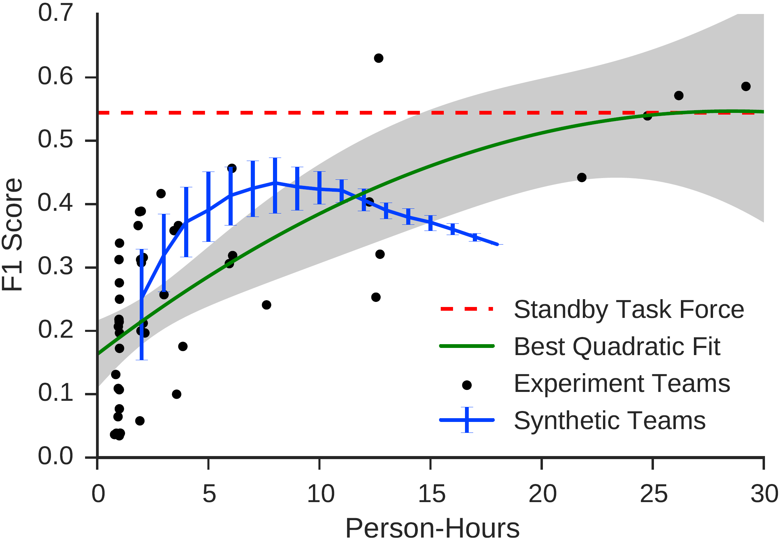
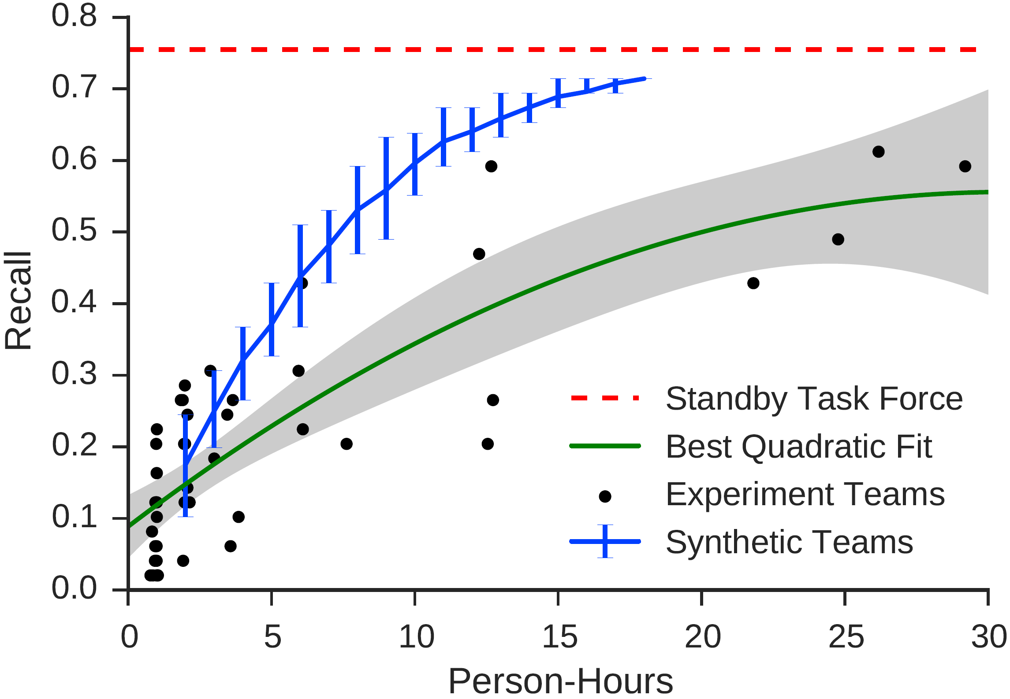
Real vs. synthetic groups
Notes:
This is perhaps the most important result we’ve found. The black dots are the actual teams. The blue bars are synthetic teams formed by randomly selecting n individuals.
What we see is that since individuals work harder alone than people in groups, their performance goes up more for lower numbers. But as this continues, the penalty from being unable to work together means many duplication happens and f1 score goes down, with the result that large teams actually outperform the synthetic teams.

Slide 33
Summary
Individuals exert more effort by themselves than in groups
Consistent with social loafing, but
Extending concept to complex tasks
Interesting that economic incentives were independent of group size
In spite of lower effort, ability of individuals in groups to coordinated ultimately allowed them to perform better
Many more ways to be wrong than to be right
Especially striking that performance of largest groups was comparable to SBTF
Supports external validity + potential practical applications

Slide 34
Collective Intelligence in Teams
Understand why division of labor / returns to specialization either isn’t happening or isn’t helping
More coaching? More time? More experienced workers?
Task itself doesn’t reward specialization?
Construct groups based on models of collaboration
Effect of high/low performers on other high/low performers?
Importance of diversity/complementarity?
Importance of leadership?
Expand to other collaborative problem solving tasks
Deploy platform in the field

Slide 35
From Science to Policy?
Past 15 years witnessed remarkable progress in social scientific data and modes of analysis
Also many new conferences, research centers, journals, etc.
But surprisingly little impact on social policy
Systemic risk in financial systems, dynamics of emerging epidemics, factors affecting cultural change, organizational performance, or political polarization and conflict
Need not just more data but better data
Better instrumentation, larger virtual labs, more collaboration between computational and social science

Slide 36
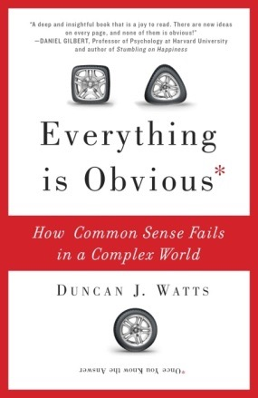
Thank you
http://research.microsoft.com/en-us/people/duncan/
http://everythingisobvious.com

Slide 37
Challenges for css

Slide 38
Improving on Found Data
Origins of “found data” as byproduct of everyday activity comes with serious disadvantages for social science
Siloed across disconnected commercial platforms
Even simple question like “when do people change their minds and why”? requires data from multiple platforms
Outcome variables of interest often not instrumented by default
We study RTs because that’s what we can observe
Privacy and IP concerns make data difficult/impossible to share
Algorithmic optimization increasing “algorithmic confounding”
Need better systems for collecting, joining, sharing data
A “social supercollider” for joining commercial data?
Social scientists may have to build their own instruments

Slide 39
Expanding Design Space of Virtual Labs
Two main obstacles to progress
Recruiting and retaining subjects
MT has ~ 3K workers, turnover every few months
Running experiments is still slow
Three advances would help
Large standing subject panel
Could study whole organizations, even “cultures”
Could resample individuals with known features
Moving from desktop to mobile
Experiments could run for months not minutes
Could exploit location and other sensor information
Reusable and shareable code-base
https://www.github.com/VirtualLab/turkserver-meteor
Realism
Crisis mapping
Long-run cooperation
Duration
Music Lab
Physical labs
Small-world
Scale

Slide 40
Focus on Solving Problems
Social science is traditionally theory driven: “How does my theoretical framework inform problem X?”
Result is that for any problem we have many theories and perspectives but they are not compatible (or even comparable)
A problem orientation would instead ask: “What do we know that can help us solve problem X?”
Naturally integrates disciplines and methodologies
Also has natural outcome metric (“Did we solve the problem?”)
Challenge is identifying suitable (“goldilocks”) problems
Non-trivial but also not impossible

Slide 41
Adoption → Contagion
Adoption of new products/ideas/behaviors a longstanding puzzle
Why do some things succeed and not others?
What is the dynamics of success?
Adoption → Contagion
People learn from, coordinate with, or simply copy each other
Thus adoption can spread from individual to individual
Disease metaphor long invoked to describe crowds, fads, etc.
Charles Mackay (1841), Gustave Le Bon (1896)
Many models of social contagion…
“Disease” models (Bass ,1969)
“Threshold” models (Granovetter,1978)
“Learning” models (Bikhchandani et al, 1992)
“Cascade” models (Kleinberg and Kempe, 2003)

Slide 42
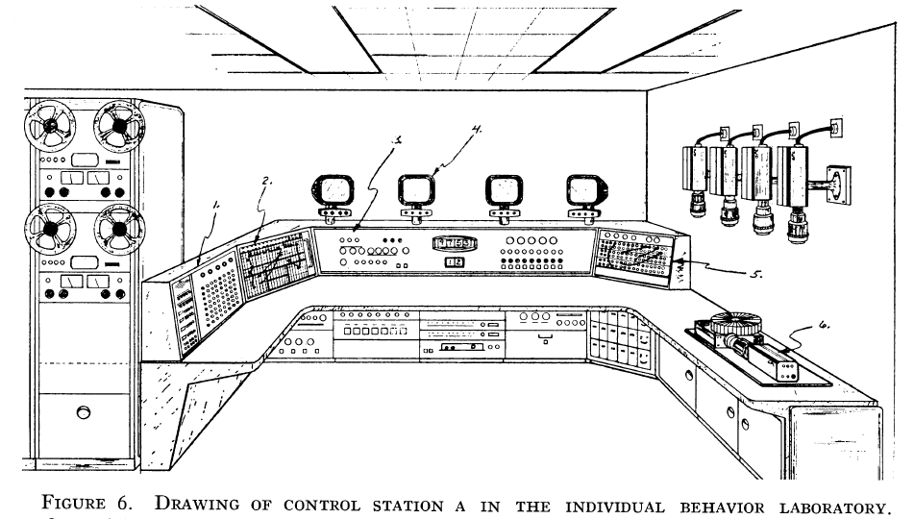
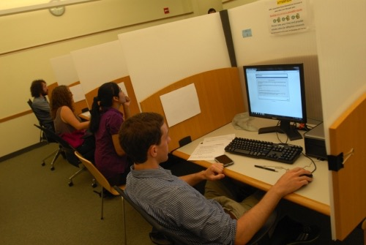
Behavioral Experiments in Physical Labs
Advantages:
High degree of procedural control
Optimized for causal inference
Limitations:
Artificial environment + interactions
Simple tasks
Small N
WEIRD subjects, one use only
Short duration (~1hr)
Result:
Good for testing specific theories but bad for external validity
Also expensive and slow
ca. 1960s
ca. 2000s

Slide 43
Design Space of Virtual Labs
Realism
More naturalistic tasks
More realistic interactions
Virtual labs: using the Internet as a lab
Duration
Physical labs
Longer periods of time
Fewer constraints on location
Scale
Larger samples
More diverse subjects

