Slide 1
ANOMALY DETECTION FOR REAL-WORLD SYSTEMS
Manojit Nandi
Data Scientist
STEALTHbits Technologies
@mnandi92

Slide 2
WHAT ARE ANOMALIES?
Hard to define; “You’ll know it when you see it”.
Generally, anomalies are “anything that noticeably different” from the expected.
One important thing to keep in mind is that what is considered anomalous now may not be considered anomalous in the future.

Slide 3
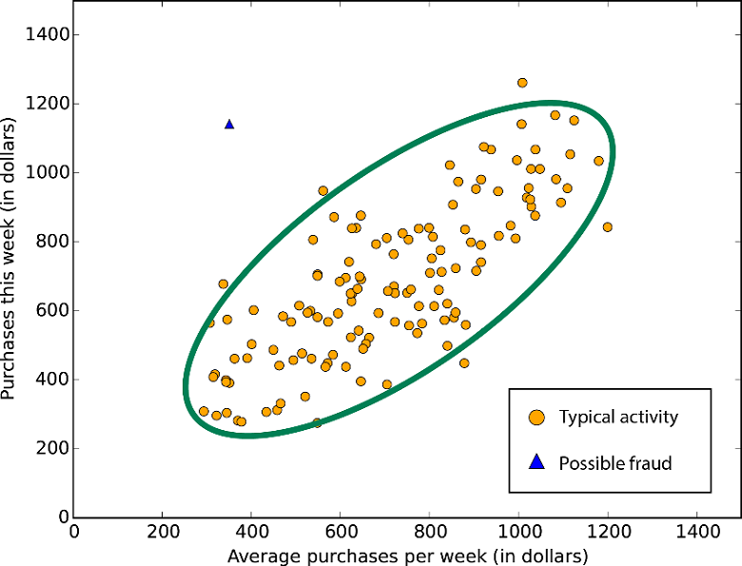
Different approaches to anomaly detection
We can develop a statistical model of normal behavior. Then we can test how likely an observation is under the model.
We can take a machine learning approach and use a classifier to classify data points as “normal” or “anomalous”.
In this talk, I’m going to cover algorithms specially designed to detect anomalies.
Photo Credit: Microsoft Azure

Slide 4
Anomalies in Data Streams
Problem: We have data streaming in continuously, and we want to identify anomalies in real-time.
Constraint: We can only examine the last 100 events in our sliding window.
In data streaming problems, we are “restricted” to quick-and-dirty methods due to the limited memory and need for rapid action.

Slide 5
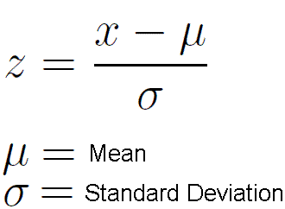
Heuristic: Z-Scores
Z-scores are often used as a test statistic to measure the “extremeness” of an observation in statistical hypothesis testing.
How many standard deviations away from the mean is a particular observation?

Slide 6
Moving Averages and Moving St. Dev.
As the data comes in, we keep track of the average and the standard deviation of the last n data points.
For each new data point, update the average and the standard deviation.
Using the new average and standard deviation, compute the z-score for this data point.
If the Z-score exceeds some threshold, flag the data point as anomalous.

Slide 7
Standard Deviation not robust
Standard deviation (and mean, to a lesser extend) is highly sensitive to extreme values.
One extreme value can drastically increase the standard deviation.
As a result, the Z-scores for other data points dramatically decreases as well.

Slide 8
Mathematics of Robustness
The arithmetic mean s is the number which solves the following minimization problem:
The median m is the number which solves the following minimization problem:

Slide 9
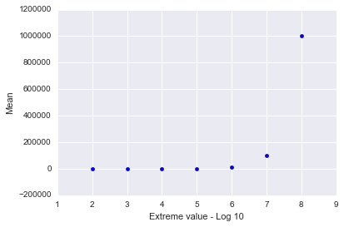
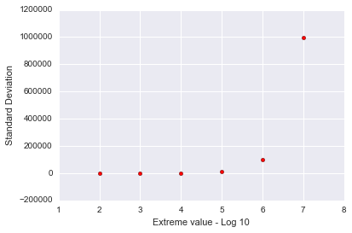
Visualizing robustness
Mean vs. Outlier
St. Dev vs. Outlier

Slide 10
Median Absolute Deviation
The Median Absolute Deviation provides a robust way to measure the “spread” of the data.
Essentially, the median of the deviations from the “center” (the median).
Provides a more robust measure of “spread” compared to standard deviation.

Slide 11
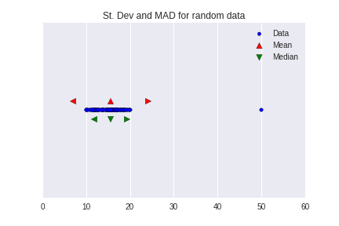
Median Absolute Deviation

Slide 12
Modified Z-Scores
Now, we can use the median and the MAD to compute the modified Z-score for each data point.
We then use the modified z-score to perform statistical hypothesis testing, in the same manner as the standard z-score.

Slide 13
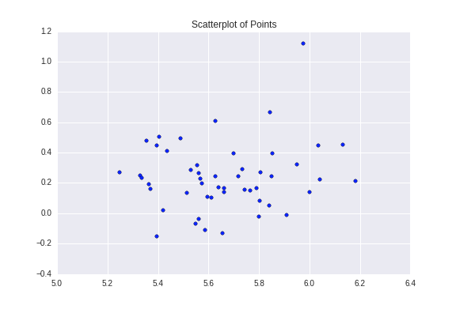
Density-Based Anomaly Detection
We have a bunch of points in some n-dimensional space.
Which ones are “noticeably” different from the others.

Slide 14
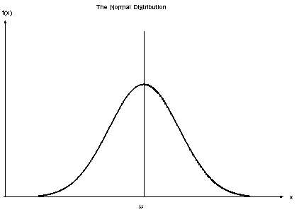
Probabilistic Density: A Primer
In statistics, we assume all data is generated according to some probability distribution.
The goal of density-based methods is to estimate the underlying probability density function, based on the data.
Many density-based methods, such as DBSCAN and Level Set Tree Clustering.

Slide 15
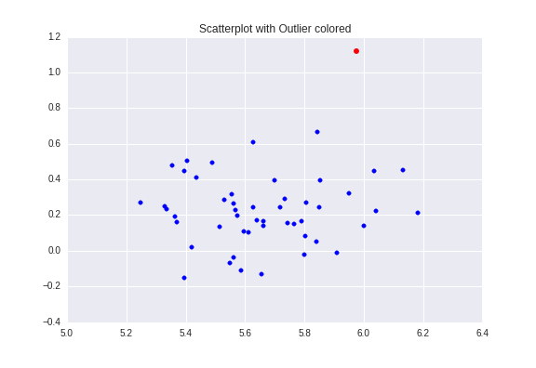
Local Outlier Factor
Goal: Quantify the relative density about a particular data point.
Intuition: The anomalies should be more isolated compared to “normal” data points.
LOF estimates density by looking at a small neighborhood about each point.

Slide 16
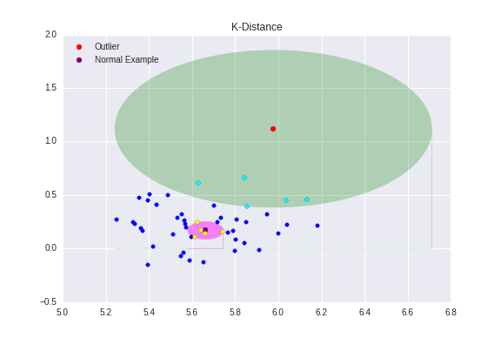
K-Distance
For each datapoint, compute the distance to the Kth-nearest neighbor.
Meta-heuristic: The K-distance gives us a notion of “volume”.
The more isolated a point is, the larger its k-distance.

Slide 17
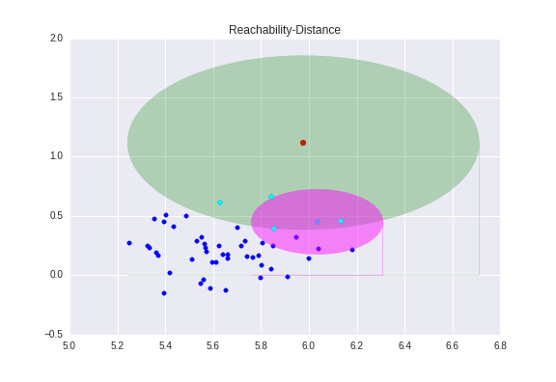
Reachability Distance
Reachability-Distance(A,B) =
Max(K-Dist(B), Dist(A,B))
“Do your close neighbors see you as one of their close neighbors”.

Slide 18
Local Reachability Density
Now, we are going to estimate the local density about each point.
For each data point, compute the average reachability-distance to its K-nearest neighbors.
The Local Reachability Density (LRD) of a data point A is defined as the inverse of this average reachability-distance.

Slide 19
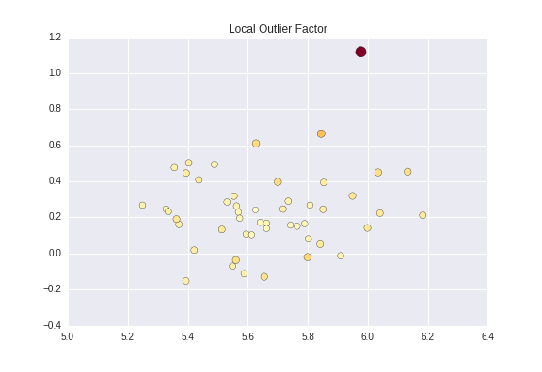
Local Outlier Factor
LOF score is the ratio of point A’s density to the average density of its neighbors.
Outliers come from less dense areas, so the ratio is higher for outliers.

Slide 20
Interpreting LOF scores
Normal points have LOF scores between 1 and 1.5.
Anomalous points have much higher LOF scores.
If a point has a LOF score of 3, then this means the average density of this point’s neighbors is about 3x more dense than its local density.

Slide 21
Time Series based Anomalies
Given activity indexed by time, can we identify extreme spikes and troughs in the time series.
Want to find global anomalies and local anomalies.
Source: Twitter Engineering Blog

Slide 22
Seasonal Hybrid - ESD
Algorithm invented at Twitter in 2015.
Two components:
Seasonal Decomposition: Remove seasonal patterns from the time series
ESD: Iteratively test for outliers in the time series.
Remove periodic patterns from the time series, then identify anomalies with the remaining “core” of the time series.

Slide 23
Seasonal Decomposition
Time Series Decomposition breaks a time series down into three components:
Trend Component
Seasonal Component
Residual (or Random) Component
The trend component contains the “meat” of the time series that we are interested in.
The Seasonal component represents periodic patterns, and the Residual component reflects random noise.

Slide 24
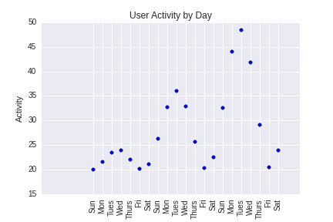
Seasonality Example

Slide 25
Extreme Studentized Deviate
ESD is a statistical procedure to iteratively test for outliers in a dataset.
Specify the alpha level and the maximum number of anomalies to identify.
ESD naturally applies a statistical correction to compensate for multiple hypothesis testing.

Slide 26
Extreme Studentized Deviate
For each datapoint, compute a G-Score (absolute value of Z-Score)
Take the point with the highest G-Score.
Using the pre-specified alpha value, compute a critical value.
If the G-Score of the test point is greater than the critical value, flag the point as anomalous.
Remove this point from the data.
Repeat steps 1-5 for a fixed number of iterations.

Slide 27
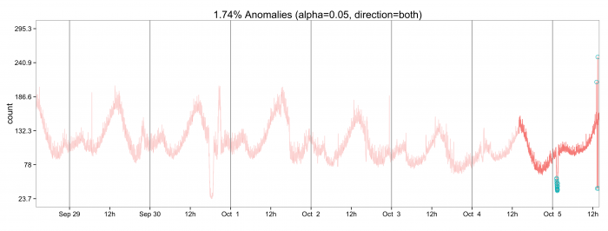
Seasonal Hybrid - ESD: Example
Photo Credit: Twitter Engineering Blog

Slide 28
Robust PCA
Created in 2009 by Candes et al.
Regular PCA identifies a low-rank representation of the data using Singular Value Decomposition.
Robust PCA identifies a low-rank representation, outliers, and noise.
Used by Netflix in the Robust Anomaly Detection (RAD) package.

Slide 29
Robust PCA
Specify thresholds for the singular values and the error value.
Iterate through the data:
Apply Singular Value Decomposition.
Using thresholds, categorize the data into “normal”, “outlier”, “noise”.
Repeat until all points are classified.

Slide 30
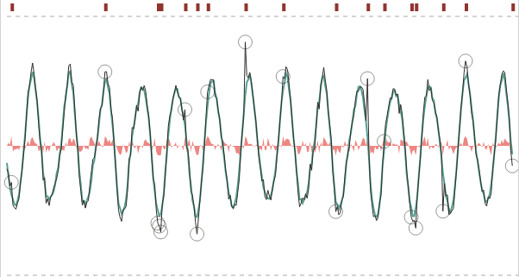
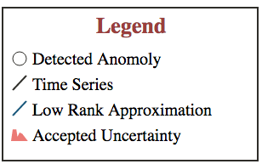
Robust PCA - Example
Source: Netflix Techblog

Slide 31
Risk Scores
When doing anomaly detection in practice, you want to treat it more as a regression problem rather than a classification problem.
Best practices recommend calculating the likelihood that a data point or event is anomalous and converting the likelihood into a risk score.
Risk scores should be from 0-100 because people more intuitively understand this scale.

Slide 32
Risk Scores using Bayesian Inference
We have some risk measure r, and we assume r comes from a well-defined distribution.
Example: Prob(Getting risk measure r) = (Exponential Distribution)
Want to compute likelihood Prob(Getting r | data).

Slide 33
Risk Scores using Bayesian Inference
Baye’s Theorem tells us that
Prob(Data | λ) is the likelihood function, and by choosing Prob(λ) as the Gamma distribution, we get a computable posterior distribution for Prob( r | Data).

Slide 34
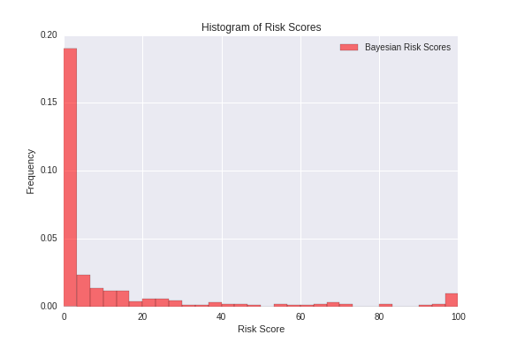
Risk Scores using Bayesian Inference

Slide 35
Testing your algorithms
Be sure to test algorithms in different environments. Just because it performs well in one environment does not mean it will generalize well to other environments.
Since anomalies are rare, create synthetic datasets with built-in anomalies. If you can’t identify the built-in anomalies, then you have a problem.
You should be constantly testing and fine-tuning your algorithms, so I recommend building a test harness to automate testing.

Slide 36
Questions?

